Slide 1
Apheresis
Dr H

Slide 2
objectives
Plasmapheresis generalities
Plasmapheresis indications
Notes on cytapheresis
Common order sets
Conventional apheresis therapies: a review. J Clin Apher. 2011;26(5):230-8

Slide 3
Plasmapheresis exchange of blood plasma membrane filtration or centrifugation
Plasma is removed
Plasma is replaced with FFP, 5% albumin, or other colloid (sometimes autologous)

Slide 4
plasmapheresis
Removal of autoantibodies
  Thrombotic thrombocytopenic purpura
  Immune thrombocytopenic purpura
  Myasthenia gravis
  Guillain–Barré syndrome
  Neuromyelitis optica
  Anti-gbm glomerulonephritis
  Anca-associated glomerulonephritis
  Antiphospholipid crisis
  Chronic inflammatory demyelinating polyradiculoneuropathy
  Multiple sclerosis
  Anti-nmda receptor encephalitis

Slide 5
PLEX vs IVIg in Myasthenia gravis
IVIg 1g/kg/day for 2 consecutive days or
PLEX - 1.0 plasma volume exchanges for 5 exchanges
same proportion of patients improved with treatment
  69% on IVIg and 65% on PLEX
Barth, et al. Comparison of IVIg and PLEX in Patients with Myasthenia Gravis. Neurology 2011 76(23)

Slide 6
plasmapheresis
Removal of antigen-antibody complexes
  Vasculitidies
    HCV
    Systemic lupus erythematosus

Slide 7
plasmapheresis
Removal of alloantibodies
  Transplant sensitization
  Transplant rejection
  Transfusion reactions

Slide 8
plasmapheresis
Removal of paraproteins
  Neurologic and renal damage from hyperviscosity
    Waldenstrom’s
    Light chain neuropathy / glomerulopathy
    Myeloma cast nephropathy

Slide 9
plasmapheresis
Removal of pathogenic molecules
  FSGS
  homozygous hypercholesterolemia

Slide 10
plasmapheresis
Removal of toxins
  Hypercholesterolemia
  Liver failure
  Sirs
  Amanita poisoning
  drugs

Slide 11
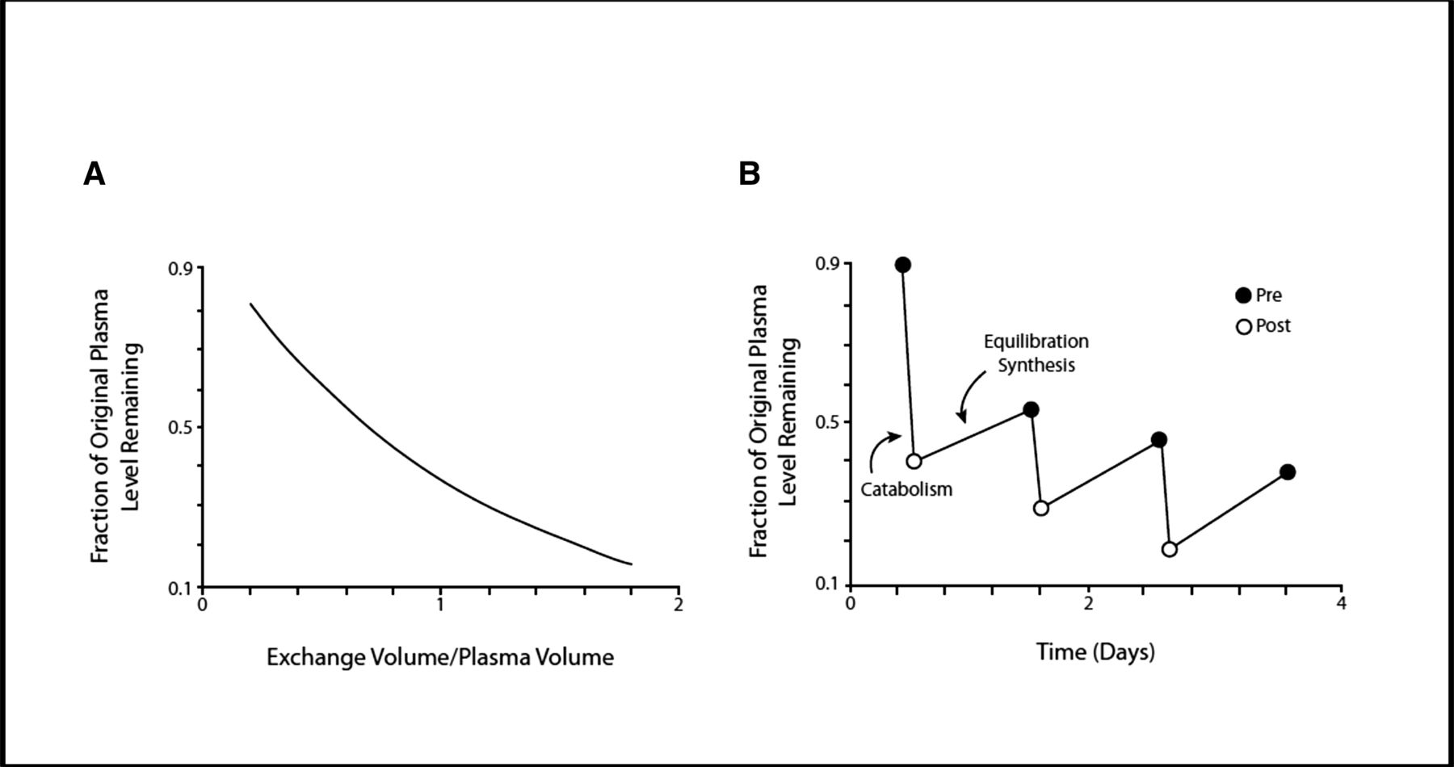
plasmapheresis
Removal of 1.0-1.5 (usually 1.2) x patient’s circulating plasma volume
63-72% removal of constituents
  Then another 63-72%
    Then another 63-72%
      Then another 63-72%
        Then another 63-72%
  However, there are constituents also in the interstitial fluids (10-12L)

Slide 12
plasmapheresis
CENTRIFUGAL
  PACK RED CELLS TO A HEMATOCRIT OF 80%+
    THUS REMOVE 80% OF PLASMA
  PROCESS ONLY 1.5X BLOOD VOLUME TO REMOVE 1.2X PLASMA VOLUME
  ANTICOAGULATE WITH CITRATE OR HEPARIN

Slide 13
plasmapheresis
MEMBRANE FILTRATION
  PACK RED CELLS TO A HEMATOCRIT OF 30%
    THUS REMOVE ONLY 30-35% OF PLASMA
  MUST PROCESS 3-4X BLOOD VOLUME
  MUST HAVE A CENTRAL LINE
  ANTICOAGULATE WITH HEPARIN

Slide 14
PLASMAPHERESIS
CITRATE ANTICOAGULATION IS ADDED WHERE BLOOD LEAVES THE BODY (FIXED RATIO TO BLOOD FLOW)
  AC RATIO 1:18; 1:16; 1:12
CALCIUM INFUSION TO THE RETURN LINE COUNTERACTS THE RISK OF CITRATE-INDUCED SYMPTOMS
  1Gm; 2Gm; 3Gm infused during plasma exchange

Slide 15
plasmapheresis
Replacement fluid
  Ffp
    Used for ttp (ffp is the only source of missing adamts13 enzyme)
  Albumin (5%)
    If fibrinogen falls to <120mg/dl, should finish therapy with ffp (at least 500ml)
  0.9% Saline ¼ followed by Albumin (5%) ¾
    Must increase rate when saline is used because of third spacing

Slide 16
Double filtration plasmapheresis (DFPP)
Minimal replacement fluid needed

Slide 17
cytapheresis
Removal of excess cells
  Erythro
  Leuka
  Thrombo
Centrifugation only

Slide 18
erythrocytapheresis
Sickle cell
  Before surgery of the eye or those that create periods of organ ischemia
Hemoglobinopathy
After abo marrow transplant to remove rbcs before new marrow causes hemolysis
Occasionally in malaria and babesiosis

Slide 19
leukapheresis
Hyperleukocytosis
  Improves mortality in AML (indicated when blast count is >70,000)
    Must watch for re-emergence of sequestered cells
  End-organ damage from low-flow
Debulking before lytic therapy
Cell collection for autologous hematopoietic stem cell transplant

Slide 20
thrombocytaphersis
Symptomatic thrombocytosis
Platelet count >1,000,000

Slide 21
Calculating volumes
Estimated plasma volume (in litres) = 0.07 x wt (kg) x (1 - hematocrit)
So, 1 plasma volume in 80kg male with Hct of 30 (0.3) = 0.07 x 80 x 0.7 = 3.92L 1.5 plasma volumes = 3.92 x 1.5 = 5.88L
Whereas… 1 plasma volume in 60kg female with Hct of 35 (0.35) = 0.07 x 60 x 0.65 = 2.73L

Slide 22
Diagnostics: Prior to first apheresis treatment:
q CBC w/Diff q Liver Profile q Fibrinogen q Chem 7 q Ionized Calcium q Magnesium q PT, PTT, INR
q BUN, Creatinine q LDH q HgbS q Other: _____________________________________________
Early AM on subsequent treatment days:
q Chem 7 q Serum Calcium q Protein q CBC w/Diff q Fibrinogen q Other: ______________________

Slide 23
PLASMA EXCHANGE PROCEDURE:
1. Procedure Target: Plasma processed: q 1 Volume q 1.5 Volume q Other: ________ Liters
2. Frequency of procedure: q One time q Daily x ____________ qOther: ______________
3. Replacement fluids: Colloid: q 5% Human Serum Albumin _________ ml
q Fresh Frozen Plasma: Number of units ______ or ________________ ml
q Cryo-Poor Plasma: Number of units _______ or ________________ ml
Crystalloid: q NS ________________ ml
4. Fluid balance: q 100% q Other: ____________________________
5. Anticoagulant Citrate Dextrose Formula A
AC Ratio: q 1:16 q 1:12 q 1:18 q Other: ______________________________

Slide 24
LEUKAPHERESIS:
1. Frequency of procedure: q One time q Daily x __________ q Other: ________
2. Process two times TBV (total blood volume) q 1.5 X TBV for critical/unstable patient
3. Do not collect more than 1200 ml
4. Replacement fluid: Albumin 5%, 250 ml IV x 2 doses PRN to maintain fluid balance and oncotic pressure

Slide 25
ERYTHROCYTAPHERESIS: frequency of procedure ONE time (not ordered in cycles)
1. End Hematocrit goal (up to 3% change) _______
2. FCR (fraction of cell remaining) ___________
3. Fluid Balance q 100% q Other: _______________
4. AC ratio 1:12 or _________ other
5. GOAL: TRBC (Total red blood cell volume exchange) 1.5 to 2.0 volume
6. Amount of Replacement fluid: Red Blood Cells ________ ml or # of packed red blood cell units _______________
7. Replacement fluid: q PRBC q Sickle cell negative q leuko-reduced

Slide 26
THROMBOCYTAPHERESIS (PLATELETS)
1. Frequency of procedure: __________________
2. Process 1 x total blood volume ________ 1.5 x TBV __________
3. Replacement fluids:
Colloid: q Albumin 5%, 250 ml IV x 2 doses PRN to maintain fluid balance and oncotic pressure
Crystalloid: q NS ________________ ml
4. AC ratio 1:6

Slide 27
MEDICATIONS:
1. Pre-treatment medications:
q Benadryl (diphenhydramine) 25-50 mg po or 12.5-25 mg IV x 1 dose
q Tylenol (acetaminophen) 650 mg po or per rectum x 1 dose
q Solu-Cortef (hydrocortisone) _____ mg IV x 1 dose
2. Nausea/Vomiting: q Zofran (ondansetron) 4 mg q 6 hrs IV prn
3. Other medications:
Magnesium Sulfate
q Magnesium Sulfate 1 gm – infused during plasma exchange
q Magnesium Sulfate 2 gm – infused during plasma exchange
Calcium Gluconate:
q Calcium Gluconate 1 gm – infused during plasma exchange
q Calcium Gluconate 2 gm – infused during plasma exchange
q Calcium Gluconate 3 gm – infused during plasma exchange

Slide 28
Final notes
Stop ace-inhibitors! Need to be held ~24 hours before procedure. 100% of patients will have some sort of adverse reaction
  Flushing, hypotension, dyspnea, bradycardia
Replacement fluid depends on underlying condition you are treating
Immune therapy is often also part of the treatment, again depending on the underlying condition you are treating

