Slide 1
CPET
Dr H. Professional CPET Reader

Slide 2
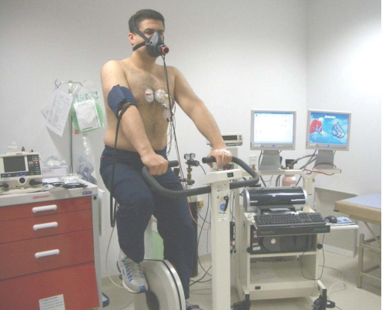

Slide 3
INDICATIONS
HF patients being considered for transplant
Differentiation between cardiac vs pulmonary limitation for dyspnea on exertion
  *Others: evaluation of exercise capacity when medically indicated, evaluation of response to intervention, determine exercise training intensity for cardiac rehab

Slide 4
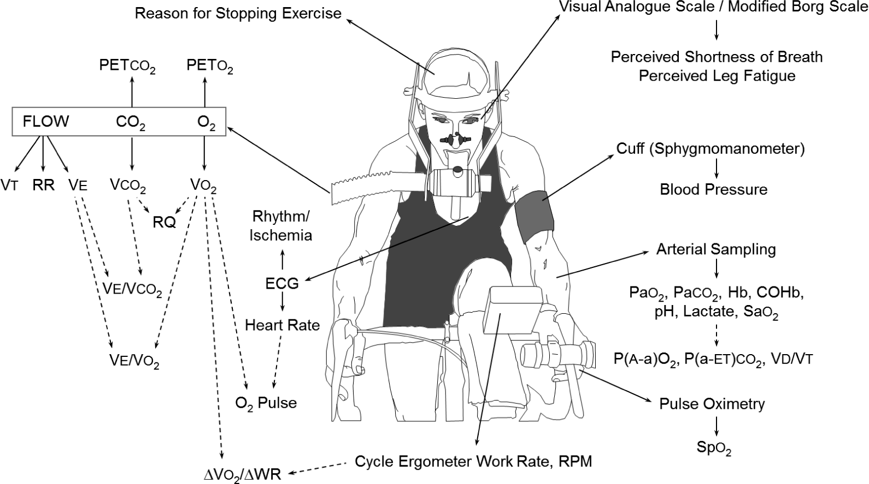

Slide 5
CPET
Usually a bicycle (can be a treadmill)
Breath-by-breath analysis
  Non-rebreathing valve (so inspired and expired air don’t mix)
  Oxygen and CO2 gas analyzers
  Respiratory volumes
  Minute volumes

Slide 6
INDICATIONS TO STOP
Symptoms of maximal exercise
  Muscle fatigue
  Exhaustion
  Extreme dyspnea
  Light-headedness, Confusion, Loss of coordination
Sustained tachyarrhythmias or ischemic changes
Falling SBP (below resting level)

Slide 7
PEAK EXERCISE
“The maximum ability of the cardiovascular system to deliver oxygen to exercising skeletal muscle and of the exercising muscle to extract oxygen from the blood”
*normal individuals are limited by the cardiac system

Slide 8
CPET MEASUREMENTS
Work
VO2
VC02
AT
HR
EKG
BP
RR
SpO2
ABG
Lactate
CP
Dyspnea
Leg Fatigue

Slide 9
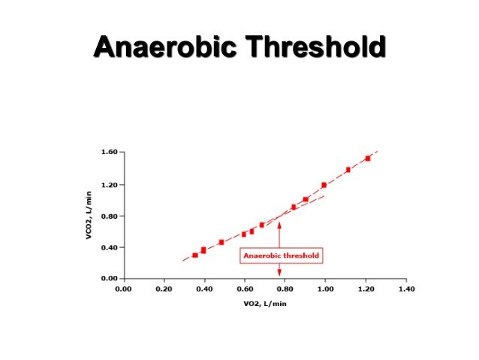
VARIABLES
VO2 = respiratory oxygen uptake (given in L/min and %)
  MET is resting oxygen uptake in sitting position = 3.5mL/kg/min (250mL/min)
  VO2max 15x resting (30-50mL/kg/min)
  Athletes may reach 20x resting values (80mL/kg/min)
VCO2 = carbon dioxide production
VCO2/VO2 = gas exchange ratio or respiratory exchange ratio (RER)
  Steady state, RER = RQ (RQ is determined by fuel for metabolic processes)
    RQ 1 = carbs, RQ~0.7 = carbs+fat, RQ~0.8 = carbs+protein
O2 Pulse (VO2/HR) = surrogate marker for SV
VAT = ventilatory anaerobic threshold
  VE = expired ventilation, reflects aerobically produced CO2 in muscles (minimal lactate)
  Towards the end of exercise, as oxygen is depleted, lactate rises (this is VAT), and ventilation increases disproportionately
  Instead of checking lactate levels, we see that the V-slope of VCO2 (y axis) and Vo2 (x axis) changes
  VE/VCO2 = minute ventilation (at VAT, should be <34)
VENTILATORY RESERVE
  VE/MVV (L/min) or 1-(VE/MVV)x100 (%) Should be >11L/min or 20-30%
VD/VT = dead space
HRR = Heart Rate Reserve (HR_{premax} - HR_{actmax}) Should be <15BPM

Slide 10
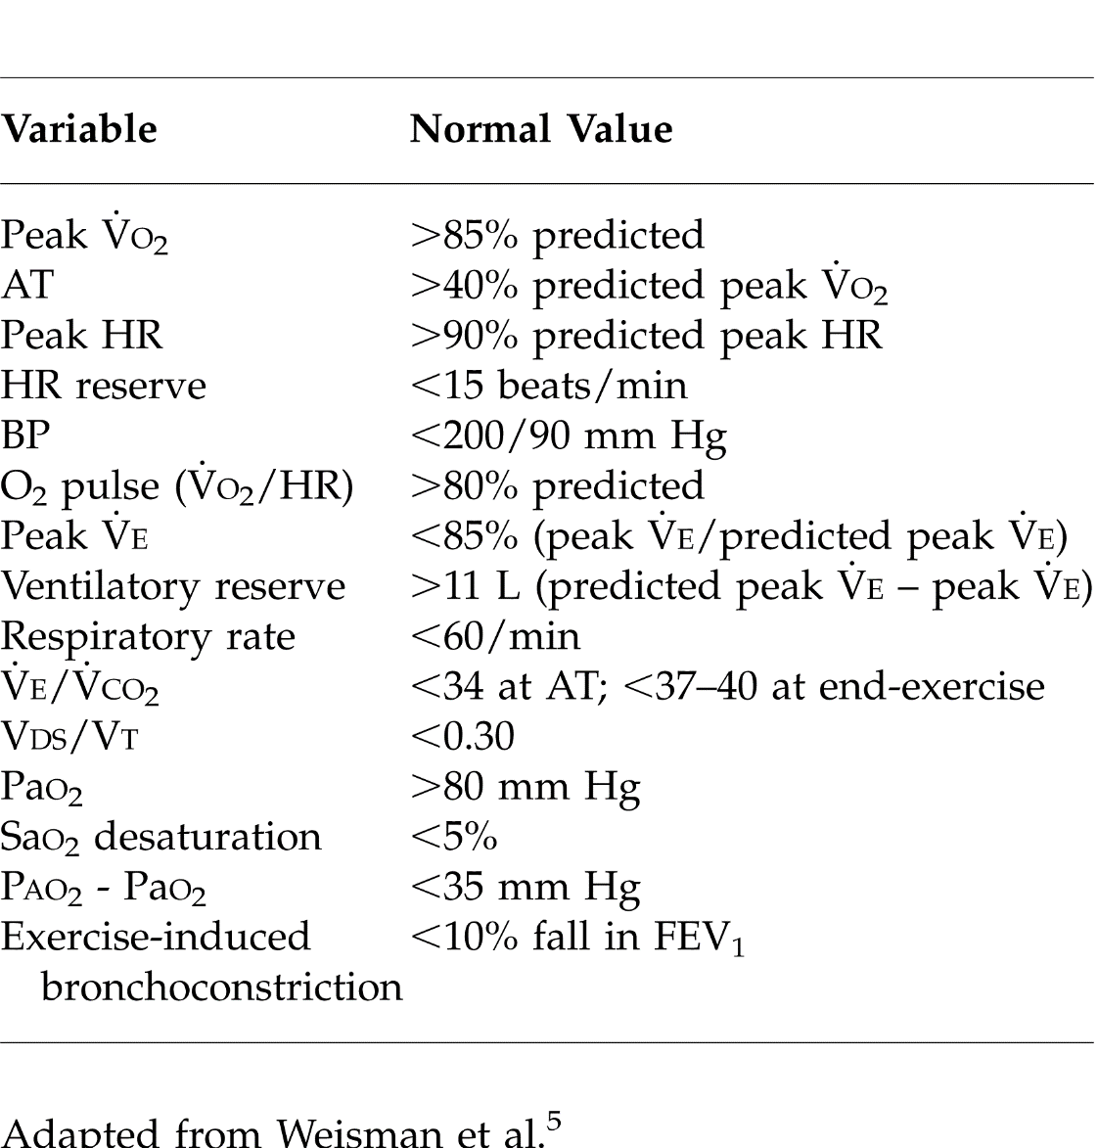
NORMAL VALUES

Slide 11
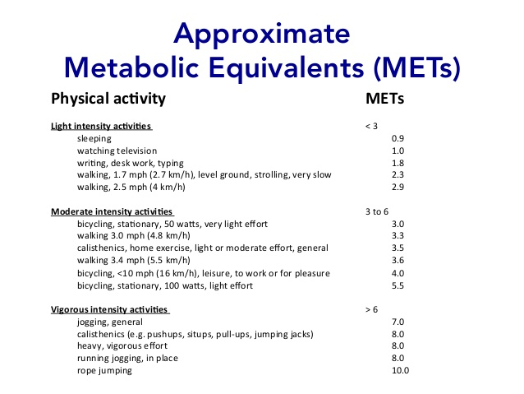
COMMON METs

Slide 12
FICK EQUATION
VO2 = (SVxHR) x (CaO2 – CVO2)
Oxygen uptake equals Cardiac Output x Arterial-Mixed Venous O2
  Pulmonary gas exchange
  Cardiovascular performance
  Skeletal muscle metabolism
These can be maximized – thus the functional aerobic capacity
  VO2max (we use peak, PVO2 to estimate this maximum in the lab)

Slide 13
ANALYZING GRAPHS
9 Panels, 15 Graphs Systematic analysis
Panel 3 is Key Cardiovascular: 2, 3, 5 Ventilation: 1, 3, 4, 7 Vent/Perf: 3, 6, 9 Metabolism: 3, 8
VO2
  Rises linearly with exercise
HR
  Maximal HR does not change 220-Age
SV
  Curvilinear response with exercise
a-v O2
    Widens with exercise because arterial O2 does not change in normal subjects
VE
  Increases linearly with VO2

Slide 15

EXERCISE INTOLERANCE
Low VO2max or Low WRmax
Fick Equation
  $\text{↓}HR$
  ↓SV
  $\text{↓}$CaO2
  ↑CvO2
Cardiovascular (Cardiomyopathy)
  No HRR, Low O2 Pulse, Early VAT
  HR vs VO2, O2 Pulse, VAT, VO2 vs WR
Ventilatory (COPD)
  High HRR, Usually nl AT, low Ventilatory Reserve, High VD/VT
  VE/MVV, Max RR, PaCO2
Gas Exchange (ILD)
  No RR, Low O2 pulse, Early VAT, nl Ventilatory Reserve, Abnl Oxygenation
  VD/VT, VE/VCO2, PaO2, P(A-a)O2, SpO2

Slide 17



Slide 18
HR (CV SYSTEM RESPONSES)

Slide 19
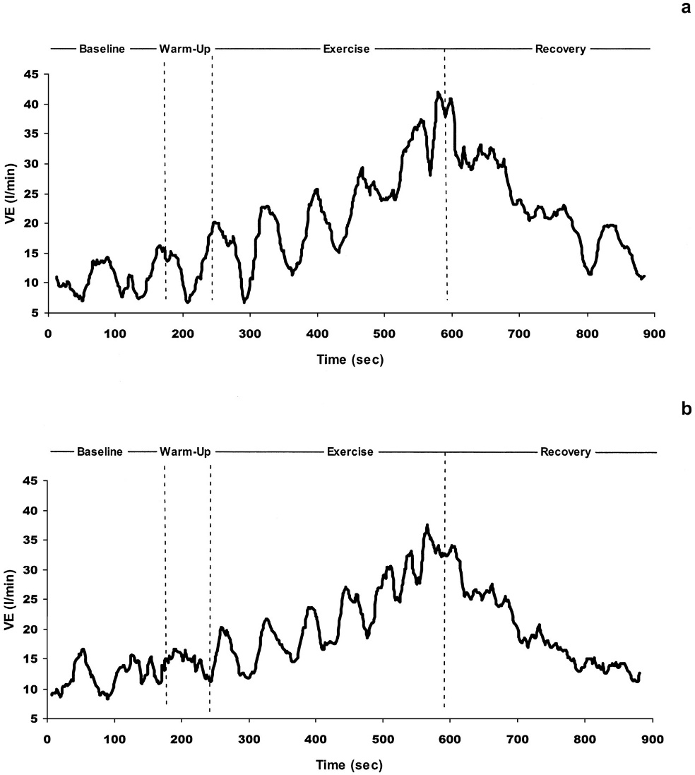
OSCILLATIONS IN VENTILATION can be seen in pt’s with CHF during CPET (Cheyne-Stokes)

Slide 23
VE (VENTILATORY SYSTEM RESPONSES)

Slide 24
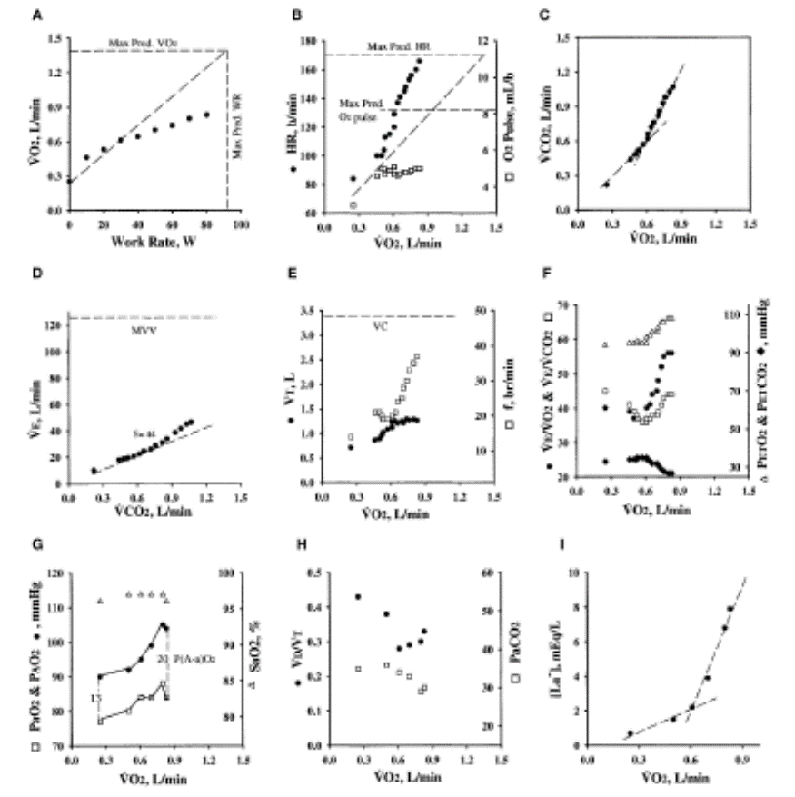
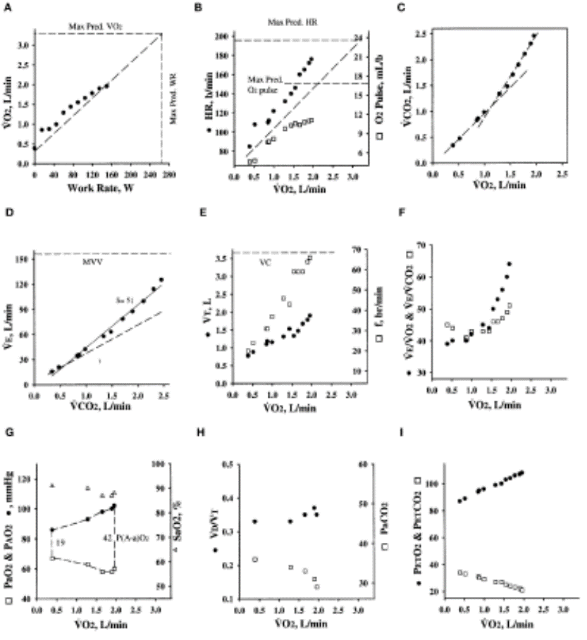
Normal
CHF
COPD
ILD
PVD

Slide 25
SPIROMETRY DURING CPET

Slide 26
SPIROMETRY IN OBESITY

Slide 27
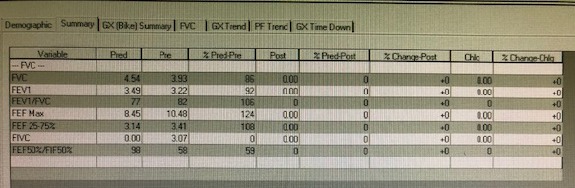
SLVHCS CPET SPIROMETRY

Slide 28
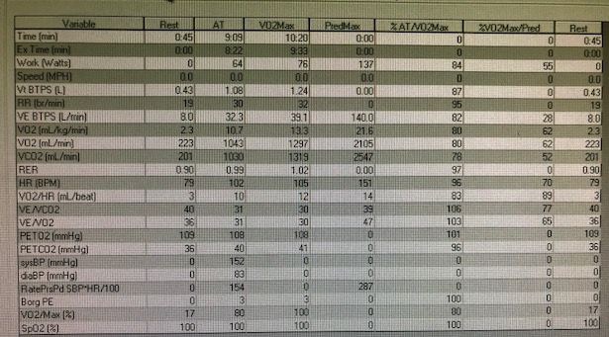
SLVHCS CPET DATA

Slide 29
CARDIAC APPLICATIONS
Risk Stratification Mancini et al
CHF PATIENT POPULATION | 1 YEAR SURVIVAL
Patients with PVo₂ of <14 ml/kg/min who had been accepted for heart transplantation. | 48%
Patients with PVo₂ of ⩾14 ml/kg/min who were considered too well for transplantation. | 98%
Patients with PVo₂ of <14 ml/kg/min but with significant comorbidity that precluded heart transplantation. | 47%
*Of note, a PVo₂of <10 ml/kg/min was associated with significantly poorer predicted survival

Slide 30
CARDIAC APPLICATIONS
Cardiac Events Opasich et al
CHF PATIENT POPULATION | 1 YEAR SURVIVAL
PVo₂ values of ⩽10 ml/kg/min | 59%
PVo₂ values of >10 to ⩽14 ml/kg/min | 32%
PVo₂ values of >14 to ⩽18 ml/kg/min | 32%
PVo₂ values of >18 ml/kg/min. | 15%

Slide 31
CARDIAC APPLICATIONS
HF-ACTION STUDY Swank et al
Heart Failure and a Controlled Trial to Investigate Outcomes of Exercise Training
1620 participants
Baseline CPET and at 3months after Cardiac Rehab
Every 6% increase in peak VO₂, was associated with a 5% lower risk of the primary endpoint (all-cause mortality or all-cause hospitalization)
4% lower risk of the secondary endpoint of time to cardiovascular mortality or cardiovascular hospitalization
8% lower risk of cardiovascular mortality or HF hospitalization
7% lower all-cause mortality

Slide 32
GOOD LUCK ON YOUR BOARDS!!!!

