Slide 1
Code Status Discussions
Dr H

Slide 2
Objectives
Epidemiology of Inpatient Arrest &
Setting the Stage for Discussion
Shared Decision Making Tool
Autonomy vs Paternalism
Code Status is NOT An “àl a carte” Menu
Guidelines Regarding Futility

Slide 3
CPR Decision Aid Cards Shared Decision Making Tool
©2015 Mayo Foundation for Medical Education and Research MCHS – NWWI, December 2015

Slide 4
May I talk with you about something that might happen?
Tell me about your health.
Tell me about yourself.
What do you hope for?
©2015 Mayo Foundation for Medical Education and Research 2
Notes:
Blue

Slide 5
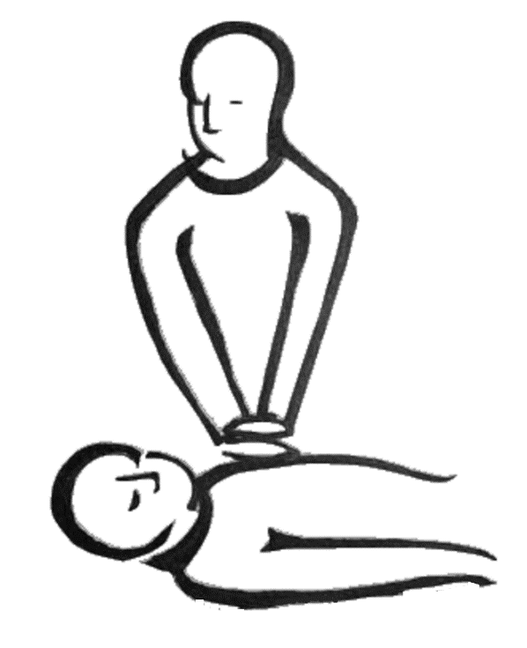
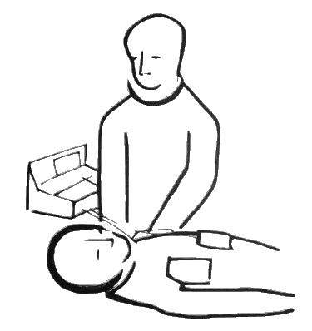
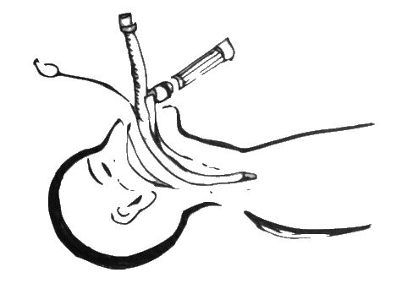
If a person’s heart stops, we can try CPR
Chest compressions
Electric shock
Breathing tube
©2015 Mayo Foundation for Medical Education and Research 3
Notes:
Blue

Slide 6
PROs
CONs
©2015 Mayo Foundation for Medical Education and Research 4
Notes:
Blue

Slide 7
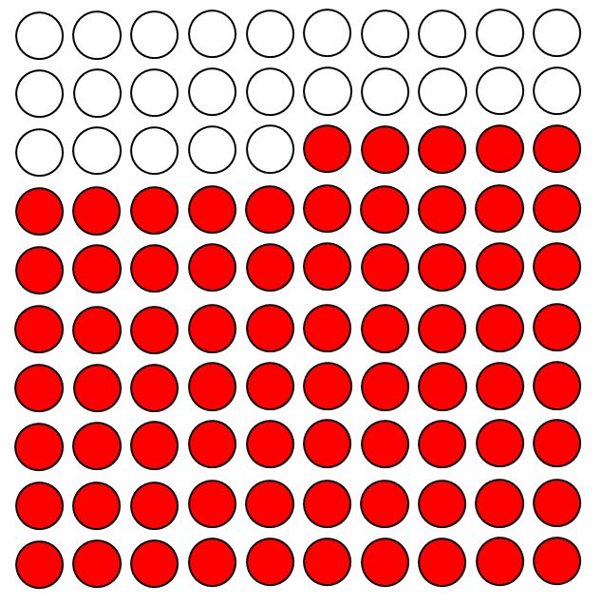
On TV…
about 75 out of 100 people do well after CPR
©2015 Mayo Foundation for Medical Education and Research 5
Notes:
Tan

Slide 8
In real life… about 15 out of 100 people in the U.S. leave the hospital after CPR
©2015 Mayo Foundation for Medical Education and Research 6
Notes:
Tan

Slide 9
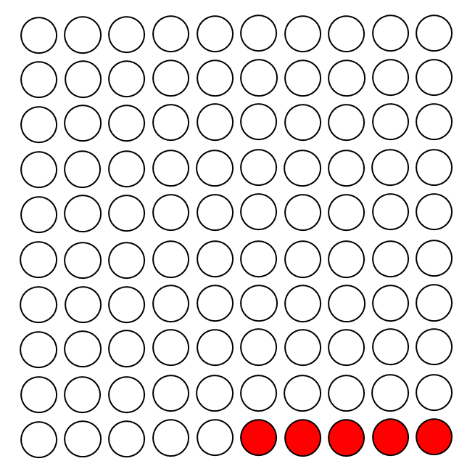
For frail older people… less than 5 out of 100 leave the hospital after CPR
©2015 Mayo Foundation for Medical Education and Research 7
Notes:
Tan

Slide 10
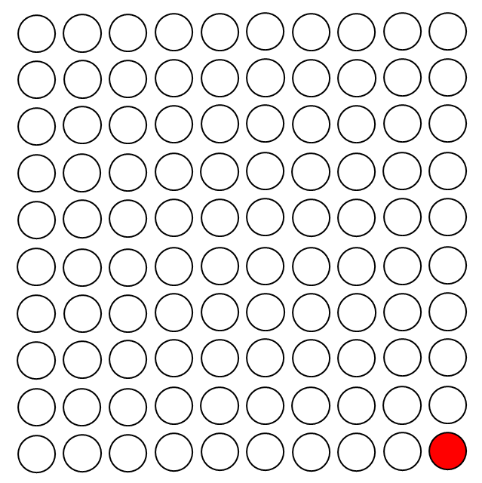
In advanced chronic disease… less than 1 out of 100 leave the hospital after CPR.
©2015 Mayo Foundation for Medical Education and Research 8
Notes:
Tan

Slide 11
CPR may save your life.
It may hurt or result in a stroke, life support machine, or dependence on others.
©2015 Mayo Foundation for Medical Education and Research 9
Notes:
Blue

Slide 12
Full Code
Try to revive
Low odds
Side effects
DNR
No CPR
Comfort
Natural death
©2015 Mayo Foundation for Medical Education and Research 10
Notes:
Blue

Slide 13
Instructions
A discussion about CPR should start with a conversation about goals of care.
Check
understanding:
Clarify
values:
Learn
preferences:
Other tips:
As you show these cards, offer your advice on which CPR option matches their values.
CPR status addresses emergencies only, not routine care.
Listen more than talk.
Tell me about your health.
What have you been told?
What do you see in the future?
Tell me about yourself.
What are your passions?
What makes life worth living?
Where do you get your strength?
Would you call yourself a spiritual or a religious person?
What experiences have you had with illness and how has this shaped your views?
What do you hope for?
What do you worry about?
What limits would you set?
©2015 Mayo Foundation for Medical Education and Research 10b
Notes:
Blue On back of card 8

Slide 14
Autonomy
freedom from external control or influence; independence

Slide 15
Paternalism
the policy or practice on the part of people in positions of authority of restricting the freedom and responsibilities of those subordinate to them in the subordinates' supposed best interest

Slide 16
Shared Decision Making
collaborative process that allows patients and their providers to make health care decisions together
takes into account the best clinical evidence available, as well as the patient's values and preferences

Slide 17
Would You
Treat lymphoma with ceftriaxone?
Treat acute renal failure with ibuprofen?
Treat a subarachnoid hemorrhage with tPA?

Slide 18
Would You
Punch your patient in the face?
Yell obscenities at your patient?
Operate unnecessarily on your patient?

Slide 19
Then
Why on earth would you assault your patient because they don’t understand what cardiopulmonary resuscitation really means?

Slide 20
Code Status
You either want resuscitation
Or you want comfort
There is no in-between.
Time-limited intubation is different than a code
Trial of pressors is different than a code
DNR/DNI does NOT mean DO NOT TREAT

Slide 21
Futility
pointlessness or uselessness
Use term “potentially inappropriate” instead

Slide 22
An Official ATS/AACN/ACCP/ESICM/SCCM Policy Statement: Responding to Requests for Potentially Inappropriate Treatments in Intensive Care Units
Clinicians should explain and advocate for the treatment plan they believe is appropriate
Conflicts regarding potentially inappropriate treatments that remain intractable despite intensive communication and negotiation should be managed by a fair process of conflict resolution
The medical profession should lead public engagement efforts and advocate for policies and legislation about when life-prolonging technologies should not be used
Am J Respir Crit Care Med Vol 191, Iss 11, pp 1318–1330, Jun 1, 2015

Slide 23
An Official ATS/AACN/ACCP/ESICM/SCCM Policy Statement: Responding to Requests for Potentially Inappropriate Treatments in Intensive Care Units
Patients have an interest in receiving care consistent with their values and preferences.
Clinicians have an interest in not being compelled to act against their best understanding of their professional obligations
Society has important interests in protecting individual rights, fostering clinician professionalism, and ensuring the fair allocation of medical resources
Am J Respir Crit Care Med Vol 191, Iss 11, pp 1318–1330, Jun 1, 2015

Slide 24
Recommended Practices for Improving Communication and Support for Surrogates in the Intensive Care Unit
Systems-level interventions
Conduct regular, structured interprofessional family meetings
Integrate palliative care and/or ethics teams into ICU care for difficult cases
Provide printed educational materials to family
Maintain dedicated meeting space for ICU family meetings
Am J Respir Crit Care Med Vol 191, Iss 11, pp 1318–1330, Jun 1, 2015

Slide 25
Recommended Practices for Improving Communication and Support for Surrogates in the Intensive Care Unit
Clinician-level skills Coordinate an effective ICU family meeting Establish consensus among treating clinicians before the meeting
Use a private, quiet space for family meetings
Introduce all participants
Use patient/family-centered communication strategies (see below)
Affirm nonabandonment and support family decisions
Provide family-centered communication Elicit surrogates’ perceptions first
Use active listening skills and deliver information in small chunks
Respond to questions and check for understanding of key facts
Acknowledge and address emotion
Support religious/spiritual needs and concerns
Foster shared decision making
Assess clinical prognosis and degree of certainty Evaluate surrogate preferences for decision-making responsibility
Am J Respir Crit Care Med Vol 191, Iss 11, pp 1318–1330, Jun 1, 2015

Slide 26
Conflict Resolution
1. Enlist expert consultation to continue negotiation during the dispute resolution process
2. Give notice of the process to surrogates
3. Obtain a second medical opinion
4. Obtain review by an interdisciplinary hospital committee
5. Offer surrogates the opportunity to transfer the patient to an alternate institution
6. Inform surrogates of the opportunity to pursue extramural appeal
7. Implement the decision of the resolution process
Am J Respir Crit Care Med Vol 191, Iss 11, pp 1318–1330, Jun 1, 2015

Slide 27
Limited Time for Conflict Resolution
When time pressures (such as a rapidly deteriorating clinical condition) make it infeasible to complete all steps of the conflict-resolution process and clinicians have a high degree of certainty that the requested treatment is outside accepted practice, they should refuse to provide the requested treatment and endeavor to achieve as much procedural oversight as the clinical situation allows.

Slide 28
DIALOGUE
Most conflicts can be managed through discussion
Ensure that you ask open-ended questions
Try to understand the thought process
Train yourself to be comfortable with silence
Do not fill the silence, people need quiet to process
Always keep the patient’s wishes at the forefront of the discussion
“surrogate is clearly not representing the values or interests of the patient, the clinician should identify an alternate surrogate or seek a court-appointed guardian”
Am J Respir Crit Care Med Vol 191, Iss 11, pp 1318–1330, Jun 1, 2015

