Slide 1
ICU TOXICOLOGY
Dr H

Slide 2
“ALL THINGS ARE POISONS, FOR THERE IS NOTHING WITHOUT POISONOUS QUALITIES. IT IS ONLY THE DOSE WHICH MAKES A THING POISON.”
― PARACELSUS

Slide 3
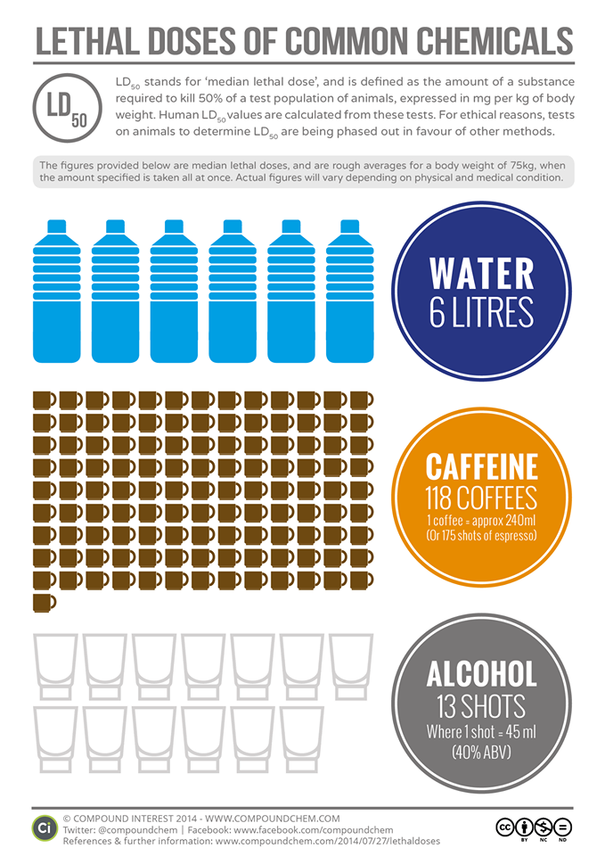
LD50

Slide 4
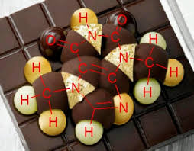
Theobromine Toxicity
1000 mg/kg in humans
200 mg/kg in cats
300 mg/kg in dogs

Slide 5
Objectives
Street Drugs
Toxidromes
Treatment for Poisoning

Slide 6

TENANTS TO ALL EMERGENCY CARE
1-800-222-1222
Secure the airway
Place the patient on a monitor!
Have IV access (lots of it)
Provide supportive care
  Serial EKGs and labs
  Benzodiazepines are your toxicology friend

Slide 7
GENERAL CONSIDERATIONS IN OVERDOSE AND ALTERED MENTAL STATUS
Dextrose (1 amp)
Thiamine (100mg)
Naloxone (0.2-0.4mg – escalate to 2 to 10mg if necessary)
  Ideally you don’t want to precipitate withdrawal but personally I don’t care if a patient has stomach cramps if I save their life
  Consider a gtt
  Monitor for seizures if OD is with tramadol or meperidine
  Little known fact, naloxone is good for Clonidine OD!

Slide 8
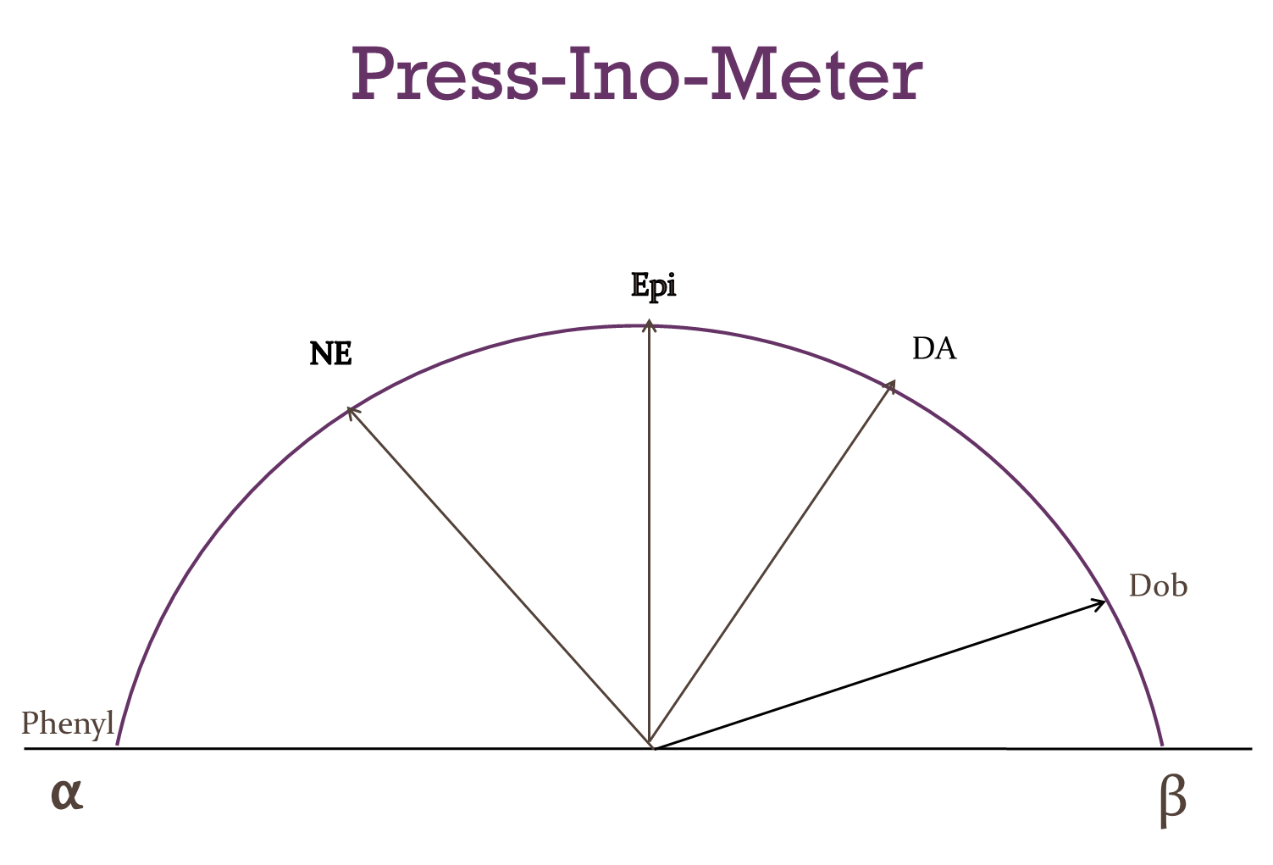

Slide 9
GI DECONTAMINATION
I rarely do it.
If you do it, contraindications include compromised airway, ileus, and bowel obstruction
Activated Charcoal
  0.5-1 g/kg in children or 25 to 100 g in adults
  Ingestion was <1 hour ago and the drug is known
    Salicylate
Whole Bowel Irrigation
  large volumes (1.5-2 L/h) of a polyethylene glycol-based solution to facilitate rapid transit of a toxin through the GI tract. In volunteer
  consider following ingestion highly toxic, extended-release preparations
    verapamil, iron, asymptomatic drug packers

Slide 10
TO UDS OR TO NOT UDS
Actual and Factual
  benzodiazepine testing is for oxazepam
  cannabinoid testing is for d -9-tetrahydrocannabinol
False Negatives
  Lorazepam and Alprazolam have different metabolites
  Synthetic Opiates (fentanyl, Demerol, methadone, propoxyphene)
  Synthetic Cannabinoid (JWH-018 aka Spice)
False Positives
  Amphetamines (pseudoephedrine)
  Benzodiazepines (some NSAIDs)
  Opiate (quinolones)
  PCP (diphenhydramine)
  TCA (diphenhydramine, cyclobenzaprine, carbamazepine, quetiapine)
Drug | Detection Period
Amphetamine | 4d
Barbituate | 24h (sa) 3 wk (la)
Benzodiazepine | 3d (sa) 4 wk (la)
Cocaine | 3d
Marijuana | 3d (su) 4wk (lu)
Opiates | 4d
Phencyclidine | 8d

Slide 11
levelable drugs
Digoxin
Salicylate
Acetaminophen
Theophylline
Alcohols
  Ethylene Glycol, EtOH, Methanol
Metals
  Iron, Lead, Mercury
AEDs
  Valproate
  Carbamazepine
  Phenytoin
  Lithium
Heme (arterial oxygen saturation gap PO2-Coox >5%)
  Carbon Monoxide, Carboxyhemoglobin, Methemoglobin, Sulfhemoglobin

Slide 12
Dialyzable drugs
Salicylates
Phenobarbital
Theophylline
Methanol
Ethylene glycol
Lithium
Diethylene glycol
Propylene glycol
Isopropyl alcohol
Valproic acid
Carbamazepine

Slide 13
ANION GAP
TOXICOLOGY IS ITS ONLY TRUE APPLICATION
+AG
  “unmeasured anions” tells you to order an Osm Gap
    Toxic Alcohols
-AG
  Lithium, Bromide, Iodide

Slide 14
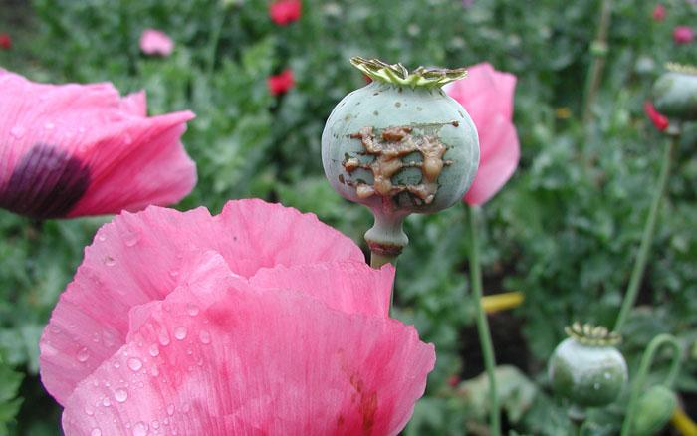
opiates
Smack, Horse, Mud, Brown Sugar, Junk, Black Tat, Big H, Paregoric, Dover’s Powder, MPTP (New Heroin), Hilbilly Heroin, Lean or Purple Drank, OC, Ox, Oxy, Oxycotton, Sippin Syrup
Tablets, capsules, skin patches, powder, chunks in varying colors (from white to shades of brown and black), liquid form for oral use and injection, syrups, suppositories, and lollipops
  swallowed, smoked, sniffed, or injected
Poppy papaver somniferum is the source for all natural opioids
Highly addictive
“Narcotic” = “Stupor”
  dulls the senses and relieves pain

Slide 15
OPIATE TOXIDROME
MORPHINE, HYDROCODONE, CODEINE, HYDROMORPHONE, FENTANYL, PROPOXYPHENE, TRAMADOL, METHADONE
Lethargy
Hypothermia
Respiratory Depression
Bradycardia and Hypotension
Miosis
Decreased Bowel Sounds
  Miosis and a respiratory rate of 12 breaths/min are both sensitive (88% and 80%, respectively) and specific (90% and 95%, respectively) for predicting a response to naloxone.

Slide 16
Opiate toxidrome
Altered mental status with depressed respiratory function
Seizures: meperidine, propoxyphene, and tramadol
QRS Prolongation: propoxyphene
  sodium channel blockade
QT Prolongation: methadone
  potassium efflux blockade
Chest Wall Rigidity: fentanyl (rapid infusion)
Protect the airway
Naloxone: 0.2-0.4mg – escalate to 2 to 10mg if necessary
  Half-life ~2 hours
  Consider gtt
Consider sodium bicarb and benzo’s depending on presentation (seizures, abnl intervals on EKG, etc)

Slide 17
Opiate withdrawal
Restlessness
Mydriasis
Lacrimation
Yawning
Insomnia
N/V/D
Muscle Cramps (including smooth muscle of intestine)
Clonidine (anxiety)
Ibuprofen (myalgias)
Dicyclomine (abd cramps)
Ondansetron (emesis)
Consider methadone

Slide 18
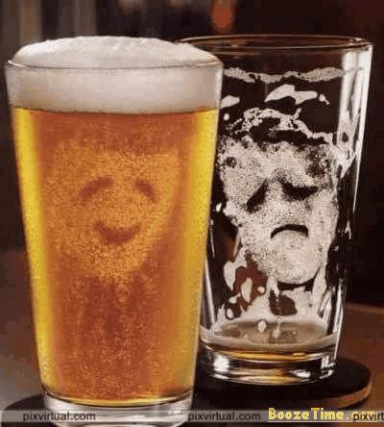
Depressants
Barbs, Benzos, Downers, Georgia Home Boy, GHB, Grievous Bodily Harm, Liquid X, Nerve Pills, Phennies, R2, Reds, Roofies, Rophies, Tranks, and Yellows
Pills, syrups, and injectable liquids
Euphoria
Misused to facilitate sexual assault

Slide 19
Sedative hypnotic syndrome
BARBITUATES, BENZODIAZEPINES, GHB, ETOH
Lethargy
  via binding at postsynaptic g -aminobutyric acid type A channels , thereby promoting chloride influx and neuronal hyperpolarization
Respiratory Depression
Hypothermia
CNS depression is enhanced
Protect the airway

Slide 20
Sedative hypnotic syndrome
Baclofen
  Hypothermia, hypotension, bradycardia, coma, seizures
Ƴ-Hydroxybutyrate
  CNS depression and respiratory failure
Carisoprodol
  Coma and myocolonus
Protect the airway
Benzodiazepines for seizures

Slide 21
Sedative hypnotic withdrawal
Tremors
Hallucinations
Agitation
Confusion
Autonomic overactivity
Seizures
Benzodiazepines
Can consider beer
Supplement (decrease amt of benzo’s)
  Dexmedetomidine
  Gabapentin

Slide 22
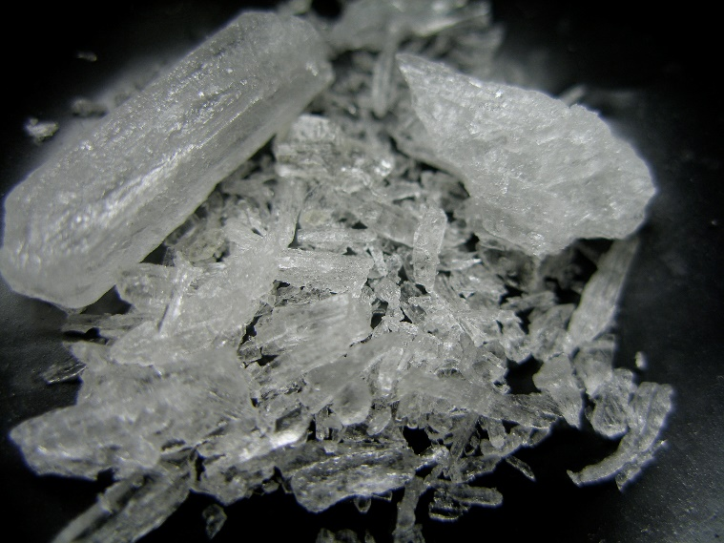
METHAMPHETAMINE
Batu, Bikers Coffee, Black Beauties, Chalk, Chicken Feed, Crank, Crystal, Glass, Go-Fast, Hiropon, Ice, Meth, Methlies Quick, Poor Man’s Cocaine, Shabu, Shards, Speed, Stove Top, Tina, Trash, Tweak, Uppers, Ventana, Vidrio, Yaba, and Yellow Bam
Pills, powder, rocks, and injectable liquids
  swallowed, smoked, sniffed, or injected
Highly addictive
Stimulant (CNS)
Acute
  “rush” (thought to be from dopamine)
Chronic
  Violence, anxiety, confusion, insomnia, psychosis

Slide 23
SYMPATHOMIMETIC TOXIDROME
COCAINE, AMPHETAMINES, PCP, CAFFEINE, PSEUDOEPHEDRINE, METHYLPHENIDATE
Mydriasis
Diaphoresis
Hyperthermia
  Agitation & muscular hyperactivity
Tachycardia
HTN
Tachypnea
Hypervigilence
Psychosis
Seizures
Cocaine toxicity responds well to benzodiazepines
  Amphetamines are hit or miss

Slide 24

HALLUCINOGENS
Acid, Blotter, Blotter Acid, Cubes, Doses, Fry, Mind Candy, Mushrooms, Shrooms, Special K, STP, X, and XTC
  Ecstasy is sold in colorful pill form
  LSD is sold in the form of impregnated paper (blotter acid), typically imprinted with colorful graphic designs.
  Synthetic THC is also called K2 or Spice
Deaths exclusively from acute overdose of LSD, magic mushrooms, and mescaline are extremely rare. Deaths generally occur due to suicide, accidents, and dangerous behavior, or due to the person inadvertently eating poisonous plant material. Synthetic THC however has been associated with MI and Renal Failure
Perceptual Distortions
  Time and Space
  Colors seem to change and take on new significance
  Weeks or even months after some hallucinogens have been taken, the user may experience flashbacks — fragmentary recurrences of certain aspects of the drug experience in the absence of actually taking the drug.

Slide 25
hallucinogens
MDMA can also act as a sympathomimetic
In high doses, it interferes with the body’s ability to regulate temperature.
  Hyperthermia can result in liver, kidney, and cardiovascular failure (i.e. death)
IVF
Benzodiazepines
Cooling device

Slide 26
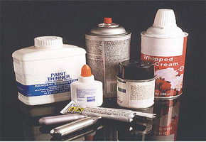
inhalants
Gluey, Huff, Rush, and Whippets
Chemical Vapors From:
  glue, lighter fluid, cleaning fluids, and paint
Rapid absorption through the lungs to the brain
Euphoria and feeling “high”
Routine use will cause brain damage
Death can occur from asphyxiation

Slide 27
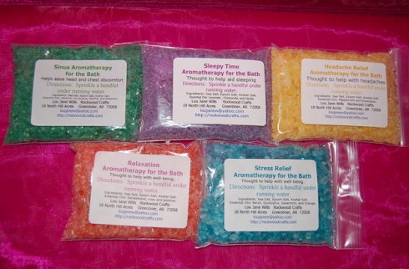
Designer cathinones aka bath salts
Bliss, Blue Silk, Cloud Nine, Drone, Energy-1, Ivory Wave, Lunar Wave, Meow Meow, Ocean Burst, Pure Ivory, Purple Wave, Red Dove, Snow Leopard, Stardust, Vanilla Sky, White Dove, White Knight, White Lightening
Usually sniffed or snorted. Can also be ingested, smoked, or injected
Euphoria and Alertness (similar to cocaine and MDMA)
Adverse Effects:
  Tachycardia, HTN, Hyperthermia, Mydriasis, Rhabomyolysis, Paranoia, Hallucinations/Delusions
IVF
Benzodiazepines

Slide 28
ANTICHOLINERGIC (ANTIMUSCARINIC) TOXIDROME
ANTIHISTAMINES, TCAS, ANTIPYSCHOTICS, ANTIPARKINSONIAN, ANTISPASMODITCS/MUSCLE RELAXANTS, BELLADONNA ALKALOIDS/JIMSONWEED, OPHTHO MYDRIATICS, AMANITA MUSHROOMS
Blind as a bat (mydriasis with loss of accommodation)
Mad as a hatter (delirium)
Red as a beet (flushed)
Hot as hell (hyperthermia)
Dry as a bone (anhydrosis)
Loss of tone (constipation and urinary retention)
Heart runs alone (tachycardia)
PHYSOSTIGMINE
  0.5-2mg IM/IV as needed
    Repeat q10-30 min
    HAVE ATROPINE AVAILABLE!

Slide 29
CHOLINERGIC TOXIDROME
ORGANOPHOSPHATES, CARBAMATES, PHSYO/PYRIDOSTIGMINE, NERVE GAS, MUSCARINE MUSHROOMS
Inhibit neuronal acetylcholinesterase (AChE), resulting in acetylcholine accumulation and overstimulation of muscarinic and nicotinic receptors
  Miosis
  Salivation
  Lacrimation
  Diaphoresis
  Bronchorrhea (with bronchospasm)
  Urination
  N/V/D
  Bradycardia
ATROPINE
  2-4mg IM x1 mild/moderate symptoms
  6mg IM x1 severe symptoms
    Go half dose if elderly
PRALIDOXIME (2-PAM)
  1-2GM IV x1, then 250mg IV q5min until symptoms reverse
    Give 1 dose atropine first
Of note, respiratory muscle paralysis does not respond to atropine
  Nicotinic hyperstimulation

Slide 30
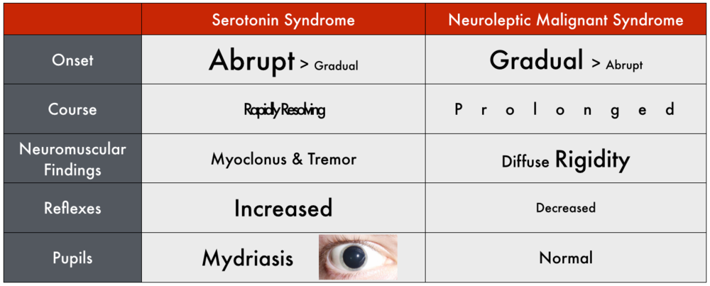
SEROTONIN SYNDROME VS
NEUROLEPTIC MALIGNANT SYNDROME
NMS: Dopaminergic withdrawal, Haloperidol, Fluphena/Thiorida-zine, Chlorpromazine, Cloza/Olanza/Quetia -pine, Risperi/Ziprasi -done, Metoclopramide, Promethazine, Aripiprazole, Droperidol, Procholeperazine
SS: SSRIs, SNRIs, Bupropion, TCA, MAOIs, Anti-migraine, Lithium, Cyclobenzaprine, Fentanyl, Tramadol, Dextromethorphan, St. John’s Wart, Ginseng, Nutmeg, Anti-nausea, Linezolid, Ritonavir

Slide 31
SS VS NMS
SS
NMS (restore dopamine)
MILD
  Benzo’s
MODERATE
  Cyproheptadine (5-HT_{2A} antagonist)
SEVERE
  Intubate and Sedate (benzo gtt)
  Consider paralysis
  Antihypertensive gtt?
  Cooling device
  I also give cyproheptadine
MILD TO MODERATE
  Bromocryptine 2.5-5mg q8h (max 30mg/day)
  Amantadine 100mg q8h (200-400mg/day)
  Consider benzo’s
MODERATE TO SEVERE
  Dantrolene 1-2.5mg/kg IV (1mg/kg q6h)
  Consider ECT if neuroleptic cannot be restarted

Slide 32
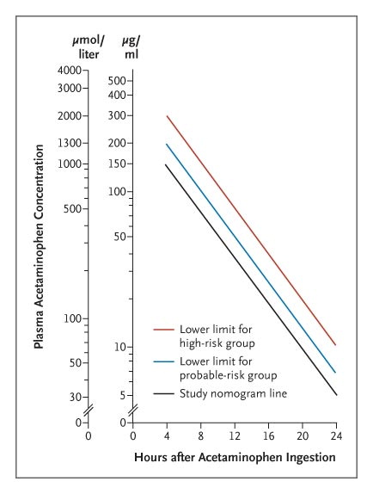
acetaminophen
The earlier the NAC, the better (treat until you can trend the acetaminophen level)
  140mg/kg loading dose po followed by 70mg/kg q4h x 17 doses po (tastes gross!)
  150mg/kg over 15-60 min followed by 12.5mg/kg/hr x 4 hours followed by 6.25mg/kg/hr x 16 hours
  Consider longer treatment if levels are still high (or LFTs are still abnl)
Stages
  Preclinical
  Hepatic Injury
  Hepatic Failure
  Recovery
5% of the dose is metabolized by CYPP450 2E1 to N-acetyl-benzoquinone imine (NAPQI)
NAPQI is toxic (covalent binding to proteins and nucleic acids)
Glutathione detoxifies NAPQI (to cysteine and mercapturic acid conjugates)
N-acetylcysteine is synthesized to cysteine to improve glutathione stores
Transplant:
  Arterial pH < 7.3 despite resuscitation
  Or the combination of grade III/IV hepatic encephalopathy, prothrombin time >100 s, and serum creatinine level > 3.4 mg/dL.

Slide 33
Salicylates
Mechanism
  uncoupling of oxidative phosphorylation,
    decreased adenosine triphosphate (ATP) production, increased acidosis, and hyperthermia
Symptoms
  Mild: tinnitus, hyperventilation, abdominal pain, vomiting (if intubated keep that respiratory drive!)
  Severe: diaphoresis, delirium
URINARY ALKALINIZATION
  44-100mEq in 1L of 5% dextrose in 0.25% NS
  88-150mEq in 1L of 5% dextrose at 2-3mL/kg/h (adults 150-200mL/h)
  Goal urine pH 7-8.5 / (keep blood pH <7.55) (monitor hourly)
  Hypokalemia & Hypovolemia prevent effective alkalinization
  Add 20-40mEq of K to each liter (unless there is renal failure)
  Urinary excretion is more dependent upon urine pH than renal flow rate
  “trapping” salicylates in urine and serum (increasing excretion and decreasing further redistribution, esp to the brain)
HEMODIALYSIS
  AMS, Pulmonary edema, Seizures, Elevated and rising levels (100 mg/dL)

Slide 34
Cardiac glycosides digoxin
Inhibit the sodium-potassium ATPase pump
  ↑ intracellular sodium&calcium and extracellular potassium
    Increased contractility
  Increased automaticity with bradycardia and conduction blocks
DIGOXIN-SPECIFIC FAB FRAGMENTS
  hyperkalemia (>5.5 mEq/L) and life-threatening dysrhythmias
  #vials = dig level (ng/mL) x wt (kg) / 100 (give 6 if unsure)
  #vials = 10 every 25 tabs/caps ingested acutely

Slide 35
Intralipid therapy
In the event of local anesthetic-induced cardiac arrest that is unresponsive to standard therapy, in addition to standard cardio-pulmonary resuscitation, Intralipid 20% should be given i.v. in the following dose regime:
Intralipid 20% 1.5mL/kg over 1 minute
  Take a 500ml bag of Intralipid20%and a 50ml syringe.
  Drawup 50ml and give stat i.v.X2
  Then attach the Intralipid bag to an iv administration set (macrodrip) and run it i.v. over the next 15 minutes
  Repeat the initial bolus up to twice more – if spontaneous circulation has not returned.
Follow immediately with an infusion at a rate of 0.25mL/kg/min
Continue chest compressions
Repeat bolus every 3-5 minutes up to 3 mL/kg total dose until circulation is restored
Continue infusion until hemodynamic stability is restored. Increase the rate to 0.5 mL/kg/min if BP declines
A maximum total dose of 8mL/kg is recommended (560mL for a 70kg man)
Developed for LAST
Case reports in almost everything
  Olanzapine
  Lamotrigine
  Bupropion
  Dosulepin
  Verapamil
  Haloperidol
  Quetiapine
  Sertraline

Slide 36
Calcium channel blocker
& beta blocker overdose
glucagon
High-dose insulin therapy
IVF
50 to 150 mcg/kg bolus (3-10mg for a 70kg person)
  Repeat q3-5 minutes
Continuous infusion
  Initiate if more than two boluses given
  Dose by effective bolus dose each hour (for example, if two 5mg boluses given, rate should be 10mg/hr)
IVF
Baseline glucose (goal ~200mg/dL)
1U/kg bolus
0.5-1.0 U/kg/h continuous infusion
  Increase by 2U/kg/h every 10 min to a max of 10U/kg/h
Dextrose infusion
  10% in ½ NS or 5-10%D5W, goal glucose >100
Monitor
  Glucose q10min & Potassium q60min while titrating insulin
  Glucose q30-60 min & Potassium q6h when infusion rate stable

Slide 37
TOXIC ALCOHOLS (ETHYLENE GLYCOL &METHANOL)
Ethylene glycol
  Ophthalmoplegia
  Cranial nerve palsies
  Hyporeflexia
  Myoclonus
  ATN
  Abnl (low) Ca, Mg, K
Methanol
  Headache
  Confusion
  Vertigo
  Visual impairment & photophobia
    afferent pupillary defect is an ominous sign
  Blindness
  Pancreatitis
Prevent renal failure (EG), permanent neurological damage, seizures, severe acidosis (and of course death)
FOMEPIZOLE
  Ethylene Glycol & Methanol dosing:
    15mg/kg IV q12h until level <20mg/dL; then 10mg/kg IV q12h x 4;
Consider HD
Consider 1-2 amps of Bicarb if pH <7.3
Administer cofactors: thiamine, folate, pyridoxine
Ethanol can be substituted for fomepizole if it is unavailable

Slide 38
Carbon monoxide
Rapidly absorbed odorless gas
210x the affinity for Hgb than O2
Shifts Oxygen-Dissociation curve to the left
  Headache, Dizziness, Nausea →
    Confusion →
    Coma →
      Death
MI can occur
Diagnose with multiwavelength co-oximetry
  BUT TREAT BY SYMPTOMS
100% OXYGEN
HBO is controversial

Slide 39
cyanide
Inhibits cytochrome a 3 in mitochondrial cytochrome oxidase,
  No electron transport, No oxygen consumption, No ATP!
Rapid onset of:
  coma, seizure, metabolic acidosis, tachycardia, and hypotension
SODIUM NITRITE & SODIUM THIOSULFATE
  300mg IVx1 of Nitrite followed by 12.5GM IVx1 of Thiosulfate
  Increases MetHgb to remove HCN from tissues
  Thiosulfate turns HCN to thiocyanate which is renally excreted
HYDROXOCOBALAMIN
  5GM IV
  May repeat (doses of up to 20GM have been used)
  Turns HCN to cyanocobalamin which is renally excreted

Slide 40
HAVE A GOOD WEEKEND
REMEMBER NO MORE THAN 12 SHOTS OF 40 PROOF ALCOHOL

