Slide 1
Liver Disease in Pulmonary and Critical Care Medicine
Dr H

Slide 2
Objectives
Review of fulminant liver failure
Alcoholic hepatitis
GI Bleed (Variceal, Non-Variceal, Lower)
Review of Hepatopulmonary Syndrome
Review of Portopulmonary Hypertension

Slide 3
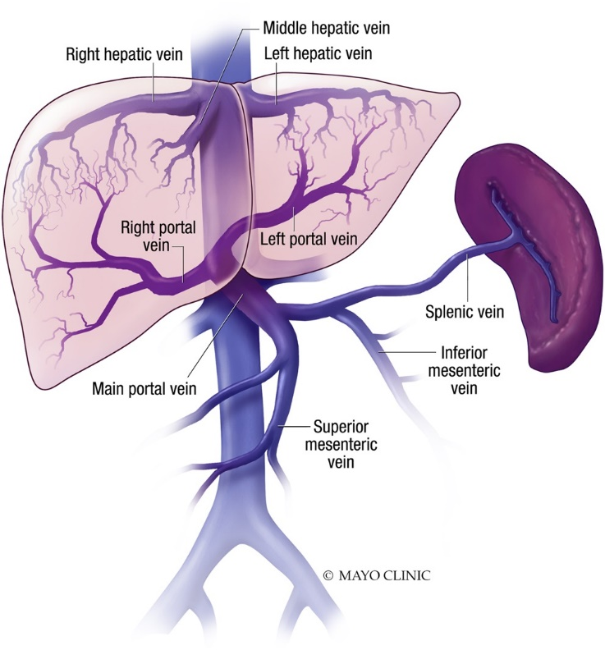
Normal Liver
Blood Flow:
  1/3 from hepatic artery (from the heart)
    increases flow ~25% in shock states, maintaining oxygen perfusion to the liver even in shock until blood losses are down 30%
  2/3 from portal venous system (from the small intestine)
    Carries blood from the entire GI tract (except upper esophagus and distal rectum), pancrease, gallbladder, and spleen to the liver
    Drain into hepatic sinusoids → IVC → hepatic veins
Cells:
  60% Hepatocytes
  30% Kupffer cells (macrophages that produce inflammatory mediators), Endothelial Sinusoidal cells, Neutrophils, and Mononuclear cells
Synthesizes proteins including clotting factors, Stores vitamins, Filters, Excretes, Gluconeogenesis
Simonetto et al. ACG Guideline Disorders of the Hepatic and Mesenteric Circulation. The American Journal of Gastroenterology: January 2020 - Volume 115 - Issue 1 - p 18-40

Slide 4
Shock Liver
Liver dysfunction from poor perfusion “ischemic hepatitis”
  Cardiogenic failure (including decompensated CHF)
    Decreased hepatic blood flow
    Passive congestion of venous system
  Respiratory failure (including ARDS)
    Profound hypoxia
  Septic shock
    Increased metabolic demands
    Mechanical intubation may increase intrathoracic pressure and reduce hepatic blood flow
  Toxic shock
    Direct toxicity and increased metabolic demands (common with TPN infusion)
    *interestingly, HD has been associated with ischemic hepatitis
Soultatit et al. Annals of GI 2005; 18(1): 35-45

Slide 5
Diagnosis
Elevated LFTs (including GGT and LDH)
Hyperbilirubinemia
Decreased coagulation factors
Low albumin

Slide 6
Acute Liver Failure
<10/million
50% mortality
Most prevalent in 30 y/o
“Fulminant Hepatic Failure” – severe liver injury, potentially reversible in nature and with onset of hepatic encephalopathy within 8 weeks of the first symptoms in the absence of pre-existing liver disease”
Bernal et al. NEJM Review 2013; 369:2525-2534

Slide 7
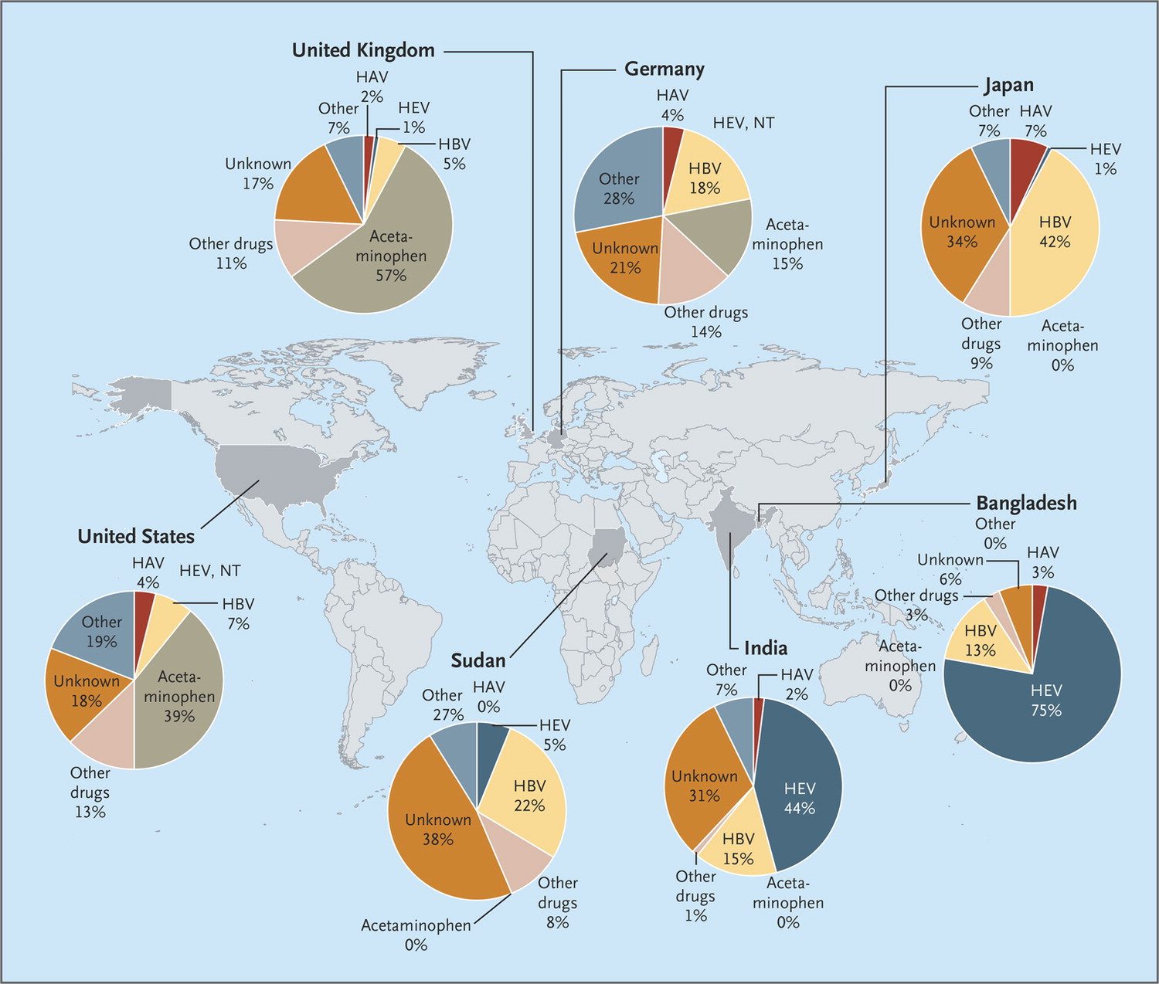

Worldwide Causes of Acute Liver Failure
Hepatitis A, B, and E (developing world)
  HBV most common in treatment-induced immunosuppression for cancer
  HSV, CMV, EBV, Parvovirus
Drug induced (developed world)
  Acetaminophen
    Most commonly accidental and over time
  MDMA, Cocaine
  Amanita poisoning (mushrooms)
Acute Ischemic Hepatocellular Injury
  Sepsis, Cardiac Shock, Respiratory Failure
Bernal W, Wendon J. N Engl J Med 2013;369:2525-2534.

Slide 8
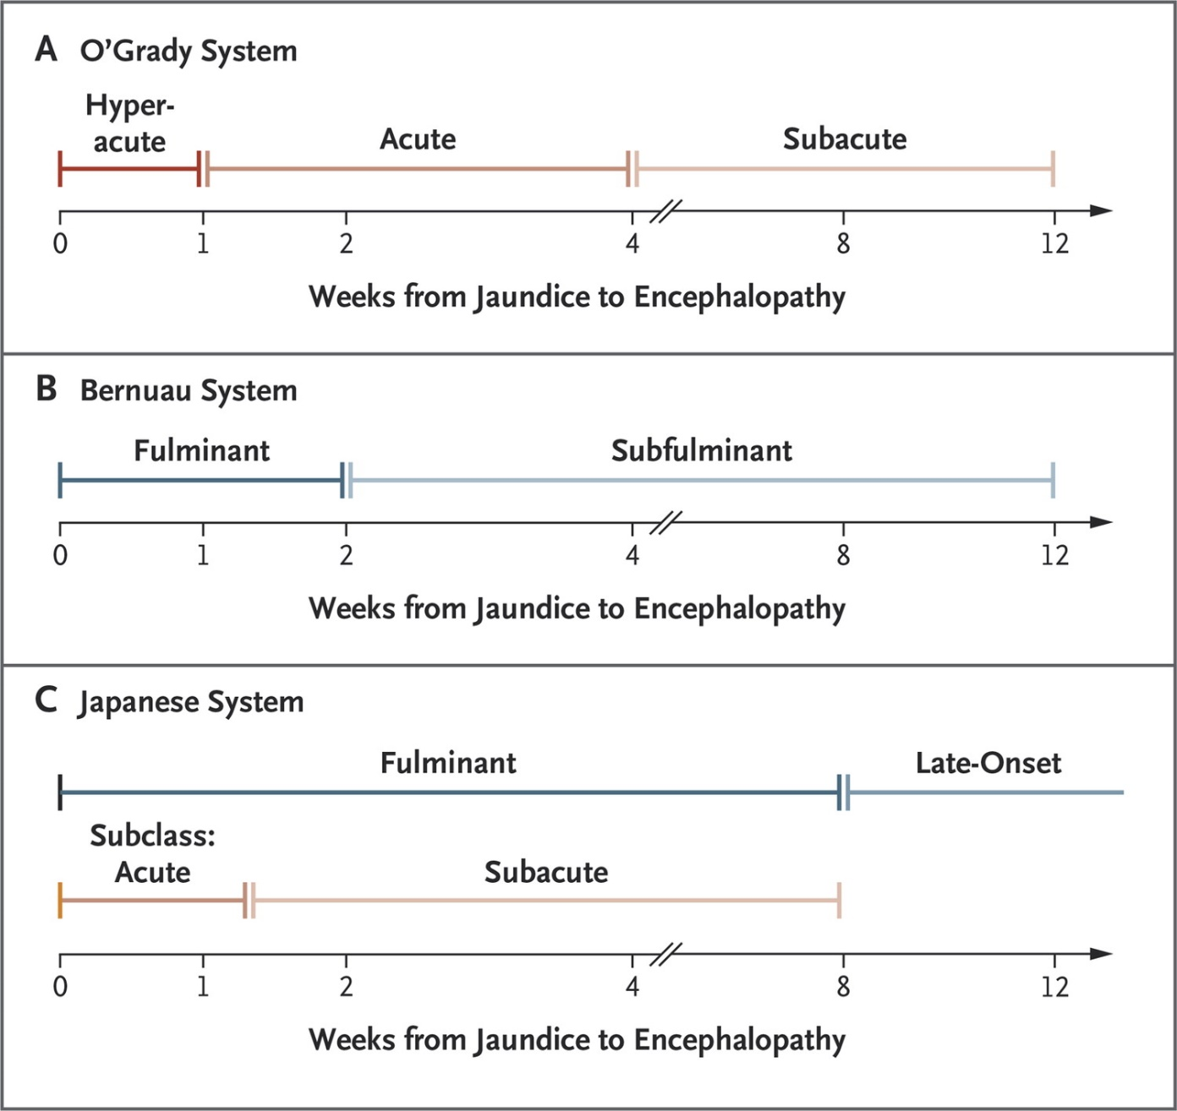
Classification Systems for Acute Liver Failure.
Bernal W, Wendon J. N Engl J Med 2013;369:2525-2534.

Slide 9
Presentation of Acute Liver Failure
Hepatic dysfunction
Abnormal LFTs
Coagulopathy
Encephalopathy
MODS

Slide 10
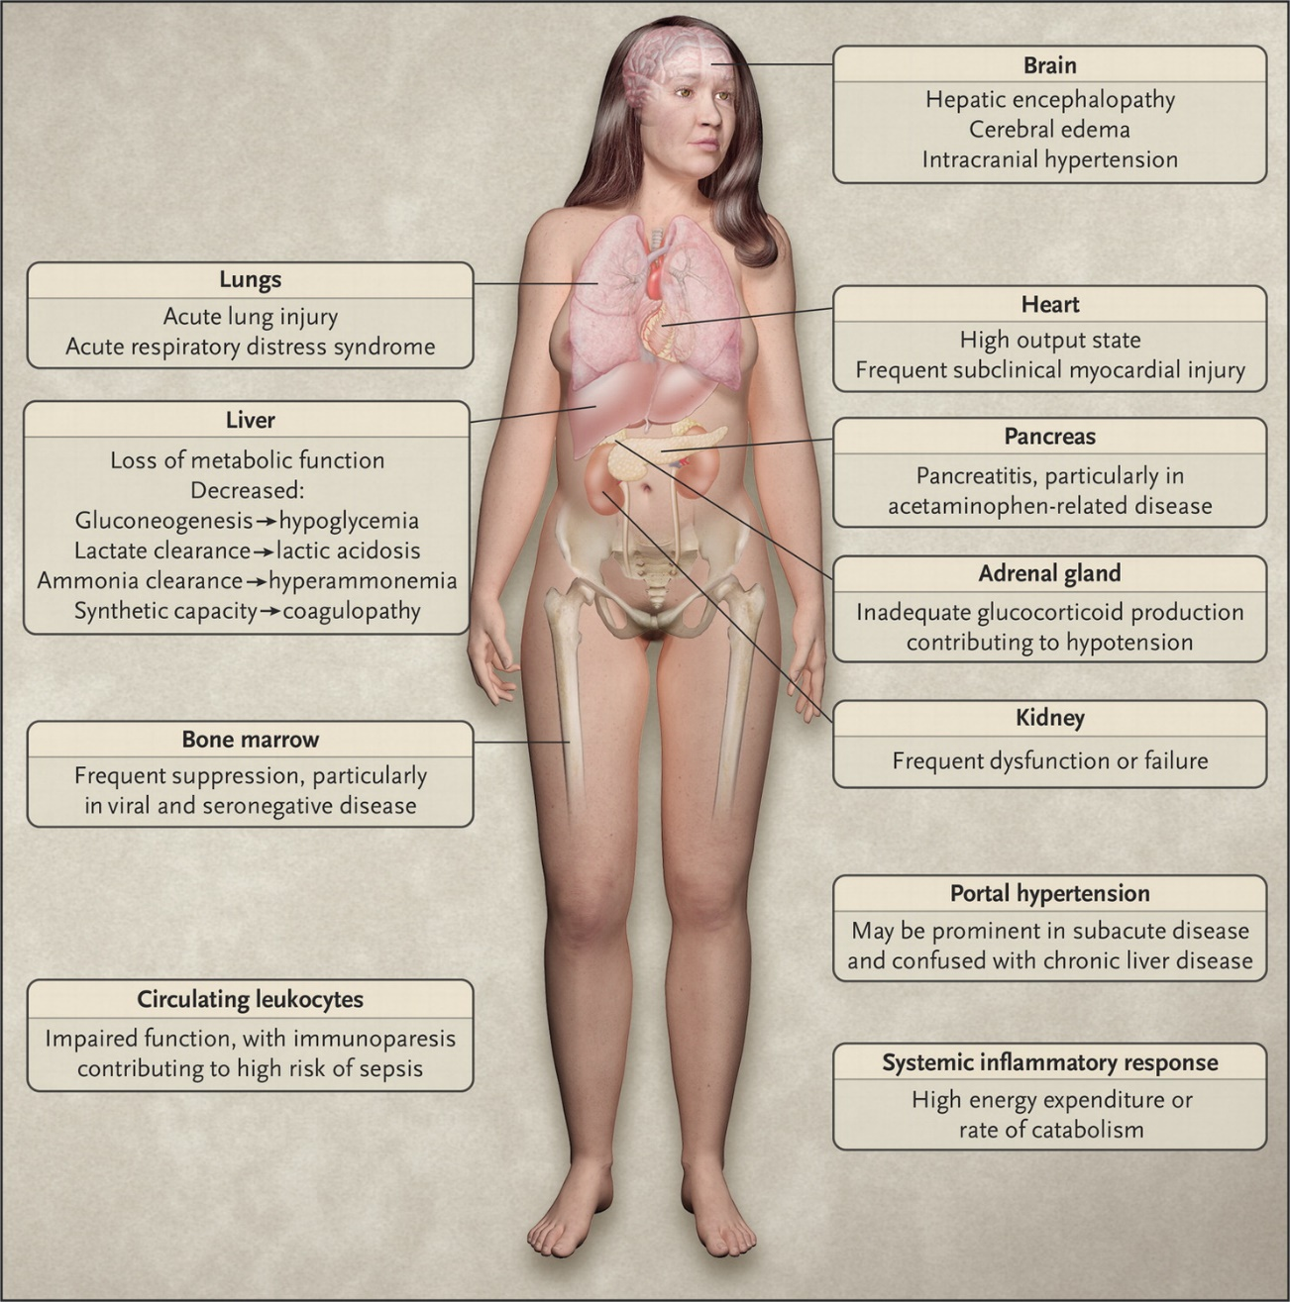
Clinical Features of Acute Liver Failure.
Bernal W, Wendon J. N Engl J Med 2013;369:2525-2534.

Slide 11
Blood testing:
Complete blood cell count with platelets
Electrolytes and renal function – Na, K, Cl, CO2, BUN, Cr International normalized ratio Factors 5, 7
Liver panel Alanine aminotransferase Aspartate aminotransferase Alkaline phosphatase Total bilirubin Direct bilirubin Albumin Gamma glutamyl transpeptidase
Blood lactate
Ammonia
Blood gas with pH
Viral Testing: HIV testing (rapid) Viral markers Hepatitis A virus IgM HBcAb IgM HBsAg HBsAb HBcAb total Hepatitis C virus Ab Hepatitis B virus DNA Hepatitis C virus RNA Hepatitis E virus Ab Hepatitis E virus polymerase chain reaction (PCR) (in appropriate patients with travel history) Cytomegalovirus (CMV) PCR CMV Ab Herpes simplex virus (HSV) PCR HSV Ab Epstein-Barr virus Ab
Autoimmune markers: Antinuclear antibody Antismooth muscle antibody Anti-liver kidney microsomal
Metabolic markers: Uric acid Serum copper and urine copper
Hypercoagulable markers: Lupus anticoagulant Factor 5 Leiden
Toxicology screen: and drug panel Acetaminophen Opiates Barbiturates Cocaine Alcohol
Pregnancy testing: (females) beta human chorionic gonadotropin
Urinalysis and microscopic analysis Urine electrolytes and osmolarity
Blood cultures
Urine cultures
Imaging and other testing Chest radiograph Abdominal ultrasound with Doppler study of the liver ECG Echocardiogram with estimation of pulmonary artery pressures

Slide 12
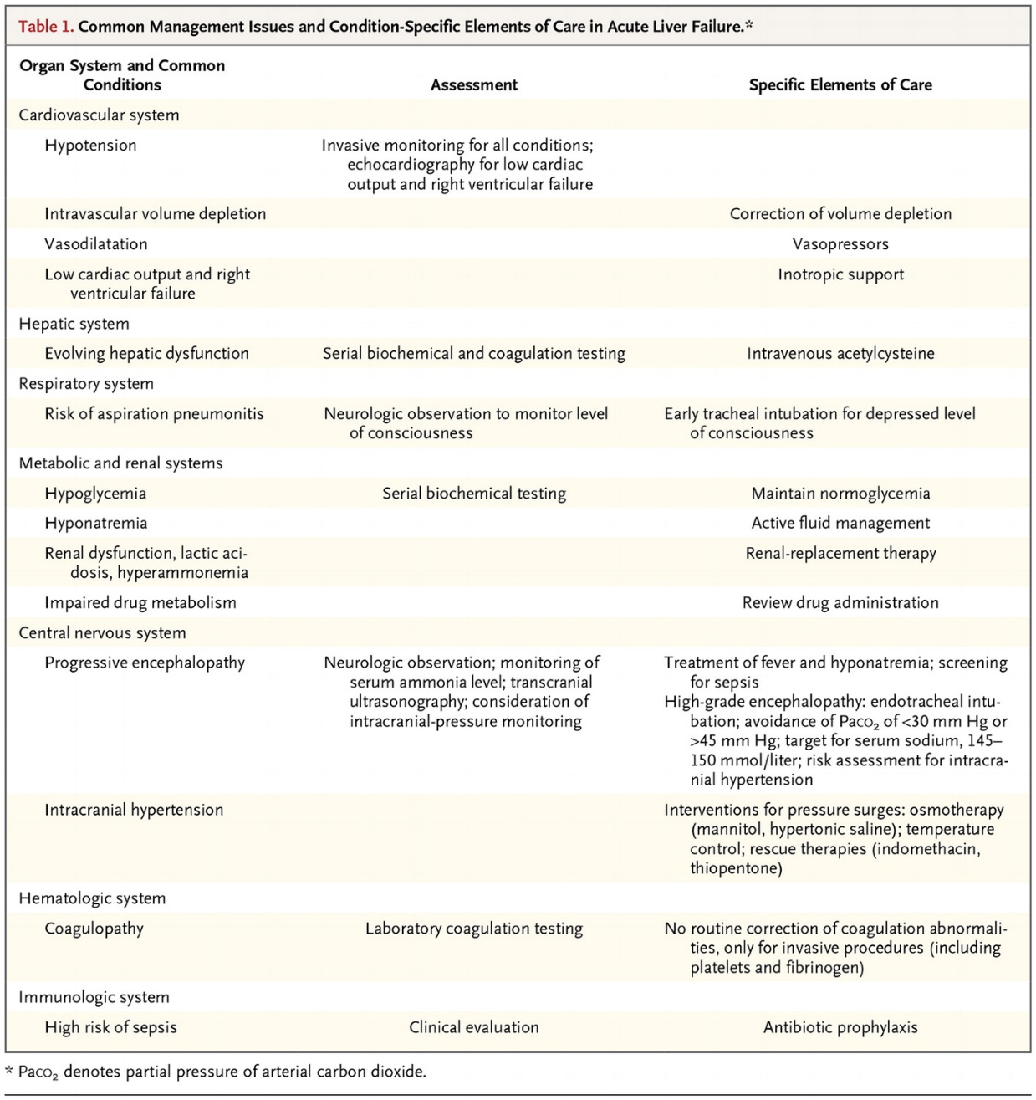
Common Management Issues and Condition-Specific Elements of Care in Acute Liver Failure.
Bernal W, Wendon J. N Engl J Med 2013;369:2525-2534.

Slide 13
West Haven Encephalopathy Grades
Grade 1 - Trivial lack of awareness; euphoria or anxiety; shortened attention span; impaired performance of addition or subtraction
Grade 2 - Lethargy or apathy, minimal disorientation for time or place; subtle personality change; inappropriate behaviour
Grade 3 - Somnolence, but responsive to verbal stimuli; confusion; gross disorientation
Grade 4 - Coma (unresponsive to verbal or noxious stimuli)

Slide 14
Treatment – Neurological Failure
Cerebral Edema & Intracranial Hypertension
  Features:
    WHE grade 3 or 4
    Ammonia >150µm
    Rapid Progression
Consider EVD
  Keep ICP < 25mm Hg
  CCP 50-65mm Hg
Avoid overstimulation (infrequent suctioning, HOB 30°)
Control fever with cooling (avoid further hepato-toxins like acetaminophen and ibuprofen)
Avoid changes in serum glucose, sodium, and CO2
  Consider hypertonic saline to keep Na 145-155mEq/L
CVVH is the preferred RRT
Consider continuous EEG
Schilsky et al. Clin Chest Med 30 (2009) 71–87

Slide 15
Hepatic Encephalopathy
Types
  Type A resulting from ALF
  Type B resulting predominantly from portosystemic bypass or shunting
  Type C resulting from cirrhosis
Grades (it is a continuum)
  West Haven is the gold standard
Ammonia is sensitive, but it’s level is not specific for HE
Treat!
  Lactulose to 4BM/day; Rifaximin
  Others: BCAAs, LOLA, Neomycin, Metronidazole
Control any underlying precipitating factor (infection, bleed, etc)
Vilstrup et al. Hepatic Encephalopathy in Chronic Liver Disease: 2014 Practice Guideline by AASLD and EASL. July 2014

Slide 16
Treatment – Supportive Care
Intubate if needed
Propofol for sedation if possible
Norepinephrine and Vasopressin for shock
  Goal MAP 50
  Work-up infection
  Steroids if pressors aren’t working
CVVH for RRT (renal failure is common)
Coagulopathy
  Empirically administer 10mg Vitamin K IV x1
  Goal INR 1.5 and Plt 50,000 for active bleeding or invasive device (such as EVD)
    FFP > Cryo (good for low fibrinogen ,100mg/dL) > rFactor VII
Nutrition
  Prone to hypoglycemia, try to at least administer trophic feeds (also helps prevent gut bacteria translocation)
Schilsky et al. Clin Chest Med 30 (2009) 71–87

Slide 17
Treatment – “liver replacement therapy”
Extracorporeal Albumin Dialysis (ECAD)
Molecular Adsorbents Recirculating System (MARS)
  Hemodiafiltration with countercurrent albumin dialysis
  Bridge to transplant – removes both water-soluble and albumin-bound toxins in the low and middle molecular-weight range
Fractionated Plasma Separation and Adsorption (SEPAD)
*I don’t know transplant hepatologists who use these methods…

Slide 18
King’s Criteria for Liver Transplantation
APAP-associated AHF | All other causes of AHF
pH < 7.3 | INR >6.5
or | or
INR > 6.5, serum creatinine >3.4 mg/dl, and grade III–IV encephalopathy | Three of the following variables:
 | 1. Age <10 or >40 years
 | 2. Cause is nonA, nonB hepatitis or idiosyncratic drug reaction
 | 3. Duration of jaundice before encephalopathy >7 days
 | 4. INR > 3.5
 | 5. Serum bilirubin >17.5 mg/dl

Slide 19
Transplant
STATUS 1 (adults)
AHF and encephalopathy who are in an intensive care unit with a life expectancy of <7 days without a liver transplant.
Status 1 also includes patients with primary graft failure, hepatic artery thrombosis <7 days post transplant, or fulminant Wilson disease.

Slide 20
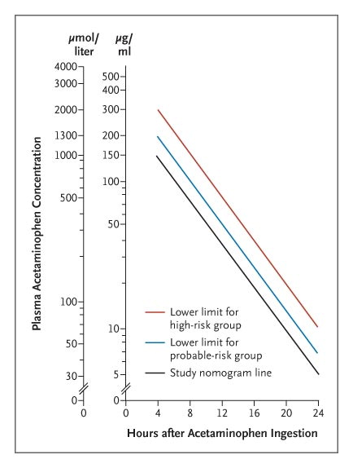
Acetaminophen
(aka paracetamol) Overdose
The earlier the NAC, the better (treat until you can trend the acetaminophen level)
  140mg/kg loading dose po followed by 70mg/kg q4h x 17 doses po (tastes gross!)
  150mg/kg over 15-60 min followed by 12.5mg/kg/hr x 4 hours followed by 6.25mg/kg/hr x 16 hours
  Consider longer treatment if levels are still high (or LFTs are still abnl)
Stages
  Preclinical
  Hepatic Injury
  Hepatic Failure
  Recovery
5% of the dose is metabolized by CYPP450 2E1 to N-acetyl-benzoquinone imine (NAPQI)
NAPQI is toxic (covalent binding to proteins and nucleic acids)
Glutathione detoxifies NAPQI (to cysteine and mercapturic acid conjugates)
N-acetylcysteine is synthesized to cysteine to improve glutathione stores
Rumack-Matthew Nomogram

Slide 21
Amanita Poisoning
10-30% mortality
Treat with Silibinin or PCN G

Slide 22
Metabolic
Wilson Disease
  Copper chelation
  If in liver failure, will likely need transplant (long-standing disease lends to poor hepatic reserve)
Acute Fatty Liver of Pregnancy (AFLP)
  3rd trimester
  With or without preeclampsia
  Diagnose with biopsy
  Deliver fetus (can consider plasma exchange until delivery)
Preeclampsia
  HELLP
  Deliver fetus

Slide 23
Vascular
Budd-Chiari
  Hepatic venous thrombosis
    Usually from an underlying thrombotic diathesis (1/3 are idiopathic)
    Usually need occlusion of 2 hepatic veins
    Hepatomegaly, ascites, and abd pain
  Treat with TIPS (transplant may be necessary in 10-15%)
  Often hypercoagulable
Simonetto et al. ACG Guideline Disorders of the Hepatic and Mesenteric Circulation. The American Journal of Gastroenterology: January 2020 - Volume 115 - Issue 1 - p 18-40

Slide 24
Alcoholic Hepatitis
Occurs in about 10-20% of heavy drinkers
Steatosis →Injury/Remodeling→Cirrhosis→Portal Hypertension→
Vague symptoms: anorexia, fever, jaundice, diarrhea, abd pain, weakness, n/v
AST>ALT, Hypoalbuminemia, Hypertriglyceridemia, Leukocytosis with Thrombocytopenia
  Elevated bili and INR indicate severe AH or Cirrhosis
Maddrey's Discriminant Function (DF): [4.6 × (PT patient – PT control) + total bilirubin (mg/dl)] >32 portends 50% mortality
Treatment: abstinence, nutritional support, weight loss, screen HCC q6months, screen for varices, infection evaluation (including paracentesis)
  Steroids if DF > 32; MELD > 21; Encephalopathy
  Prednisolone 40 mg/day x 28 days, taper over two to four weeks
  Check to see if “responder” at day 7 (study in ‘16 suggests 4 days sufficient)
    if Lille score improves to <0.45, then steroids are working
    Consider prophylactic abx and NAC
Singal et al. ACG Guideline: Alcoholic Liver Disease. The American Journal of Gastroenterology: February 2018 - Volume 113 - Issue 2 - p 175-194

Slide 25
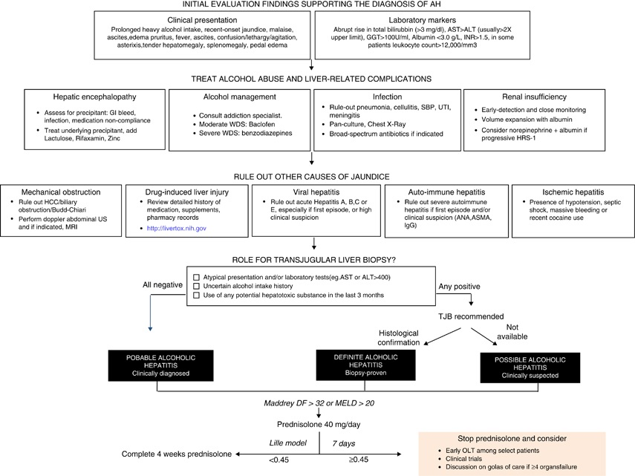
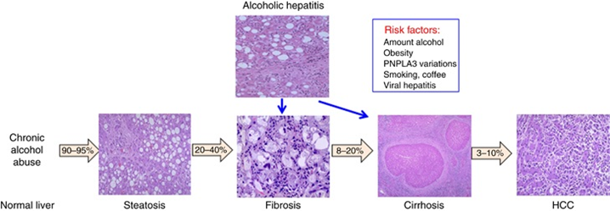
Alcoholic Hepatitis
Patients non-responsive to corticosteroids, ineligible for early LT, and with multiple organ failures may be considered for palliative therapy.

Slide 26
GI Bleed - Variceal
ADMIT TO ICU
Mortality of 20-35%
  Esophageal and Gastric
2 large bore IVs
Low transfusion threshold
  Goal Hgb 8 (avoid crystalloids)
  INR correlates poorly with thrombin generation and risk of bleeding in patients with cirrhosis
Octreotide gtt 50mcg bolus followed by 50mcg/hr x 3-5days
  Decreases portal and collateral pressures (decreases rebleeding)
Vasopressin IV infusion of 0.2–0.4 units/minute
  ?Nitroglycerin (study in ‘82)
7 days of Norfloxacin or Ciprofloxacin with underlying cirrhosis
  Decreases infectious complications and rebleed AND SURVIVAL BENEFIT
  Consider Ceftriaxone in places with high fluoroquinolone resistance
EVL within 12 hours (consider intubation)
  Ligation for Esophageal, + PPI (ulcers often develop)
  Tissue Adhesive for Gastric
Balloon Tamponade
  Short-term bridge (can necrose the esophagus)
TIPS
  Refactory bleeding
?TPO-receptor agonists
  (eltrombopag, lusutrombopag, and avatrombopag) have demonstrated to effectively stimulate thrombopoiesis in patients with cirrhosis and thrombocytopenia
Garcia-Tsao. Prevention and Management of Gastroesophageal Varices and Variceal Hemorrhage in Cirrhoiss. American Journal of Gastroenterology: September 2007 - Volume 102 - Issue 9 - p 2086-2102

Slide 27
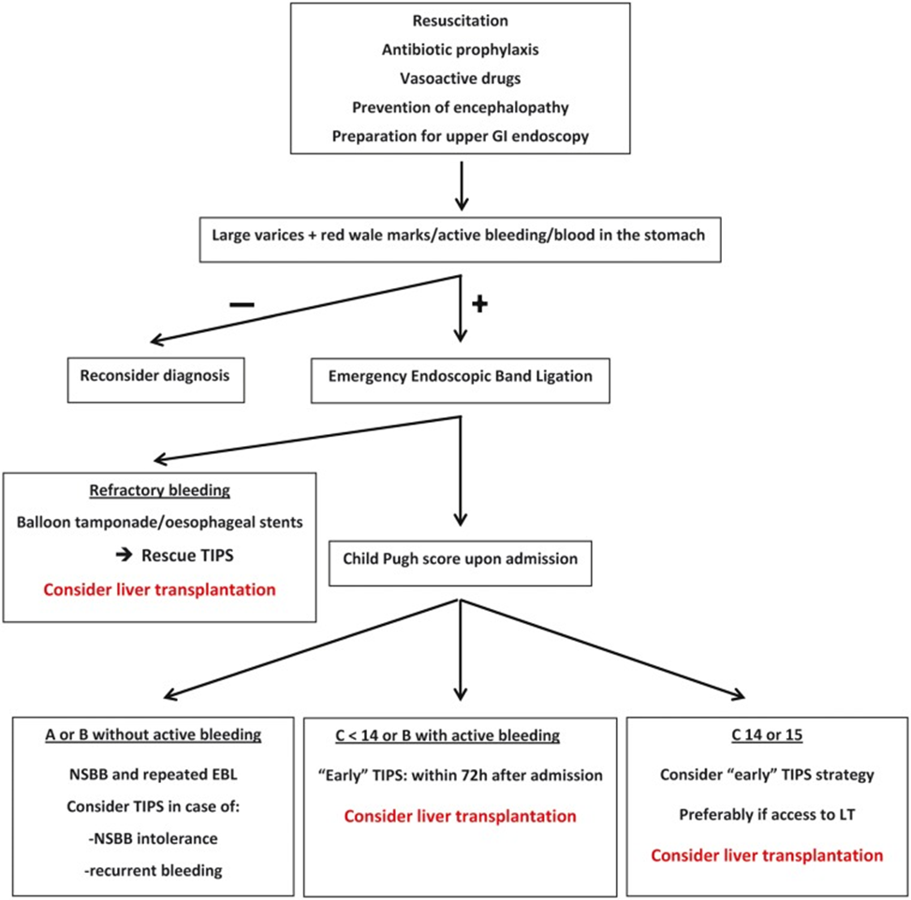
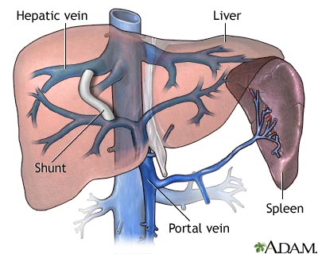
GI Bleed - Variceal
Mallet etal. Variceal Bleeding in Cirrhotic Patients. Gastroenterol Rep (Oxf). 2017 Aug; 5(3): 185–192.

Slide 28
GI Bleed – Variceal Prevention
Screen ALL pts with cirrhosis (EGD)
Patients with compensated cirrhosis
  No varices on screening endoscopy - EGD should be repeated in 2–3 years
  Small varices, the EGD should be repeated in 1–2 years
  Decompensated cirrhosis, EGD should be repeated at yearly intervals
Small Varices / High-risk patients should be on a non-selective BB
  Child B/C or presence of red wale marks on varices
Medium/Large Varices should be on a non-selective BB or have EVL (endoscopic variceal ligation)

Slide 29
GI Bleed - Upper
Ulcers occur in 1.5-8.5% of pts with critical illness
  Risks are mechanical ventilation >48h; Plt <50K, INR>1.5
Other
  Mallory-Weiss; Aortoenteric fistula (graft pts); Tumor (<3%)
2L bore IVs with IVF (cystalloid)
PPI
Transfuse if Hgb <7 (or if actively bleeding or if concern for comorbidities)
  Patients with restrictive-strategy rebleed less and have decreased mortality (worst in Child-Pugh Class A/B)
Correct INR
Endoscopy within 24 hours
Sachar, et al. Intermittent vs continuous proton pump inhibitor therapy for high-risk bleeding ulcers: a systematic review and meta-analysis. JAMA. 2014 Nov;174(11):1755-62

Slide 30
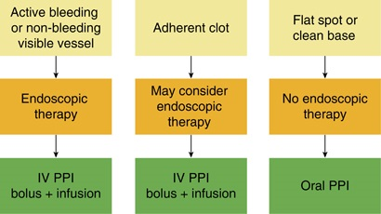
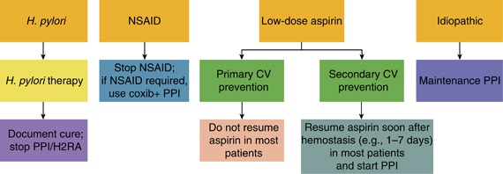
ULCER
Prep with Erythromycin (250 mg ∼30 min before endoscopy)
NG lavage not recommended
PPI (80 mg bolus followed by 8 mg/h infusion)
  Administer until endoscopy (decreases level of bleeding and risk of rebleeding)
  Continue infusion for 72 hours in patients with active bleeding, visible vessel, or adherent clot
    Consider BID dosing rather than continuous infusion
Endoscopy within 24 h of admission, following resuscitative efforts to optimize hemodynamic parameters and other medical problems
  High-risk pts should be scoped within 12 h
    tachycardia, hypotension, bloody emesis or NG aspirate in hospital
  If further bleeding occurs after a second endoscopic therapeutic session, surgery or interventional radiology with transcathether arterial embolization is generally employed
Stigmata of bleeding (in descending risk of further bleeding)
  active spurting
  non-bleeding visible vessel
  active oozing
  adherent clot
  flat pigmented spot
  clean base
Laine et al. Management of Patients with Ulcer Bleeding. American Journal of Gastroenterology: March 2012 - Volume 107 - Issue 3 - p 345-360

Slide 31
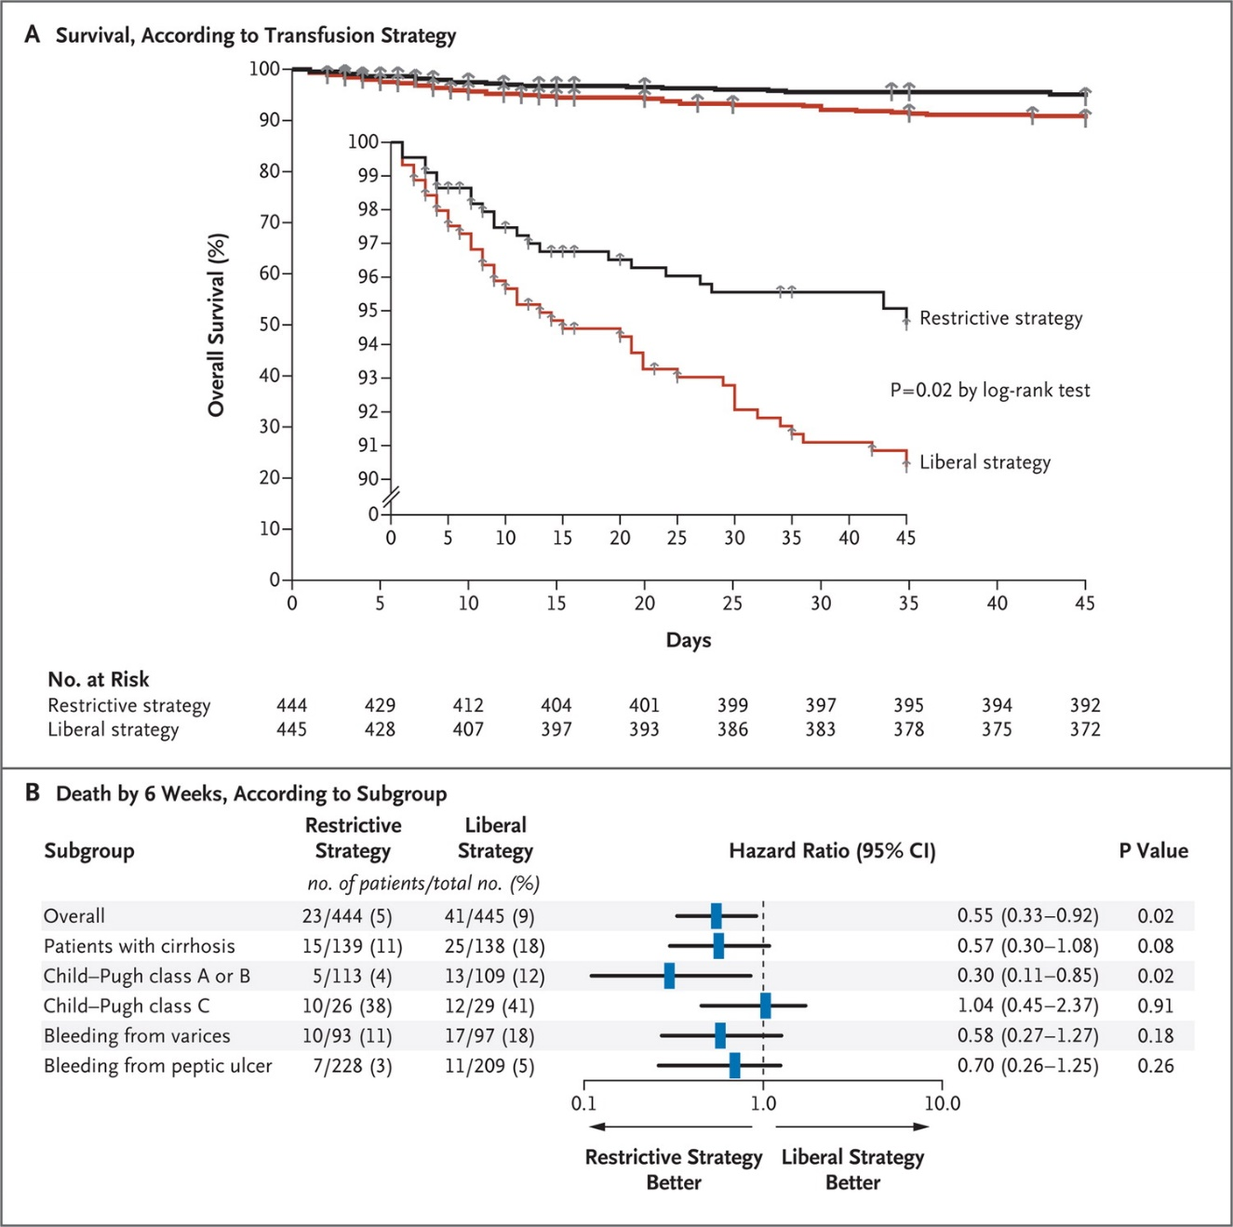
Rate of Survival, According to Subgroup.
Villanueva C et al. N Engl J Med 2013;368:11-21.

Slide 32
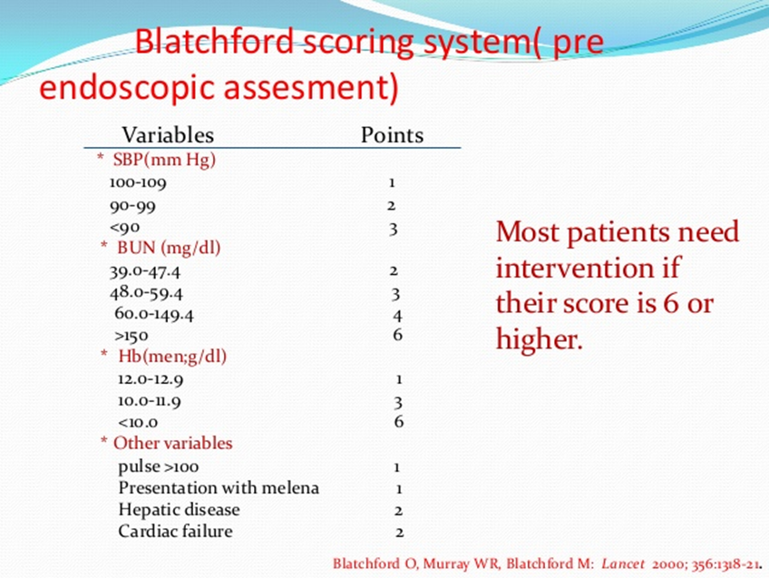
UGIB D/C FROM ER
urea nitrogen <18.2 mg/dl
hemoglobin ≥13.0 g/dl for men (12.0 g/dl for women)
systolic blood pressure ≥110 mm Hg
pulse <100 beats/min
absence of melena, syncope, cardiac failure, and liver disease
  <1% chance of requiring intervention

Slide 33
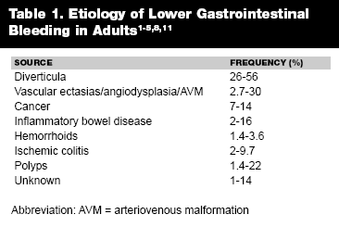
GI Bleed- Lower
Resuscitate (2 large-bore IVs)
Unprepped scope NOT recommended (consider NGT to facilitate)
INR <2.5
Plt > 50
Scope within 24 hours if high-risk
CT angio is imaging of choice
Strate et al. ACG Clinical Guideline: Management of Patients with Acute Lower Gastrointestinal Bleeding. American Journal of Gastroenterology: April 2016 - Volume 111 - Issue 4 - p 459-474

Slide 34
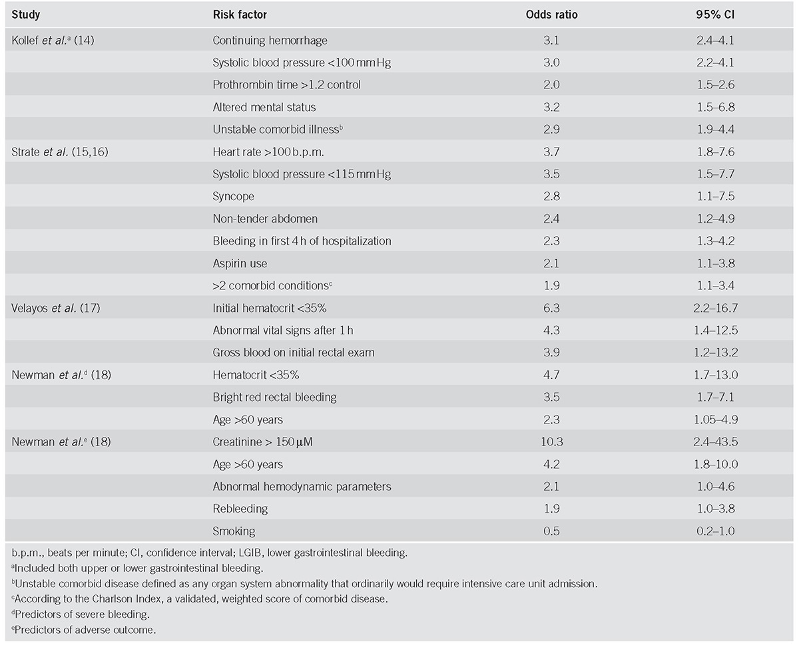
GI Bleed- Lower
High-Risk Features

Slide 35
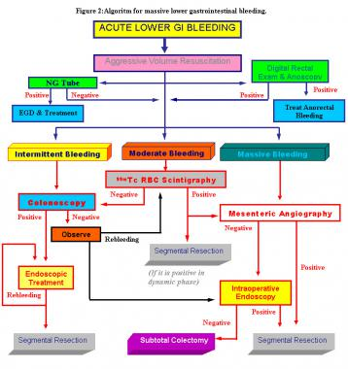
GI Bleed - Lower

Slide 36
HPS
Triad of liver disease, hypoxemia, and “intrapulmonary vascular dilatations”
  Dilated vessels
  Possibly AVMs
Platypnea, Orthodeoxia, dyspnea, cyanosis, spider angiomata, clubbing
Transplant
  Only effective treatment (shunts do not respond well to O2)
  PaO2<60mmHg is an indication for transplant
Rodriguez-Roisin et al. N Engl J Med 2008; 358:2378-238

Slide 37
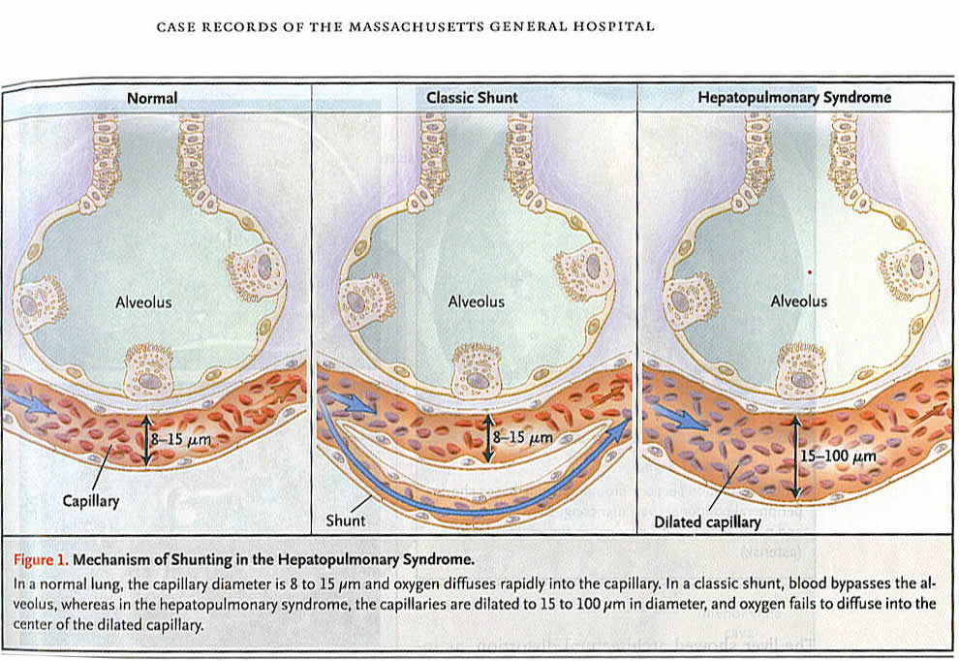
HPS

Slide 38
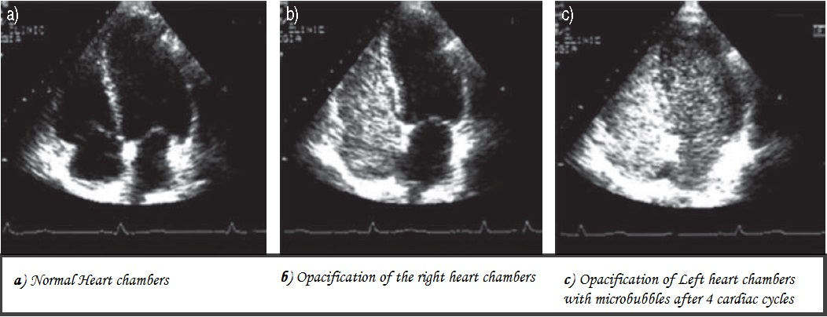
Contrast-enhanced Transthoracic Echocardiography
Agitated saline in peripheral vein
Microbubble opacification of left atrium within 3-6 cardiac cycles after right-atrial opacification
  Usually microbubbles do not pass through capillaries, they are too small

Slide 39
PPH
Pulmonary Hypertension in a Cirrhotic from Portal Hypertension
  Mean pulmonary artery pressure > 25 mmHg at rest
  Pulmonary vascular resistance > 120 dyne·s·cm5
  Pulmonary capillary wedge pressure (PCWP) < 15 mmHg
  Portal hypertension (portal pressure > 10 mmHg)
Symptoms: dyspnea on exertion (most common), syncope, chest pain, fatigue, hemoptysis, orthopnea
Poor prognosis (if left untreated): mean survival 15 months; median survival 6 months.
Treat with prostacyclins (then consider transplant if PAP <40mmHg)

