Slide 1
PFT Nuances
Dr H

Slide 2
Objectives
Review of Lung Volumes
Caveats to PFT Interpretation
Obstruction
Restriction
Mixed Obstruction/Restriction
Bronchodilator Response
Degree of Change Over Time

Slide 3
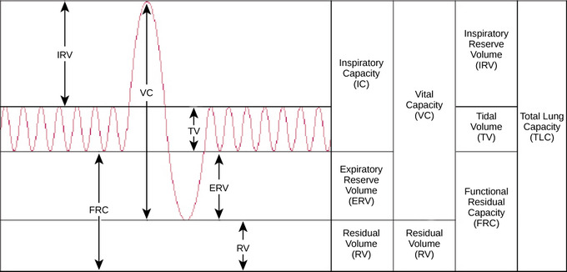
Lung Volumes

Slide 4
Caveats
Ensure that you first check to see if the results are valid, if they aren’t – DO NOT INTERPRET!
Labs should use LLN for age, sex, and race to predict a patient’s “normal,” know what your lab does
We tend to believe that ALL smokers will get obstructive lung disease, the percentage is actually about 20%
VC is better than FVC
  Technically you can calculate VC by TLC-RV (mind you this is imperfect)
  Describe what ratio you are using whether it be: FEV1/VC or FEV1/FVC or FEV1/SVC or FEV1/IVC
  You should use the largest of these vital capacities, not the smallest. Many false POSITIVE results (not negative) occur when using FEV1/FVC, particularly if you are using a “5th percentile” margin

Slide 5
Obstruction
FEV1/FVC <0.70 (or 70%) of LLN
If you see the flow-volume loop scooping, you may call early obstruction (suggest smoking cessation in your report)
If you see the FEF25-75% reduced, you may call small airways disease

Slide 6
Restriction
TLC <80% of LLN
If ERV is very low and BMI is high, you can consider body habitus as the cause of restriction.

Slide 7
Mixed Obstruction/Restriction
You still need a reduced ratio and a reduced TLC.
  Technically the degree of defect is uninterpretable as the two processes oppose one another. You need to say this in your report.
Comparing FEV1 to TLC may account for this.
  FEV1/TLC = appropriate FEV1

Slide 8
Grading
This varies by institution and individual (it is quite arbitrary)
Use the POST-BRONCHODILATOR FEV1 (I actually just pick the larger of the two)
  Also if the numbers cross different degrees you can put in a range!
State in your report which criteria you are using
  Of note, I like FVC for grading restriction, you can use FEV1 by ATS, or TLC by others…
RV > 120 indicates air trapping; TLC >120 indicates hyperinflation

Slide 9
Grading
ATS Criteria
GOLD Criteria
Degree of Severity | FEV1 % Pred
Mild | >70
Moderate | 60-69
Moderately Severe | 50-59
Severe | 35-49
Very Severe | <35
Degree of Severity | FEV1 % Pred
Mild | >80
Moderate | 50-79
Severe | 30-49
Very Severe | <30

Slide 10
Bronchodilator Response
>12% and 200mL improvement
If there is no response, you need to put a statement in reflecting the following: Lack of bronchodilator response does not preclude their use for symptomatic benefit. I have seen primary care providers STOP inhalers when this statement is not placed. Seems obvious to us, but, it is not obvious to everyone.

Slide 11
Degree of Change Over Time
12% and 200mL change (whether it be higher or lower) This is worth putting in your report

Slide 12
Diffusion Capacity
I often use the corrected DLCO for lung volume if there is restriction, this makes intuitive sense to me.
Degree of Severity | DLCO % Pred
Mild | > 60 and < LLN
Moderate | 40-60
Severe | <40

Slide 13
Report
Is there obstruction?
Is there restriction?
Do they smoke?
Are they obese?
What is the ERV?
Is the diffusion capacity preserved?

