Slide 1
Procalcitonin
Dr H

Slide 2
Objectives
Procalcitonin Overview
Studies in Antibiotic Stewardship Utilizing Procalcitonin
Algorithms for Use
  Pneumonia
  Critical Care

Slide 3
Clinical Question 1
A 66 y/o Veteran presents to the Emergency Department with nonproductive cough in October. He is a 1ppd smoker with a known history of COPD. His FEV1 is 60%. He is maintained on Symbicort and Spiriva. He has not had a COPD exacerbation in a year. His other PMH is significant for HTN, HL, and a history of Prostate Cancer, in remission. His has a fever to 101.0. HR 96. BP 115/74. His oxygen saturation is 95% on RA with a RR of 20. Lung sounds are distant but clear. CXR identifies bilateral hazy bilateral infiltrates. Procalcitonin is 0.05. What would be your plan of care?
A. Supportive care, discharge
B. Broad-spectrum abx, steroids, nebulizers, admission to the Wards
C. CAP abx, steroids, discharge
D. Monitor the patient in the ER for 12 hours and then make a disposition

Slide 4
Clinical Question 2
You are a hospitalist who admitted a patient with pneumonia three days ago. The patient presented with productive cough and mild dyspnea, fever to 102, leukocytosis to 14, and lactate of 2.7. A RLL dense infiltrate was identified on Xray. The patient responded very well to Ceftriaxone and Azithromycin and has defervesced. Today you obtained a procalcitonin of 0.20. The patient’s admission procalcitonin was 1.1. What would you do with the antibiotic course for this patient?
A. Finish 14 days of antibiotics
B. Finish 7 days of antibiotics
C. Finish 5 days of antibiotics
D. Stop antibiotics

Slide 5
Clinical Question 3
You are the Intensivist on in the ICU. You have a patient that presented in shock, presumed to be Septic. They had a fever, a leukocytosis to 18, and a lactate of 6 on admission. PCT was 10. The patient has been on broad-spectrum antibiotics for 5 days. No culture data has returned positive. The patient is doing much better. He is alert and oriented. Vital signs are normal. His PCT is now 2. What would you do with his antibiotics?
A. Finish a 14 day course of antibiotics for a patient who presented with an unknown infection with septic shock
B. Finish a 10 day course of antibiotics
C. Finish a 7 day course of antibiotics
D. Stop antibiotics

Slide 6
Procalcitonin
Prohormone of calcitonin
  Released from multiple sources in response to bacterial infection
  Low circulating level at baseline in normal individuals
  Release not stimulated by viral infection, chronic inflammatory diseases or autoimmune diseases

Slide 7
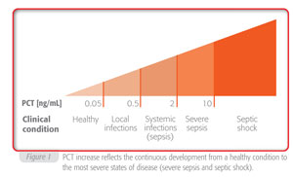
Procalcitonin Levels in the Spectrum of Infectious Illness

Slide 8
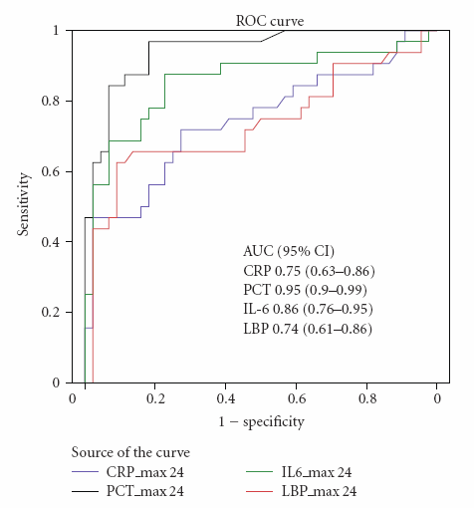
Procalcitonin as a Sepsis Marker
Notes:
Single center prospective observational study examining 76 consecutive patients admitted with SIRS (n=44) or sepsis (n=32) to the ICU. PCT was best – compared with LBP, CRP and IL-6 – at discriminating between SIRS and sepsis with the highest area under the ROC curve (0.95, 95% CI 0.90–0.99)

Slide 9
Procalcitonin in Viral vs Bacterial Infection
Notes:
PCT level in 52 patients with confirmed influenza A pneumonia, of whom 19 patients had bacterial co-infection (54% S. pneumonia, 31% S. aureus) pneumonia, captured in retrospective observational study in 23 ICUs in France during the 2009 H1N1 pandemic.

Slide 10
Procalcitonin Guidance in LRTI: Systematic Review
11 trials, 4090 patients
Procalcitonin-guided patients had:
  Lower odds of antibiotic initiation (odds ratio: 0.26; 95% confidence interval [CI]: 0.13-0.52)
  Shorter mean antibiotic use (weighted mean difference: -2.15 days; 95% CI: -3.30 to -0.99)
  Procalcitonin use had no adverse impact on mortality (relative risk: 0.94; 95% CI: 0.69-1.28)
Hey et al. Clin Chem Lab Med 2018 Jul 26;56(8) 1200-1209

Slide 11
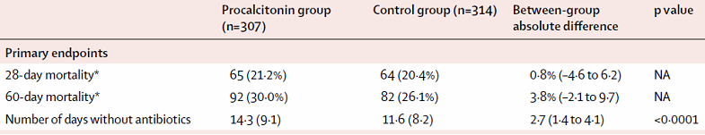
PRORATA Trial
Use of procalcitonin to reduce patients' exposure to antibiotics in intensive care units
RCT in 7 ICUs (5 university-affiliated hospitals)
307 abx on PCT algorithm
314 abx on standard guidelines
Bouadma et al. Lancet 2010 Feb 6; 375(9713):463-74
Notes:
Open-label, randomized controlled trial
7 ICUs in 5 university-affiliated hospitals in France
Patients were admitted between 6/2007 and 5/2008 with suspected bacterial infection
307 received antibiotics based on PCT algorithm (71% with pulmonary infection)
314 received antibiotics based on standard guidelines (75% with pulmonary infection)
Inclusion criteria
Age ≥ 18 years
Received antibiotic for <24 hours
Developed sepsis during ICU stay
Exclusion criteria
Pregnancy
Expected ICU stay <3 days
Neutropenia
Infection requiring long-term antibiotic therapy
SAPS II >65
DNR
Primary end points
Death from any cause by days 28 and 60
Number of days without antibiotics by day 28
Secondary end points
Relapse of infection by day 28
Super-infection by day 28
Number of days without mechanical ventilation
SOFA score
Length of stay in the ICU and hospital
Days of exposure to each antibiotic per 1000 inpatient days
Duration of antibiotic treatment by infection site
Emergence of new multi-drug-resistant bacteria
→ Mortality of PCT group vs ctrl at day 28: 21.2% (65/307) vs 20.4% (64/314); absolute difference 0.8%, (90% CI –4.6 to 6.2)
→ Mortality of PCT group vs ctrl at day 60: 30% (92/307) vs 26.1% (82/314); absolute diff 3.8% (90% CI –2∙1 to 9∙7)
→ Days without abx in PCT group vs ctrl: 14.3 days (SD 9.1) vs 11.6 days (SD 8.2); absolute difference 2.7 days (95% CI 1.4 to 4.1, p<0∙0001)
53% of patients randomized to the procalcitonin group were not given algorithm-guided treatment

Slide 12
SAPS Trial
Stop antibiotics on guidance of procalcitonin study
RCT (3 university-affiliated hospitals, 12 teaching hospitals)
Clinicians advised to stop abx if PCT <0.5 ng/mL or decreased by >80%
Primary Endpoint | PCT Group | Control Group | p-value
28 Day Mortality | 20% | 35% | 0.0122
365 Day Mortality | 36% | 43% | 0.0188
Assink-de Jong et al. BMC Infectious Diseases 2013, 13:178

Slide 13
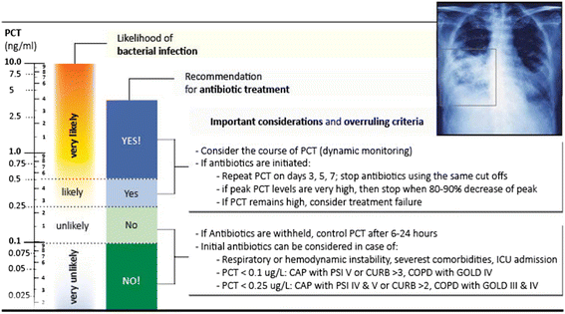
ALGORITHMS
Sager et al. Procalcitonin-guided diagnosis and antibiotic stewardship revisted. BMC Medicine. 2017

Slide 14
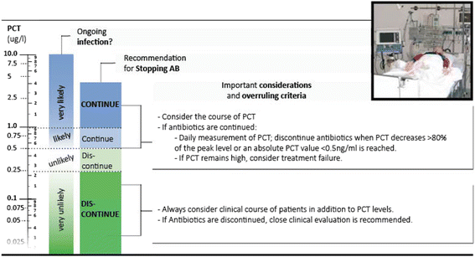
ALGORITHMS
Sager et al. Procalcitonin-guided diagnosis and antibiotic stewardship revisted. BMC Medicine. 2017

Slide 15
Clinical Question 1
A 66 y/o Veteran presents to the Emergency Department with nonproductive cough in October. He is a 1ppd smoker with a known history of COPD. His FEV1 is 60%. He is maintained on Symbicort and Spiriva. He has not had a COPD exacerbation in a year. His other PMH is significant for HTN, HL, and a history of Prostate Cancer, in remission. His has a fever to 101.0. HR 96. BP 115/74. His oxygen saturation is 95% on RA with a RR of 20. Lung sounds are distant but clear. CXR identifies bilateral hazy bilateral infiltrates. Procalcitonin is 0.05. What would be your plan of care?
A. Supportive care, discharge
B. Broad-spectrum abx, steroids, nebulizers, admission to the Wards
C. CAP abx, steroids, discharge
D. Monitor the patient in the ER for 12 hours and then make a disposition

Slide 16
Clinical Question 2
You are a hospitalist who admitted a patient with pneumonia three days ago. The patient presented with productive cough and mild dyspnea, fever to 102, leukocytosis to 14, and lactate of 2.7. A RLL dense infiltrate was identified on Xray. The patient responded very well to Ceftriaxone and Azithromycin and has defervesced. Today you obtained a procalcitonin of 0.20. The patient’s admission procalcitonin was 1.1. What would you do with the antibiotic course for this patient?
A. Finish 14 days of antibiotics
B. Finish 7 days of antibiotics
C. Finish 5 days of antibiotics
D. Stop antibiotics

Slide 17
Clinical Question 3
You are the Intensivist on in the ICU. You have a patient that presented in shock, presumed to be Septic. They had a fever, a leukocytosis to 18, and a lactate of 6 on admission. PCT was 10. The patient has been on broad-spectrum antibiotics for 5 days. No culture data has returned positive. The patient is doing much better. He is alert and oriented. Vital signs are normal. His PCT is now 2. What would you do with his antibiotics?
A. Finish a 14 day course of antibiotics for a patient who presented with an unknown infection with septic shock
B. Finish a 10 day course of antibiotics
C. Finish a 7 day course of antibiotics
D. Stop antibiotics

