Slide 1
Pulmonary Arterial Hypertension
Dr H

Slide 2
Objectives
Overview of the pathophysiology of PHTN
Literature discussion of outpatient treatment of PHTN
Review of important concepts of right heart failure in the ICU setting

Slide 3
PAH Pearls
Abnormal Elevation in Pulmonary Artery Pressure
Feature of Advanced Disease (in the etiologic process)
RV Failure is Associated with a Poor Outcome
True Idiopathic PAH is rare
Worldwide, schistosomiasis is the commonest cause (ova embolize from liver and cause an inflam rxn and resulting chronic changes). Group 1.4.5
Anorexigans are the commonest drug class associated with PAH. Group 1.3

Slide 4
Epidemiology
15-50 cases/million
Systemic Sclerosis 7-12%
Sickle Cell 2-3.75%
HIV 0.5%
Badesch DB, Raskob GE, Elliott CG, et al. Pulmonary arterial hypertension: baseline characteristics from the REVEAL Registry. Chest 2010;137:376–87.

Slide 5
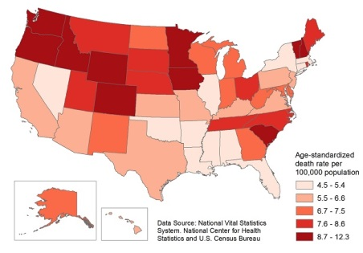
Epidemiology
Age-Standardized Death Rates of Pulmonary Hypertension as Any Cause of Death Among All Ages by State, 2010

Slide 6
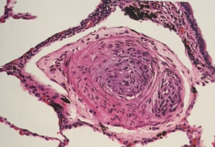
Pathophysiology
Increased resistance in pulmonary circulation➔
  Increased RV pressure (to preserve CO)➔
    Pulmonary vasculature remodels➔
    (medial hypertrophy, eccentric/concentric intimal fibrosis, fibrous webs, plexiform lesions)➔
      Sustained pulmonary hypertension

Slide 7
Features (related to progressive right ventricular dysfunction)
Exertional dyspnea
Fatigue
Angina (RV ischemia)
Near-syncope or Syncope
Peripheral edema

Slide 8
Physical Exam
⬆ JVP
⬇ Carotid impulse
Palpable RV impulse
⬆ P2
+S4 (on right side)
TR (pansystolic murmur)
Peripheral cyanosis/edema (late findings)

Slide 9
Studies
CXR
  Enlarged central pulm arteries
ECHO
  RV & RA enlargement
  TR (jet can estimate RV systolic pressure)
EKG
  RAD and RV hypertrophy
ABG
  Hypoxemia, abnl DLCO, poss Hypercapnea
TSH
  Frequently abnl in pts, should be evaluated periodically

Slide 10
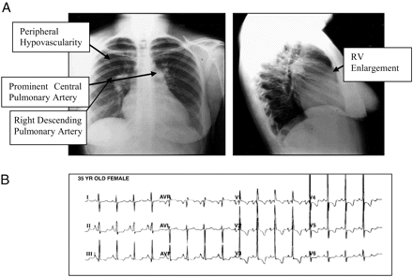

Slide 11
Classification
1. Pulmonary arterial hypertension 1.1 Idiopathic PAH 1.2 Heritable PAH 1.2.1 BMPR2 1.2.2 ALK-1, ENG, SMAD9, CAV1, KCNK3 1.2.3 Unknown 1.3 Drug and toxin induced 1.4 Associated with: 1.4.1 Connective tissue disease 1.4.2 HIV infection 1.4.3 Portal hypertension 1.4.4 Congenital heart diseases 1.4.5 Schistosomiasis1′ Pulmonary veno-occlusive disease and/or pulmonary capillary hemangiomatosis1′′. Persistent pulmonary hypertension of the newborn (PPHN)
2. Pulmonary hypertension due to left heart disease 2.1 Left ventricular systolic dysfunction 2.2 Left ventricular diastolic dysfunction 2.3 Valvular disease 2.4 Congenital/acquired left heart inflow/outflow tract obstruction and congenital cardiomyopathies
3. Pulmonary hypertension due to lung diseases and/or hypoxia 3.1 Chronic obstructive pulmonary disease 3.2 Interstitial lung disease 3.3 Other pulmonary diseases with mixed restrictive and obstructive pattern 3.4 Sleep-disordered breathing 3.5 Alveolar hypoventilation disorders 3.6 Chronic exposure to high altitude 3.7 Developmental lung diseases
4. Chronic thromboembolic pulmonary hypertension (CTEPH)
5. Pulmonary hypertension with unclear multifactorial mechanisms 5.1 Hematologic disorders: chronic hemolytic anemia, myeloproliferative disorders, splenectomy 5.2 Systemic disorders: sarcoidosis, pulmonary histiocytosis, lymphangioleiomyomatosis 5.3 Metabolic disorders: glycogen storage disease, Gaucher disease, thyroid disorders 5.4 Others: tumoral obstruction, fibrosing mediastinitis, chronic renal failure, segmental PH
Table 1 Updated Classification of Pulmonary Hypertension∗∗5th WSPH Nice 2013.
BMPR = bone morphogenic protein receptor type II; CAV1 = caveolin-1; ENG = endoglin.
J Am Coll Cardiol. 2013;62(25_S):. doi:10.1016/j.jacc.2013.10.029

Slide 12
Etiologies
Collagen Vascular Disease (Group 1.4.1)
  CREST & Scleroderma
  SLE, SjÖgren’s, Dermato&Poly-myositis, RA
  IPF common component

Slide 13
Etiologies
Lung Disease & Hypoxia (Group 3)
  Under hypoxic conditions: pulm vasc constricts
    Membrane sulfhydryl redox status changes
      Ca increases and potassium currents are inh (i.e. depolarization of the pulm sm-muscle is inh)
  Pulmonary vasculature remodels
    ⬇NO, ⬆endothelin 1/GF/AGII
  Usually PAP <50mmHg
  Polycythemia common
  COPD – treat with O2
  ILD – treat ILD (PAH tx can worsen ILD)
  OSA – treat as coexisting disease
  Chest Wall Disorders

Slide 14
Etiologies
Thromboembolic Disease (Group 4) ~rare cases of infiltrate other than clot
  Impaired fibrinolytic resolution
  Incomplete recanalization
  Chronic obstruction
  Chronic: May attempt thromboendarterectomy (mortality is 12%, in specialized centers this is decreasing to 1% with >90% efficacy).
  Riociguat
    RCT 443 pts (2.5mgTID) improves symptoms & exercise tolerance, as well as time to worsening
    sGC to NO (may also be antiproliferative)
      Soluble guanylate cyclase (don’t use with PDE-5i)
  Definitely warfarin. No thrombolytics

Slide 15
Etiologies
Other
  Idiopathic (1.1)
    2cases/mil, female 4th/5th decade
  HIV (1.4.2)
    0.5% risk
    traditional PAH treatment, treating underlying disease not helpful
  Portal Hypertension (1.4.3)
    May try traditional treatment
  Congenital Shunts (1.4.4)
    Post-tricuspid (VSD or PDA)
  Sickle Cell (Group 5)
    treat underlying disease
  Sarcoidosis (Group 5)
    if pulm vasc involved, traditional treatment works well

Slide 16
Genetics
Heterozygous BMPR2 mutation (Group 1.2.1)
  75% of familial PAH
    Up to 25% of sporadic PAH
  Encodes vascular proliferation
  Others: BMPR1B and SMAD9 (Group 1.2.2)

Slide 17
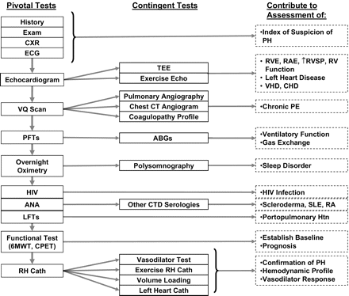

Slide 18
Echo (screening modality only)
ESC Pulmonary Hypertension Review 2015

Slide 19
Cardiac Catheterization
Accurately measures PAP, CO, LV filling pressure
  PAP>25mmHg
  PCWP (or LVEDP) <15mmHg
  PVR >3WU
  Exclude cardiac shunt
Pulmonary vasodilator reactivity testing
  Responder: ⬇PAP >10mmHg (to <40mmHg without a decrease in CO)
  NO, adenosine, or epoprostenol
  Responders can be treated with CCB
  Responders have a favorable prognosis

Slide 20
Risk Assessment
ESC Pulmonary Hypertension Review 2015

Slide 21
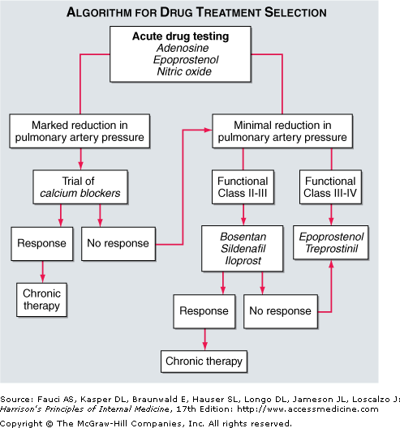
Idiopathic
Drug-induced
Hereditary
HIV (include HAART)
Consideration in CTD
Consider in PoPHTN

Slide 22
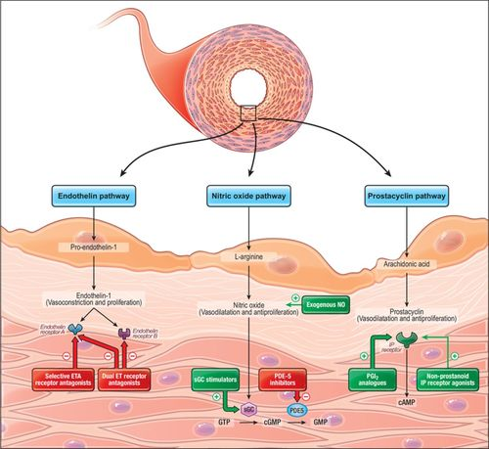
Humbert et al. Advances in Therapeutic Interventions for Patients with Pulmonary Arterial Hypertension. Circulation. 2014

Slide 23
CCB
High Dose
  Nifedipine 240mg/d
  Amlodipine 20mg/d
Decrease Pressures
Improve symptoms
Survival >20yrs
Less than 20% of pts respond to CCB
Not FDA approved
  ‘92 study demonstrated 95%5yr surv in “responders”
Rich S, Kaufmann E, Levy PS. The effect of high doses of calcium-channel blockers
on survival in primary pulmonary hypertension N Engl J Med 1992;327:76-8

Slide 24
Endothelin Receptor Antagonists
Bosentan
  Initiate at 62.5mg BID x 1 month
  125mg BID thereafter
NYHA Class III/IV
  Double-blind, placebo-controlled study of 213 pts
  Improves symptoms & exercise tolerance
Used in scleroderma pts (first study)
Monitor LFTs
Do not use if pt on cyclosporine or glyburide
Rubin LJ, Badesch DB, Barst RJ, et al. Bosentan therapy for pulmonary arterial hypertension N Engl J Med 2002;346:896-903

Slide 25
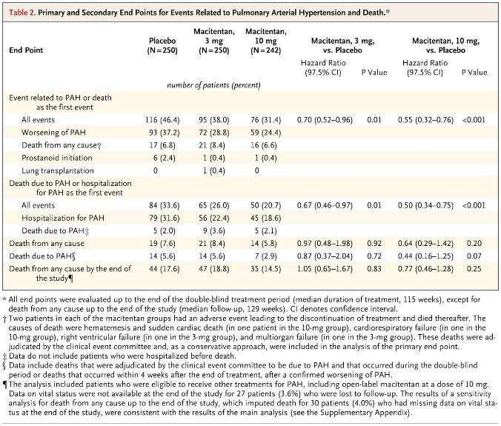
Endothelin Receptor Antagonists
Macitentan
  3 to 10mg
NYHA Class III/IV
  Double-blind, placebo-controlled study of 742 patients
  Improve symptoms & exercise tolerance but also MORTALITY BENEFIT
Pulido et al. Macitentan and morbidity and mortality in pulmonary arterial hypertension. NEJM 2013

Slide 26
Phosphodiesterase-5 Inhibitors
Sildenafil
  20mg TID
NYHA Class II&III
  Randomized, double-blind, placebo-controlled trial of 278 pts
  Improves symptoms and exercise tolerance
Do not use if pt on nitrates
Tadalafil is qd, Vardenafil is BID
Galie N, Ghofrani HA, Torbicki A, et al. Sildenafil citrate therapy for pulmonary arterial hypertension N Engl J Med 2005;353:2148-2157

Slide 27
Prostacyclins vasodilate, Plt Inh, Inh of vascular smooth-muscle growth, +inotropy
Iloprost
  2.5/5mcg/inh q2h
  NYHA III/IV – imp sym & e.t.
Epoprostenol
  CVC infusion pump (?25-40ng/kg/min)
  Half-life 3-5 minutes
  Open-label, randomized tril of 81 pts (results reproducible in two further trials)
  NYHA III/IV – imp sym, e.t., & survival
    Decreases mortality ~70%
Treprostinil
  IV/SQ infusion pump (?50-100 ng/kg/min)
  NYHA II-IV – imp symp, e.t
Barst RJ, Rubin LJ, Long WA, et al. A comparison of continuous intravenous epoprostenol (prostacyclin) with conventional therapy for primary pulmonary hypertension. The Primary Pulmonary Hypertension Study Group. N Engl J Med 1996;334:296-302

Slide 28
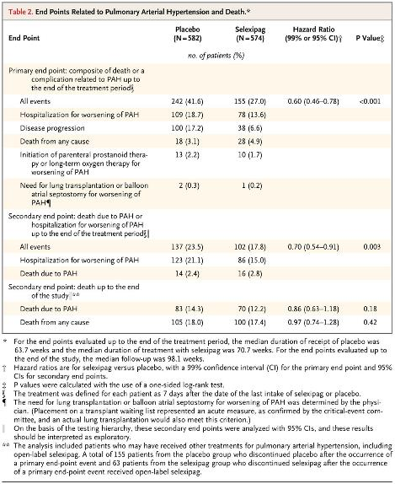
Prostacyclin IP Receptor Agonist
Selexipag
  RCT of 1156 patients
  Maximum dose 1600mcg BID
  39% reduction in composite morbidity/mortality
    I would not state this has a survival benefit
McLaughlin et al. Effect of selexipag on morbidity/mortality in pulmonary arterial hypertension: results of the GRIPHON study. J Am Coll Cardiol 2015

Slide 29
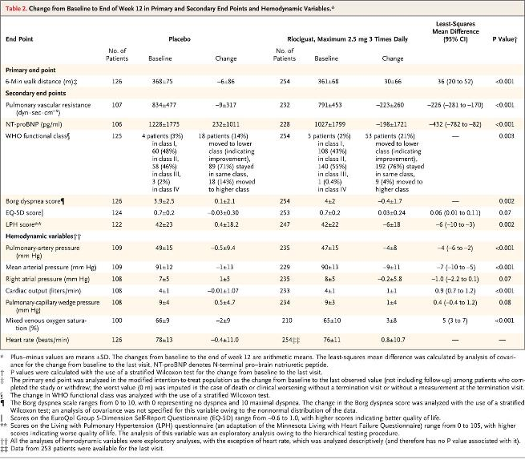
Guanylate Cyclase Stimulator
Riociguat
  RCT of 443 patients
  Maximum dose of 2.5mg TID
  Improved exercise capacity and time to worsening
  Used in inoperable CTEPH
Ghofrani et al. Riociguat for the Treatment of Pulmonary Arterial Hypertension. NEJM 2013

Slide 30
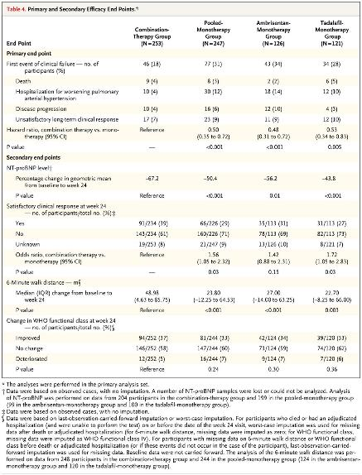
Combination Therapy
Combination Improved
  6MWT, pt satisfaction, and reduction in NTproBNP
Combination Associated With
  Increased peripheral edema, headache, nasal congestion, and anemia
Galie et al. Initial use of Ambrisentan plus Tadalafil in Pulmonary Arterial Hypertension. NEJM 2015

Slide 32
Other Treatment
Early referral for transplant
  PoPH pts must have controlled PAP (<35mmHg)
Cardiopulmonary Rehab
Diuretics
  Decrease RV overload (if pt with TR)
  Decrease edema
Supplemental O2
  If baseline O2 low, supplementation will help alleviate dyspnea and RV ischemia
Iron Supplementation
Anticoagulation
  Warfarin, INR goal 2-3xcontrol
  Avoid in PoPH
Pregnancy is HIGH risk
I also encourage DNR/DNI status

Slide 33
Right Heart Failure in the ICU
Differences between the RV and LV
  Muscle structure is purely longitudinal in contraction
    In addition, the wall is thin
  Sustained ejection
  Coronary blood flow is continuous from the RCA
Poor H., Ventetuolo C. Pulmonary Hypertension in the Intensive Care Unit. Prog Cardiovasc Dis 2012;55:187-198.

Slide 34
Etiologies of Acute RHF in the Setting of Underlying PHTN
Sepsis
  Cytokine-mediated myocardial depression
  ARDs-induced pulmonary vascular dysfunction
  Reduced SVR
Pneumonia
  Shunt inducing increased pulmonary vascular resistance (hypoxic vasoconstriction)
Arrhythmia
Acute PE
Rebound PH (from withdrawal of vasodilators)
Anemia
Positive-pressure ventilation (collapse of RV)

Slide 35
Management of RHF
Treat underlying cause
Fluid management – negative fluid balance with diuretics or hemofiltration
Vasopressors – low dose dopamine or norepinephrine are favored over neosynephrine, epinephrine, and vasopressin
Inotropes – dobutamine and milrinone may augment diuretic effect but can induce hypotension
Pulmonary Vasodilators – inhaled NO will increase CO (20%) and decrease PVR (may need to monitor for methemoglobinemia and to “titrate” off)
Goal O2Sat >90%
Goal Hgb >10
VA-ECMO as a bridge (to thromboendarterectomy or transplant)
Notes:
Optimizing preload in patients with RV failure is complex because both hypovolemia and hypervolemia can have detrimental effects on CO. In most but not all cases of RV failure, however, the dilated and stretched RV is operating on the flat portion of the Frank-Starling curve. Volume expansion in this scenario will not augment CO but will instead exacerbate RV dilatation, increase RV wall tension, worsen tricuspid regurgitation, and intensify leftward interventricular septal bowing, all of which will contribute to low CO and clinical worsening. The goal, therefore, should be to maintain a negative fluid balance with the use of diuretics and, if necessary, hemofiltration, to decrease the volume load on the distended and failing RV without compromising preload. Adjustments in the rate and amount of volume removal should be made according to hemodynamic response.^{11, 60, 61, 62, 63 and 64} In the case of clear intravascular volume depletion, a conservative strategy of holding diuretics, encouraging oral hydration (if applicable), or judiciously using small fluid boluses is preferred.

Slide 36
Transplant Considerations
World Health Organization (WHO) functional class III or IV
Mean right atrial pressure >10 mmHg
Mean pulmonary arterial pressure >50 mmHg
Cardiac index <2.5 L/min per m²
Failure to improve functionally despite medical therapy
Rapidly progressive disease

