Slide 1
Sedation, Analgesia, and agitation in the ICU
Dr H

Slide 2
Objectives
Discuss goals of sedation
Discuss nonpharmacologic interventions for distress
Discuss optimal pharmacologic interventions for distress
Discuss role of continuous infusions and daily interruptions of such

Slide 3
In your free time:
Devlin, et al. Clinical Practice Guidelines for the Prevention and Management of Pain, Agitation/Sedation, Delirium, Immobility, and Sleep Disruption in Adult Patients in the ICU. Critical Care Medicine: September 2018 - Volume 46 - Issue 9 - p e825-e873

Slide 4
distress

Slide 5
Distress
When a patient is intubated and having procedures performed on them, it can cause significant distress
Many patients have a level of delirium present when they are critically ill
It is extremely important to not add to that delirium

Slide 6
Distress
Anxiety
Fear of suffering, Frustration at losing control, Inability to communicate…
Pain
Mostly associated with procedures (ETT cause some discomfort, but not usually pain)
Delirium
“acute and potentially reversible impairment of consciousness and cognitive function that fluctuates in severity”
Dyspnea
Can occur when on mechanical ventilation
Neuromuscular paralysis
All patients who are paralyzed must receive continuous infusions of sedatives and opiates

Slide 7
anxiety

Slide 8
Anxiety
Attempt nonpharmacologic interventions
Reassurance
Frequent communication with the patient
Regular family visits
Establishment of normal sleep cycles
Cognitive-behavioral therapies
music therapy, guided imagery, and relaxation therapy
Proven to:
Decrease time on ventilator, length of ICU stay, length of hospital stay, and incidence of delirium.
No difference in PTSD, QOL, or depression, in survivors approximately two years after randomization

Slide 9
Music therapy
Chalan, et al. JAMA. 2013;309(22):2335-2344
RCT, 12 ICUs
Patient Directed Music (79.8 min/day), Noise Cancelling Headphones (34min/day), or Usual Care.
PDM group had an anxiety score 19.5 points lower than usual care group (P=.003)
PDM group also had less sedation (intensity and frequency) (P=.05, P=.01)

Slide 10
pain

Slide 11
Pain
In the critically ill,
Visual numeric rating scale was reported to be the most feasible and discriminative in terms of evaluating pain
Consider pain when the following occur,
grimacing, writhing, or signs of sympathetic activation
tachycardia, hypertension, tachypnea, diaphoresis, and piloerection
Bolus
Preferred if possible, for example, prior to bed-side procedure (even turning the patient)
Continuous
Consider in patients who have on-going pain (such as s/p ex-lap)

Slide 12
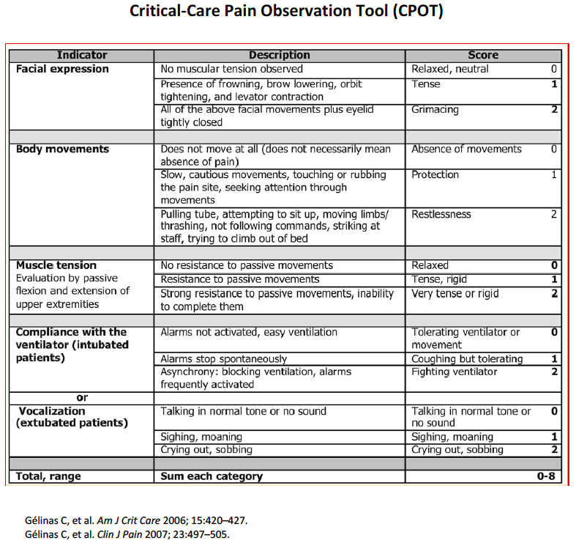
The Behavioral Pain Scale (BPS) and the Critical-Care Pain Observation Tool (CPOT) are the most valid and reliable behavioral pain scales for monitoring pain in medical, postoperative, or trauma (except for brain injury) adult ICU patients who are unable to self-report and in whom motor function is intact and behaviors are observable. (B).

Slide 13
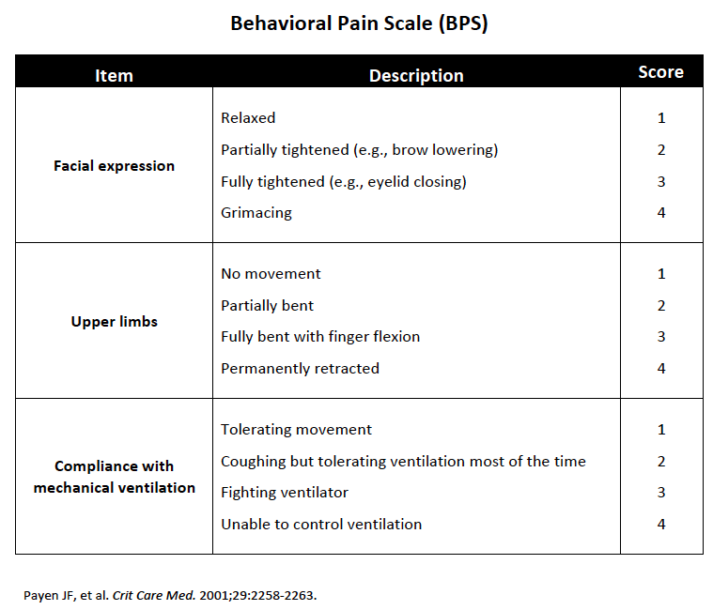
The Behavioral Pain Scale (BPS) and the Critical-Care Pain Observation Tool (CPOT) are the most valid and reliable behavioral pain scales for monitoring pain in medical, postoperative, or trauma (except for brain injury) adult ICU patients who are unable to self-report and in whom motor function is intact and behaviors are observable. (B).

Slide 14
Opiates for Pain
Fentanyl is preferred
Virtually devoid of histamine-releasing properties
Does not cause profound changes in blood pressure
Quickest onset, though shorter half-life
Not affected by renal insufficiency
Usually start with 25mcg

Slide 15
Other Pain Medications
Acetaminophen
NSAIDs
ketorolac! 30mg IVP
Caution in renal insufficiency
Avoid in GI bleeds
Careful in Cardiac Patients
Gabapentin or Carbamazepine
Useful for neuropathic pain (such as in GBS)
Ketamine?
Consider local anesthetics
Regional Nerve Blocks for rib fractures
AVOID meperidine

Slide 16
Adjuncts to pain medications
Massage √
Music √
Relaxation Techniques √
Cold Therapy √
Ice pack applied for 10 minutes applied to chest tube prior to removal
Hypnosis Ø

Slide 17
sedation

Slide 18
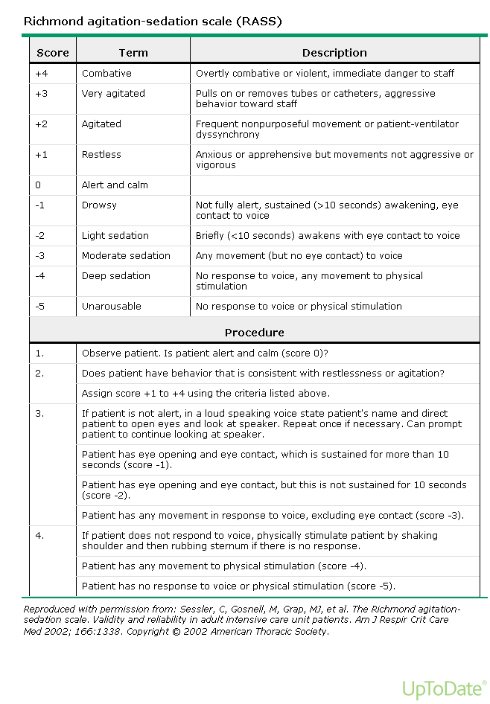
The Richmond Agitation-Sedation Scale (RASS) and Sedation-Agitation Scale (SAS) are the most valid and reliable sedation assessment tools for measuring quality and depth of sedation in adult ICU patients (B).

Slide 19
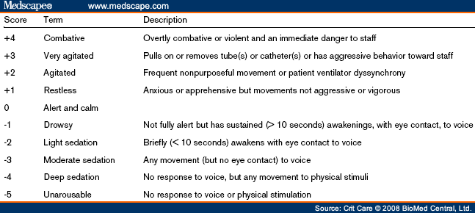
The Richmond Agitation-Sedation Scale (RASS) and Sedation-Agitation Scale (SAS) are the most valid and reliable sedation assessment tools for measuring quality and depth of sedation in adult ICU patients (B).

Slide 20
Sedation
DEPTH OF SEDATION
Maintain light levels of sedation (decreased ICU LOS and decreased duration of mechanical ventilation) unless clinically contraindicated
Use either propofol or dexmedetomidine over benzodiazepines for sedation in critically ill, mechanically ventilated adults
Some evidence that dexmedetomidine is better than propofol given that the patient can interact and thus will have decreased delirium

Slide 21
sedation
Dexmedetomidine
0.2-1.4 mcg/kg/h
Centrally-mediated sympatholytic, sedative, and analgesic effects (selective a-2 adrenergic agonist)
Propofol
5-50mcg/kg/min
Induces hypnosis
Benzodiazepines
Midazolam: 0.02-0.05mg/kg q10-15min
Enhances GABA effects

Slide 22
Dexmedetomidine vs midazolam
Riker et al. JAMA. 2009;301(5):489-499.
Prospective, double-blind, randomized trial conducted in 68 centers in 5 countries including 375 patients
Dexmedetomidine (0.2-1.4 µg/kg per hour [n=244]) or midazolam (0.02-0.1 mg/kg per hour [n=122]) titrated to achieve light sedation (RASS scores between −2 and 1) from enrollment until extubation or 30 days.
Sedation levels & ICU LOS were similar 77.3% vs 75.1% (P=0.18); 5.9 days vs 7.6 days (P=.24).
Decreased delirium 54% of Dex vs 76.6% Mid (P=0.001).
Shorter time on mechanical ventilation 1.9 vs 5.6 days (P=.01),
Increased incidence of bradycardia, but did not require treatment

Slide 23
Dexmedetomidine vs midazolam or propofol
Jakob et al. JAMA. 2012;307(11):1151-1160
Two phase 3 multicenter, randomized, double-blind trials
Sedation with dexmedetomidine, midazolam, or propofol; daily sedation stops; and spontaneous breathing trials.
(midazolam, n=251, vs dexmedetomidine, n=249; propofol, n=247, vs dexmedetomidine, n=251)
Duration of mechanical ventilation
Shorter in Dex than Mid 123 vs 164 hrs (P=0.03)
No difference in Dex vs Prop 97 vs 118 (P=0.24)
Interactive Patient
Increased vs both Mid and Prop (P=0.001 and P=0.001)
ICU LOS and Mortality unchanged
More hypotension and bradycardia
Also found to be superior vs lorazepam Pandharipande et al. JAMA. 2007;298(22):2644-2653

Slide 24
Bolus sedation
StrØm et al. Lancet 2010; 375: 475–80
Bolus sedation allowed for more days without ventilation (mean difference 4·2 days, 95% CI 0·3–8·1; p=0·0191).
Bolus sedation shortened ICU and hospital stay (p=0·0316, p=0·0039)
No difference in accidental extubations, the need for CT or MRI brain scans, or ventilator-associated pneumonia.

Slide 25
Daily interruption of sedation
Kress, et al. N Engl J Med 2000;342:1471-7.
RCT of 128 patients
Duration of mechanical ventilation 4.9 days vs 7.3 days (P=0.004)
ICU LOS 6.4 days vs 9.9 days (P=0.02)
No statistical difference in self-extubation

Slide 26
delirium

Slide 27
DELIRIUM Risk factors
Modifiable
Benzodiazepine use
Blood transfusions
Nonmodifiable
Greater age
Dementia
Prior coma
Pre-ICU emergency surgery or trauma
Higher APACHE/ASA scores

Slide 28
Long-Term Cognitive Impairment after Critical Illness
Pandharipande et al. N Engl J Med 2013; 369:1306-1316
Of the 821 patients enrolled
Delirium developed in 74%
A longer duration of delirium was independently associated with worse global cognition at 3 and 12 months (P=0.001 and P=0.04, respectively) and worse executive function at 3 and 12 months (P=0.004 and P=0.007, respectively).
Use of sedative or analgesic medications was not consistently associated with cognitive impairment at 3 and 12 months.
At 3 months, 40% of the patients had global cognition scores that were 1.5 SD below the population means (similar to scores for patients with moderate traumatic brain injury)
At 3 months, 26% had scores 2 SD below the population means (similar to scores for patients with mild Alzheimer's disease).
At 12 months, 34% had scores similar to moderate TBI and 24% had scores similar to mild Alzheimer’s.

Slide 29
The Confusion Assessment Method for the ICU (CAM-ICU) and the Intensive Care Delirium Screening Checklist (ICDSC) are the most valid and reliable delirium monitoring tools in adult ICU patients (A).

Slide 31
Delirium prevention
We recommend performing early mobilization of adult ICU patients whenever feasible to reduce the incidence and duration of delirium
Avoid benzodiazepines
Ensure nonpharmacologic strategies are in place
Reassurance
Frequent communication with the patient
Regular family visits
Establishment of normal sleep cycles
Cognitive-behavioral therapies
DO NOT ADMINISTER DRUGS TO PREVENT DELIRIUM (only to treat)
e.g. haloperidol, atypical antipsychotics, dexmedetomidine, HMG-CoA, or ketamine

Slide 32
Early mobility
We suggest performing rehabilitation or mobilization in critically ill adults
Rehabilitation is a “set of interventions designed to optimize functioning and reduce disability in individuals with a health condition”
Mobilization is a type of intervention within rehabilitation that facilitates the movement of patients and expends energy with a goal of improving patient outcomes
Vasoactive infusions or mechanical ventilation are not barriers to initiating rehabilitation/mobilization, assuming patients are otherwise stable with the use of these therapies.
Major indicators for stopping rehabilitation/mobilization include development of new cardiovascular, respiratory, or neurologic instability.
Other events, such as a fall or medical device removal/malfunction, and patient distress are also indications for stopping.
Denehy et al. Ten Reasons why ICU patients should be mobilized early. Intensive Care Med 2017; 43:8690

Slide 33
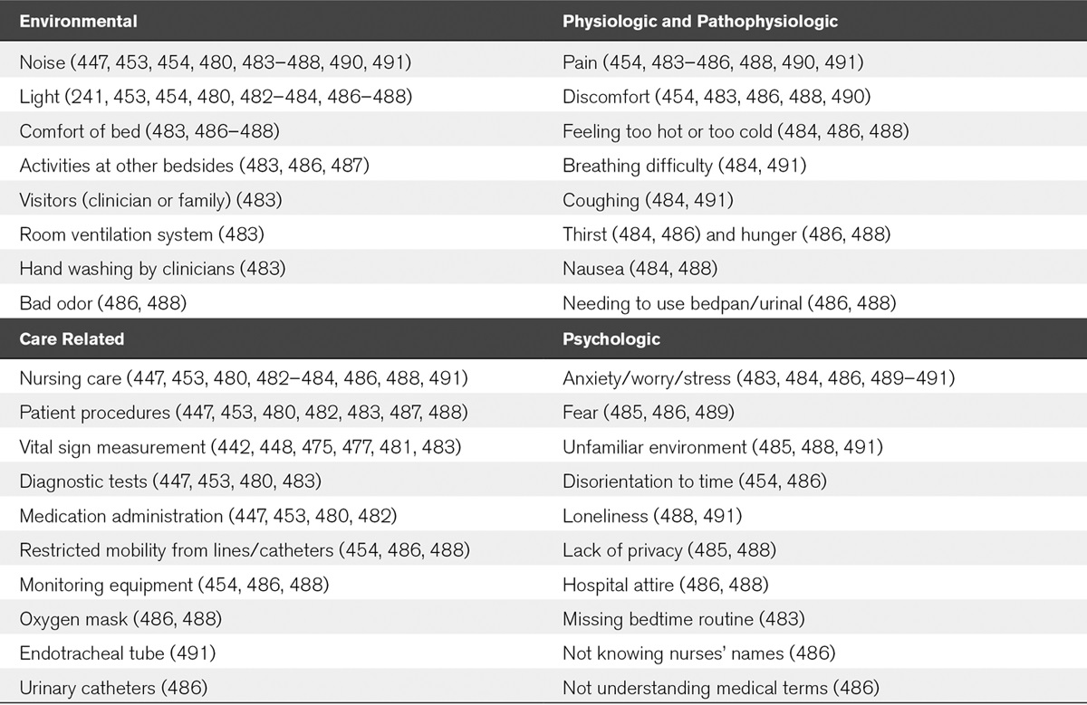
Circadian rhythm reported factors disruptive to sleep

Slide 34
Circadian rhythm
Use assist-control ventilation at night (vs pressure support ventilation) for improving sleep in critically ill adults √
Do not use aromatherapy, acupressure, or music at night to improve sleep in critically ill adults Ø
Use noise and light reduction strategies to improve sleep in critically ill adults √
Do not use propofol to improve sleep in critically ill adults Ø
We make no recommendation regarding the use of melatonin to improve sleep in critically ill adults
Ramelteon has been shown to reduce occurrence of delirium
8mg at 20:00

Slide 35
Atypical antipsychotics
Devlin, et al. Crit Care Med 2010 Vol. 38, No. 2.
Prospective, randomized, double-blind, placebo-controlled study of 36 pts
Patients were randomized to receive quetiapine 50 mg every 12 hrs or placebo.
Quetiapine was increased every 24 hrs (50 to 100 to 150 to 200 mg every 12 hrs) if more than one dose of haloperidol was given in the previous 24 hrs
Quetiapine Arm:
Shorter time to first resolution of delirium 1vs4.5 days(p =0.001)
Reduced duration of delirium 36vs120 hrs (p= 0.006)]
Less agitation 6 vs.36 hrs (p= 0.02) (but more somnolent)
Mortality, ICU LOS, QTc prolongation the same.

Slide 36
PARALYSIS
All patients on paralytics must be on continuous infusions of pain and sedative medications. There are NO exceptions.
Bispectral index (BIS) monitoring appears best suited for sedative titration during deep sedation or neuromuscular blockade

