Slide 1


SEPSIS & THE FUTURE OF EARLY-GOAL-DIRECTED-THERAPY
Dr H

Slide 2
Disclosures
None

Slide 3
Objectives
Epidemiology of Sepsis
Evolving Definition of Sepsis
Diagnostic Evaluation
Fluids
Future of Early-Goal-Directed Therapy
  EARLY IS STILL KEY!

Slide 4
Case T.C.
31 y/o Veteran, presented to an OSH after ATV roll-over
Sustained fractures to:
  Left clavicle (arm sling)
  Left humerus (arm sling)
  Left hip (s/p internal fixation)
  Left tib-fib (s/o ORIF)
Significant soft-tissue damage to right hip
Transferred to TUMC for further surgical care
Initially most pressing issue was pain control for which the patient was ultimately placed on a ketamine drip.

Slide 5
Case T.C.
No significant PMH
No allergies
+Social alcohol, -Tobacco, -Illicits
Married with 2 children
Served in Afghanistan, EODMU (Explosive Ordinance Disposal Mobile Unit)
Currently works in high-level security firm
Parents alive and healthy

Slide 6
Epidemiology
>1.5 million cases/year in the US
  Likely to increase with aging population, increased use of immunosuppressive therapy, transplantation, chemotherapy, and invasive procedures
20-50% mortality
Leading cause of death among critically ill patients in non-coronary intensive care units (~250,000 deaths/year)
Respiratory tract infections are the most common site of infection
Gram-positive infections now approximate Gram-negatives in etiology
Antibiotic resistance is problematic
$27 billion dollars spent in 2014
Novosad, Shannon et al. Vital Signs: Epidemiology of Sepsis Aug 26, 2016 / 65(33);864-869. & https://www.cdc.gov/mmwr/volumes/65/wr/mm6533e1.htm?s_cid=mm6533e1_w

Slide 7
Risk Factors
Age
  >65y/o
Male gender
Black race
?Genetics
  adopted children whose biological parents died due to infectious causes had a 5.8-fold increased risk of dying due to infections
Comorbidities
  COPD
  Cancer (10-fold increase)
  CKD
  Chronic Liver Disease
Sørensen et al. . Genetic and environmental influences on premature death in adult adoptees. N Engl J Med. 1988;318:727–32

Slide 8
Environmental Risk Factors
Colder months
  Increased frequency
  Increased mortality
  Increased respiratory infections
Mayr et al. Epidemiology of Severe Sepsis. Virulence. 2014 Jan 1; 5(1): 4–11.

Slide 9
Microbiology
 | Frequency (%) | OR (95%CI)
Gram-positive | 46.8
Staphylococcus aureus | 20.5 | 0.8 (0.6–1.1)
MRSA | 10.2 | 1.3 (0.9–1.8)
Enterococcus | 10.9 | 1.6 (1.1–2.3)
S. Epidermidis | 10.8 | 0.9 (0.7–1.1)
S. pneumoniae | 4.1 | 0.8 (0.5–1.4)
Gram-negative | 62.2
Pseudomonas species | 19.9 | 1.4 (1.2–1.6)
Escherichia coli | 16.0 | 0.9 (0.7–1.1)
Klebsiella species 12 | 12.7 | 1.0 (0.8–1.2)
Acinetobacter species | 8.8 | 1.5 (1.2–2.0)
Enterobacter | 7.0 | 1.2 (0.9–1.6)
Anaerobes | 4.5 | 0.9 (0.7–1.3)
Fungi
Candida | 17.0 | 1.1 (0.9–1.3)
Aspergillus | 1.4 | 1.7 (1.0–3.1)
Parasites | 0.7 | 1.3 (0.5–3.3)
Other | 3.9 | 0.9 (0.6–1.3)
Mayr et al. Epidemiology of Severe Sepsis. Virulence. 2014 Jan 1; 5(1): 4–11.

Slide 10
Infection Site
Site | Freq M (%) | Freq F (%) | Mortality M (%) | Mortality F (%)
Respiratory | 41.8 | 35.8 | 22 | 22
Bacteremia (unknown source) | 21 | 20 | 33.5 | 34.9
GU | 10.3 | 18 | 8.6 | 7.8
Abdominal | 8.6 | 8.1 | 9.8 | 10.6
Device-related | 1.2 | 1.0 | 9.5 | 9.5
Wound/soft tissue | 9.0 | 7.5 | 9.4 | 9.5
CNS | 0.7 | 0.5 | 17.3 | 17.5
Endocarditis | 0.9 | 0.5 | 23.8 | 28.1
Other | 6.7 | 8.6 | 7.6 | 6.5
Mayr et al. Epidemiology of Severe Sepsis. Virulence. 2014 Jan 1; 5(1): 4–11.

Slide 11
2016 DEFINITION OF SEPSIS
Presence of life-threatening organ dysfunction, which occurs as the result of a dysregulated host response to an infection
Singer et al. The Third International Consensus Definitions for Sepsis and Septic Shock. JAMA. 2016;315(8):801-810.

Slide 12
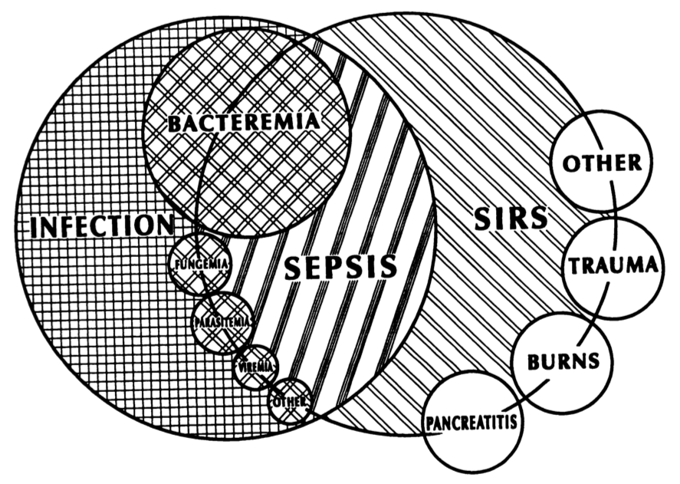
Why Not SIRS?
Nonspecific
Inflammation occurs in many clinical scenarios
  Ischemia
  Trauma
  Toxins
  Heat
  Hypersensitivity
  Radiation
Bone et al. Definitions for sepsis and organ failure and guidelines for the use of innovative therapies in sepsis. Chest. 1992. June; 101(6): 1644-55.

Slide 13

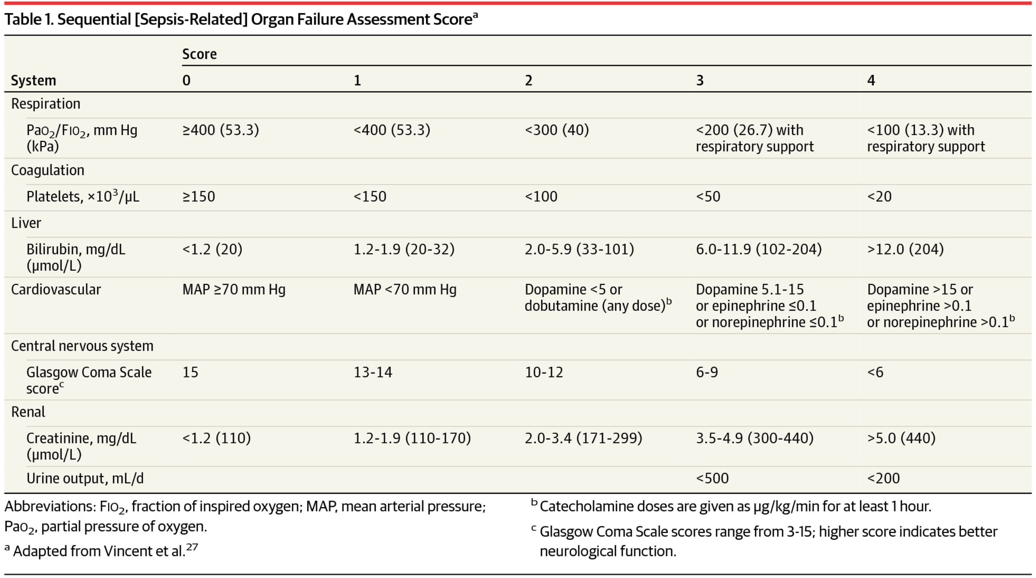
SOFA Score
Sequential (sepsis-related) Organ Failure Assessment
From: The Third International Consensus Definitions for Sepsis and Septic Shock (Sepsis-3)
Date of download: 6/28/2016
Copyright © 2016 American Medical Association. All rights reserved.
JAMA. 2016;315(8):801-810. doi:10.1001/jama.2016.0287

Slide 14
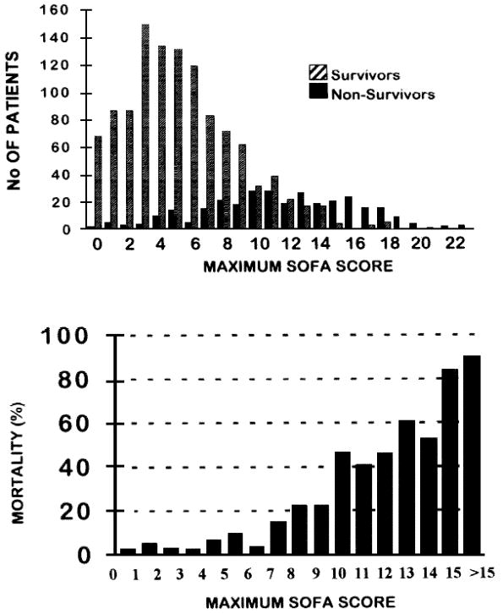

SOFA
Use of the SOFA score to assess the incidence of organ dysfunction/failure in intensive care units: Results of a multicenter, prospective study.
Vincent, Jean-Louis; MD, PhD; de Mendonca, Arnaldo; Cantraine, Francis; Moreno, Rui; Takala, Jukka; MD, PhD; Suter, Peter; MD, FCCM; Sprung, Charles; MD, JD; Colardyn, Francis; Blecher, Serge
Critical Care Medicine. 26(11):1793-1800, November 1998.
Figure 7 . Maximum Sequential Organ Failure Assessment (SOFA) score and mortality. Maximum SOFA score is defined as the highest score achieved by each patient during his/her intensive care unit stay. Top: Distribution of survivors (hatched bars) and nonsurvivors (solid bars) by maximum SOFA score; bottom: mortality rate associated with maximum SOFA score. The mortality rate was >90% in patients whose maximum SOFA score was >15. A cut-off value of a maximum SOFA score of 15 had a sensitivity of 30.7%, a specificity of 98.9%, and a correct classification of 84.2%
© Williams & Wilkins 1998. All Rights Reserved. Published by Lippincott Williams & Wilkins, Inc.
2

Slide 15
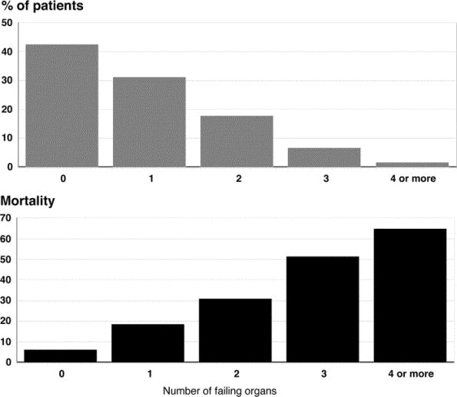
SOFA
Sepsis in European intensive care units: Results of the SOAP study *.
Vincent, Jean-Louis; MD, PhD; Sakr, Yasser; MB, BCh; Sprung, Charles; Ranieri, V; Reinhart, Konrad; MD, PhD; Gerlach, Herwig; MD, PhD; Moreno, Rui; MD, PhD; Carlet, Jean; MD, PhD; Le Gall, Jean-Roger; Payen, Didier
Critical Care Medicine. 34(2):344-353, February 2006.
DOI: 10.1097/01.CCM.0000194725.48928.3A
Figure 3. Frequency of organ failure on admission and corresponding intensive care unit mortality.
© 2006 by the Society of Critical Care Medicine and Lippincott Williams & Wilkins. Published by Lippincott Williams & Wilkins, Inc.
2

Slide 16
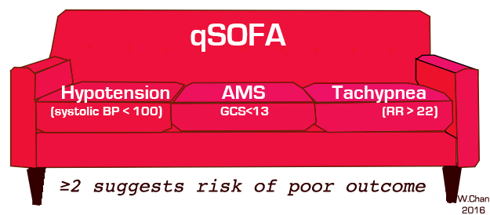
q-SOFA
quickSOFA
Offers predictive validity (AUROC = 0.81; 95% CI, 0.80-0.82) similar to that of the full SOFA score outside the ICU

Slide 17
q-SOFA + SIRS?
4022 citations reviewed, 10 studies met inclusion criteria
Sensitivity of SIRS superior to q-SOFA
Specificity of q-SOFA superior to SIRS
ROC favors q-SOFA as a predictor of inhospital mortality
Serafim et al. A Comparison of the Quick-SOFA and Systemic Inflammatory Response Syndrome Criteria for the Diagnosis of Sepsis of Prediction of Mortality. A Systematic Review and Meta-Analysis. CHEST, 2018; 153(3): 646-655

Slide 18
SIRS, MEWS, q-SOFA
Early Warning Signs
MEWs
Vital Signs
  Temp, HR, BP, RR
AVPU
  Alert, Voice, Pain, Unresponsive
qSOFA
Hypotension (systolic BP <100mmHg)
Altered Mental Status
Tachypnea (RR>22/min)
SIRS
Two or more of:
  Temperature >38°C or <36°C
  Heart rate >90/min
  Respiratory rate >20/min or Paco₂ <32 mm Hg (4.3 kPa)
  White blood cell count >12 000/mm³ or <4000/mm³ or >10% immature bands

Slide 19
Procalcitonin
Prohormone of calcitonin
  Released from multiple sources in response to bacterial infection
  Low circulating level at baseline in normal individuals
  Release not stimulated by viral infection, chronic inflammatory diseases or autoimmune diseases

Slide 20

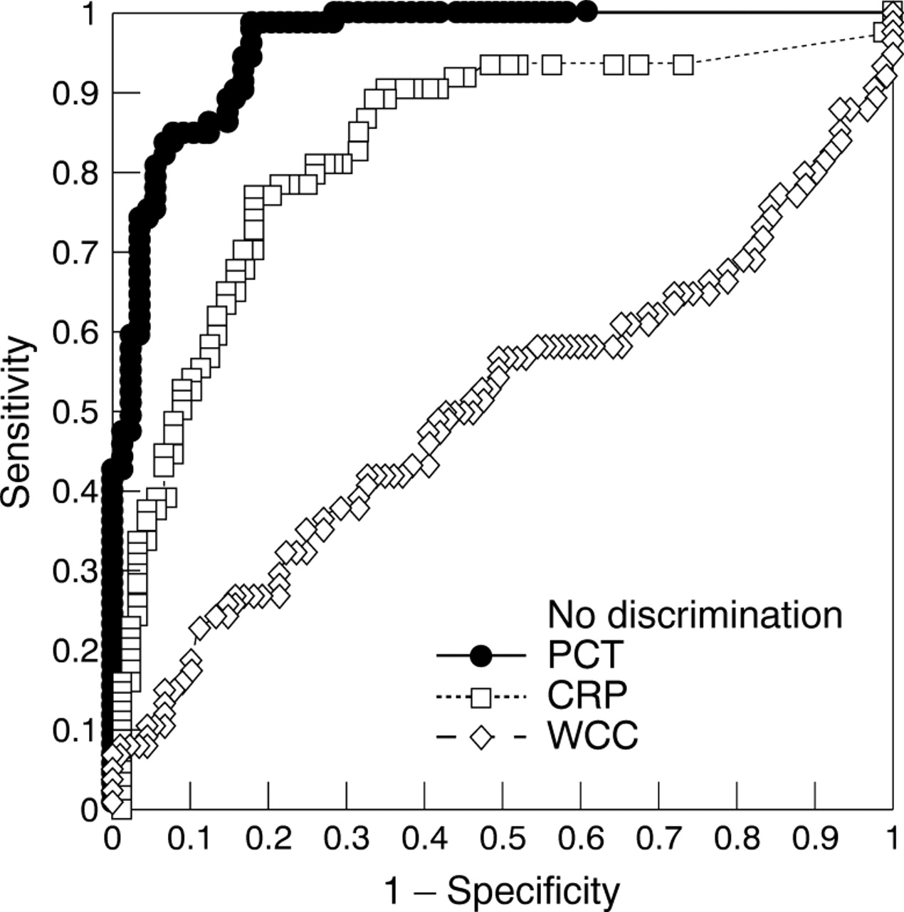
Receiver operating characteristic (ROC) curves comparing admission procalcitonin (PCT), C reactive protein (CRP), and leucocyte count (WCC) for prediction of septic shock (all patients).
Mark Hatherill et al. Arch Dis Child 1999;81:417-421
Copyright © BMJ Publishing Group Ltd & Royal College of Paediatrics and Child Health. All rights reserved.

Slide 21
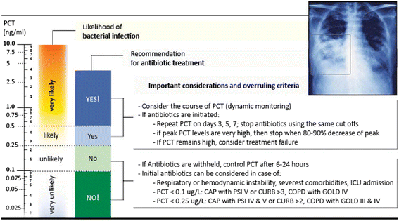
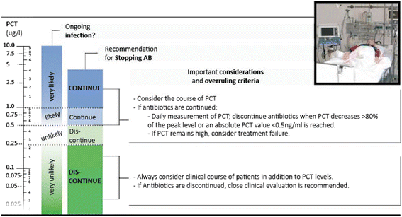
Procalcitonin
PCT Algorithm ed
Pct algorithm icu
Schuetz P et al. Procalcitonin to initiate or discontinue antibiotics in acute respiratory tract infections. Cochrane Database Syst Rev. 2012;9(9), CD007498.
Schuetz P et al. Clinical outcomes associated with procalcitonin algorithms to guide antibiotic therapy in respiratory tract infections. JAMA. 2013;309(7):717–8.

Slide 22
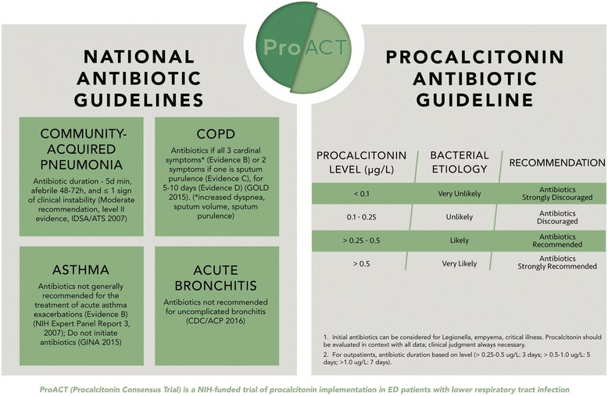
Huang et al. Design and Rationale of the Procalcitonin Antibiotics Consensus Trial (ProACT), a multicenter randomized trial of procalcitonin antibiotic guidance in lower respiratory tract infection. BMC Emerg Med. 2017; 17:25

Slide 23
SEPTIC SHOCK
Patients with infection, who are not hypovolemic, and require vasopressor support to maintain a MAP >65mmHg with a lactate >2mmol/L
Singer et al. The Third International Consensus Definitions for Sepsis and Septic Shock. JAMA. 2016;315(8):801-810.

Slide 24

Sepsis Guidelines
Surviving Sepsis Campaign: International Guidelines for Management of Sepsis and Septic Shock: 2016
Andrew Rhodes, MB BS, MD(Res) (Co-chair)1 ; Laura E. Evans, MD, MSc, FCCM (Co-chair)2 ; Waleed Alhazzani, MD, MSc, FRCPC (methodology chair)3 ; Mitchell M. Levy, MD, MCCM4 ; Massimo Antonelli, MD5
Rhodes, et al. Surviving Sepsis Campaign: International Guidelines for Management of Severe Sepsis and Septic Shock: 2016. Critical Care Medicine 2017;45(3):486-552.

Slide 25
Early Therapy
INITIAL RESUSCITATION:
1. Sepsis and septic shock are medical emergencies, and we recommend that treatment and resuscitation begin immediately (BPS/best practice statement)).
2. We recommend that, in the resuscitation from sepsis induced hypoperfusion, at least 30mL/kg of IV crystalloid fluid be given within the first 3 hours (strong recommendation, low quality of evidence).
3. We recommend that, following initial fluid resuscitation, additional fluids be guided by frequent reassessment of hemodynamic status (BPS).

Slide 26
Early Therapy
HEMODYNAMICS:
4. We recommend further hemodynamic assessment (such as assessing cardiac function) to determine the type of shock if the clinical examination does not lead to a clear diagnosis (BPS).
5. We suggest that dynamic over static variables be used to predict fluid responsiveness, where available (weak recommendation, low quality of evidence).
6. We recommend an initial target mean arterial pressure (MAP) of 65mm Hg in patients with septic shock requiring vasopressors (strong recommendation, moderate quality of evidence).
7. We suggest guiding resuscitation to normalize lactate in patients with elevated lactate levels as a marker of tissue hypoperfusion (weak recommendation, low quality of evidence).

Slide 27
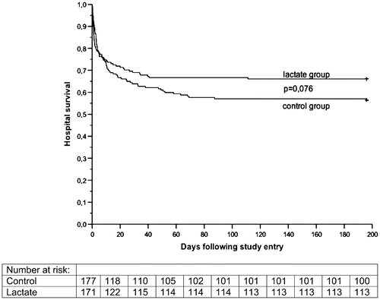
Lactate Clearance
Prognostic Tool*
In the control group 43.5% (77/177) of the patients did not survive to hospital discharge
In the lactate group 33.9% (58/171) died during their hospital stay (P = 0.067)
When adjusted for the predefined risk factors at baseline, the treatment protocol to decrease lactate levels resulted in a significant reduction in the risk of hospital death (hazard ratio [HR], 0.61; confidence interval [CI], 0.43–0.87)
Jansen et al. Early Lactate-Guided Therapy in Intensive Care Unit Patients. AJRCCM. Vol 182. No. 6 (2010), pp 752-761

Slide 28
Early Therapy
ANTIMICROBIAL THERAPY
1. We recommend that administration of IV antimicrobials be initiated as soon as possible after recognition and within one hour for both sepsis and septic shock (strong recommendation, moderate quality of evidence; grade applies to both conditions).
2. We recommend empiric broad-spectrum therapy with one or more antimicrobials for patients presenting with sepsis or septic shock to cover all likely pathogens (including bacterial and potentially fungal or viral coverage) (strong recommendation, moderate quality of evidence).
3. We recommend that empiric antimicrobial therapy be narrowed once pathogen identification and sensitivities are established and/or adequate clinical improvement is noted (BPS).
4. We recommend against sustained systemic antimicrobial prophylaxis in patients with severe inflammatory states of noninfectious origin (e.g., severe pancreatitis, burn injury) (BPS).
5. We recommend that dosing strategies of antimicrobials be optimized based on accepted pharmacokinetic/pharmacodynamic principles and specific drug properties in patients with sepsis or septic shock (BPS).

Slide 29
Early Therapy
6. We suggest empiric combination therapy (using at least two antibiotics of different antimicrobial classes) aimed at the most likely bacterial pathogen(s) for the initial management of septic shock (weak recommendation, low quality of evidence).
7. We suggest that combination therapy not be routinely used for ongoing treatment of most other serious infections, including bacteremia and sepsis without shock (weak recommendation, low quality of evidence). Remarks: This does not preclude the use of multidrug therapy to broaden antimicrobial activity.
8. We recommend against combination therapy for the routine treatment of neutropenic sepsis/bacteremia (strong recommendation, moderate quality of evidence). Remarks: This does not preclude the use of multidrug therapy to broaden antimicrobial activity.
9. If combination therapy is initially used for septic shock, we recommend de-escalation with discontinuation of combination therapy within the first few days in response to clinical improvement and/or evidence of infection resolution. This applies to both targeted (for culture-positive infections) and empiric (for culture-negative infections) combination therapy (BPS).

Slide 30
Early Therapy
10. We suggest that an antimicrobial treatment duration of 7 to 10 days is adequate for most serious infections associated with sepsis and septic shock (weak recommendation, low quality of evidence).
11. We suggest that longer courses are appropriate in patients who have a slow clinical response, undrainable foci of infection, bacteremia with S aureus, some fungal and viral infections, or immunologic deficiencies, including neutropenia. (weak recommendation, low quality of evidence).
12. We suggest that shorter courses are appropriate in some patients, particularly those with rapid clinical resolution following effective source control of intra-abdominal or urinary sepsis and those with anatomically uncomplicated pyelonephritis (weak recommendation, low quality of evidence).
13. We recommend daily assessment for de-escalation of antimicrobial therapy in patients with sepsis and septic shock (BPS).
14. We suggest that measurement of procalcitonin levels can be used to support shortening the duration of antimicrobial therapy in sepsis patients (weak recommendation, low quality of evidence).
15. We suggest that procalcitonin levels can be used to support the discontinuation of empiric antibiotics in patients who initially appeared to have sepsis, but subsequently have limited clinical evidence of infection (weak recommendation, low quality of evidence).

Slide 31
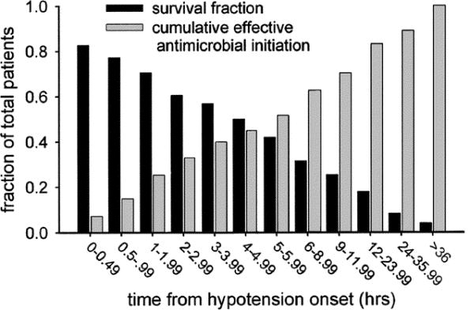
Early Antibiotics
Duration of hypotension before initiation of effective antimicrobial therapy is the critical determinant of survival in human septic shock *.
Kumar, Anand; Roberts, Daniel; Wood, Kenneth; Light, Bruce; Parrillo, Joseph; Sharma, Satendra; Suppes, Robert; Feinstein, Daniel; Zanotti, Sergio; Taiberg, Leo; Gurka, David; Kumar, Aseem; Cheang, Mary
Critical Care Medicine. 34(6):1589-1596, June 2006.
DOI: 10.1097/01.CCM.0000217961.75225.E9
Figure 1. Cumulative effective antimicrobial initiation following onset of septic shock-associated hypotension and associated survival. The x-axis represents time (hrs) following first documentation of septic shock-associated hypotension. Black bars represent the fraction of patients surviving to hospital discharge for effective therapy initiated within the given time interval. The gray bars represent the cumulative fraction of patients having received effective antimicrobials at any given time point.
© 2006 by the Society of Critical Care Medicine and Lippincott Williams & Wilkins. Published by Lippincott Williams & Wilkins, Inc.

Slide 32
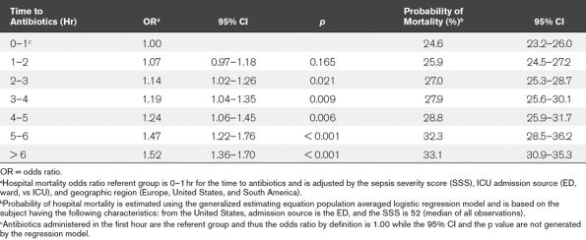
Early Antibiotics
Empiric Antibiotic Treatment Reduces Mortality in Severe Sepsis and Septic Shock From the First Hour: Results From a Guideline-Based Performance Improvement Program*.
Ferrer, Ricard; MD, PhD; Martin-Loeches, Ignacio; MD, PhD; Phillips, Gary; Osborn, Tiffany; MD, MPH; Townsend, Sean; Dellinger, R; Phillip MD, FCCP; Artigas, Antonio; MD, PhD; Schorr, Christa; RN, MSN; Levy, Mitchell; MD, FCCP
Critical Care Medicine. 42(8):1749-1755, August 2014.
DOI: 10.1097/CCM.0000000000000330
© 2014 by the Society of Critical Care Medicine and Lippincott Williams & Wilkins. Published by Lippincott Williams & Wilkins, Inc.

Slide 33
Case
Patient develops fever to 102 (no change in hemodynamics)
Broad-spectrum abx started (Vancomycin, Zosyn)
Blood cultures negative
Patient with PICC line, site clean/dry/intact
Patient with ORIF, site clean/dry/intact
Patient without indwelling foley catheter, UA unremarkable
Right leg wound with healthy granulation tissue and being debrided weekly

Slide 34
Early Therapy
1. We recommend that a specific anatomic diagnosis of infection requiring emergent source control be identified or excluded as rapidly as possible in patients with sepsis or septic shock, and that any required source control intervention be implemented as soon as medically and logistically practical after the diagnosis is made (BPS).
2. We recommend prompt removal of intravascular access devices that are a possible source of sepsis or septic shock after other vascular access has been established (BPS).

Slide 35
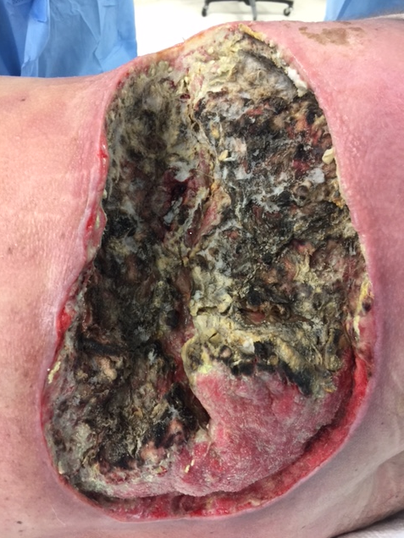
Early Source Control / Case
On day three of fever, right leg wound in OR found to be necrotic
Cultures identified Mucor

Slide 36
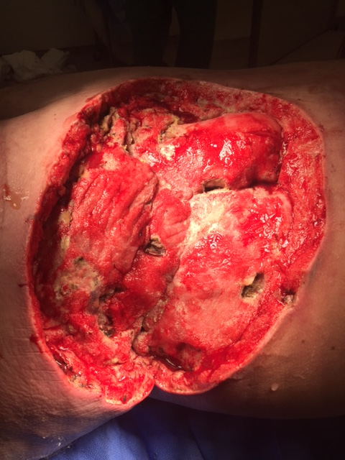
Early Source Control / Case
Patient’s wound aggressively debrided
Patient started on amphotericin
Discussion with orthopedics to remove indwelling hardware

Slide 37
Fluids
1. We recommend that a fluid challenge technique be applied where fluid administration is continued as long as hemodynamic factors continue to improve (BPS).
2. We recommend crystalloids as the fluid of choice for initial resuscitation and subsequent intravascular volume replacement in patients with sepsis and septic shock (strong recommendation, moderate quality of evidence).
3. We suggest using either balanced crystalloids or saline for fluid resuscitation of patients with sepsis or septic shock (weak recommendation, low quality of evidence).
4. We suggest using albumin in addition to crystalloids for initial resuscitation and subsequent intravascular volume replacement in patients with sepsis and septic shock when patients require substantial amounts of crystalloids (weak recommendation, low quality of evidence).
5. We recommend against using hydroxyethyl starches (HESs) for intravascular volume replacement in patients with sepsis or septic shock (strong recommendation, high quality of evidence).
6. We suggest using crystalloids over gelatins when resuscitating patients with sepsis or septic shock (weak recommendation, low quality of evidence).

Slide 38
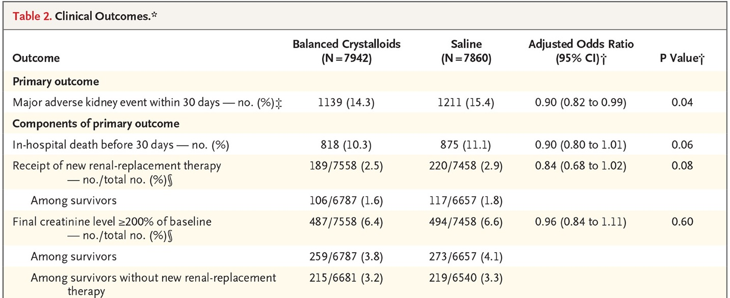
TYPE OF FLUID
Cluster-Randomized, Multiple-Crossover Trial of 5 ICUs (15,802 patients)
0.9% NS vs LR or Plasma-Lyte
Semlar, et all. Balanced Crystalloids versus Saline in Critically Ill Adults. NEJM 2018; 378:829-839

Slide 39
Fluid Responsiveness
Guyton: “we would be arguing in circles to say which is more important, venous return or cardiac output”
  Interdependent and essentially equal
CVP has an ROC curve 0.56 (the likelihood that CVP can accurately predict fluid responsiveness is no better than flipping a coin)
  IVC evaluation is the same system
Evaluate serial assessments of vital signs
Consider dynamic evaluations of fluid responsiveness
  Non-invasive cardiac output monitors
  Stroke volume variation
Marik et al. Predicting Fluid Responsiveness: A Systematic Review and Tale of Seven Mares. Chest. 2008; 134: 172-178
Marik et al. Does the Central Venous Pressure Predict Fluid Responsiveness? An Updated Meta-Analysis and a Plea for Some Common Sense. Crit Care Med. 2013 Jul;41(7):1774-81

Slide 40
Fluid Responsiveness
Arterial Circulation - i.e. the distributive system
Starling Mechanism: accumulation of ventricular excess stimulates larger stroke volume
Ohm’s Law:
  V=I˙R (potential = flow x resistance)
  MAP = CO ˙ PR (where CO = SV ˙ HR)

Slide 41
Fluid Responsiveness
Venous Circulation - i.e. collecting system
Difficult to measure, we have no “venous-returnometer”
Guyton Experiments:
  Capacitance & Volume are the important variables on the venous side (not resistance and flow)
  V=Q/C (voltage = charge/capacitance)
  Pressure = Volume/Fluid capacitance
  CVP = Blood Volume/Venous capacitance

Slide 42
Fluid Responsiveness
HEMODYNAMICS IN SEPSIS
Decrease in Venous Excess
  Increased capillary leak
  Decreased vasomotor tone
Altered Circulating Blood Volume
  Increased capacitance
Cardiac Performance
  Impaired by inflammatory cytokines

Slide 43
Static Measurements
Pulmonary Artery Occlusion Pressure
  Measures left ventricular end-diastolic pressure (not volume, thus not preload)
Central Venous Pressure
  Approximation of RAP
Right Ventricular End-Diastolic Volume
  Validation studies have not shown this to be an indicator of volume responsiveness
Left Ventricular End-Diastolic Area
  Again, validation studies have not shown this to be an indicator of volume responsiveness
Inferior Vena-Caval Diameter
  Indirect measurement of CVP (and thus RAP)

Slide 44
DYNAMIC EVALUATIONS
Pulse Pressure Variation
  Derived from arterial waveform (arterial catheter readings of pulse pressures)
Stroke Volume Variation
  Derived from pulse contour analysis
Based Upon Hemodynamic Effects of Mechanical Ventilation
PPV & SVV predicted fluid responsiveness
  ROC 0.94 & 0.85 (respectively)
  Maintained in pt’s with poor LV function
  Threshold determined as 12&13% (respectively)
  Pt must be intubated (use with VT of 8mL/kg
  Pt cannot have an arrhythmia

Slide 45
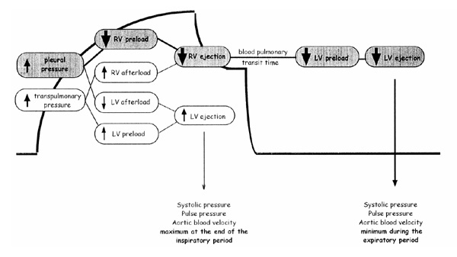
Preload Dependence

Slide 46
DYNAMIC EVALUTIONS
Transpulmonary Thermodilution
  PiCCO (Pulse Contour Continuous Cardiac Output) System follows thermal indicator
  Injected into central vein and changes are detected in a central artery
  These tracings are calibrated and analyze systolic arterial pressure divided by aortic impedance to give CO
  Also done with lithium instead of thermal indicator

Slide 47
DYNAMIC EVALUATIONS
Non-invasive Cardiac Output Monitoring
NICOM device (Cheetah Medical, Portland, OR)
  Measures the bioreactance or the phase shift in voltage across the thorax.
    Resistor (R) and a capacitor (C), which together create the thoracic impedance (Zo). The values of R and C determine the 2 components of impedance, which are (1) amplitude (a), the magnitude of the impedance (measured in ohms); and (2) phase (phi), the direction of the impedance (measured in degrees).
  The pulsatile ejection of blood from the heart modifies the value of R and the value of C, leading to instantaneous changes in the amplitude and the phase of Zo. Phase shifts can occur only because of pulsatile flow.
  Majority of thoracic pulsatile flow stems from the aorta. Therefore, the NICOM signal is correlated almost wholly with aortic flow.
    Machines can run PLR
      ~300mL blood bolus, >10% change in CO is considered fluid responsive

Slide 48
Vasoactive Medications
1. We recommend norepinephrine as the first-choice vasopressor (strong recommendation, moderate quality of evidence).
2. We suggest adding either vasopressin (up to 0.03 U/min) (weak recommendation, moderate quality of evidence) or epinephrine (weak recommendation, low quality of evidence) to norepinephrine with the intent of raising MAP to target, or adding vasopressin (up to 0.03 U/min) (weak recommendation, moderate quality of evidence) to decrease norepinephrine dosage.
3. We suggest using dopamine as an alternative vasopressor agent to norepinephrine only in highly selected patients (e.g., patients with low risk of tachyarrhythmias and absolute or relative bradycardia) (weak recommendation, low quality of evidence).
4. We recommend against using low-dose dopamine for renal protection (strong recommendation, high quality of evidence).
5. We suggest using dobutamine in patients who show evidence of persistent hypoperfusion despite adequate fluid loading and the use of vasopressor agents (weak recommendation, low quality of evidence).
6. We suggest that all patients requiring vasopressors have an arterial catheter placed as soon as practical if resources are available (weak recommendation, very low quality of evidence).

Slide 49
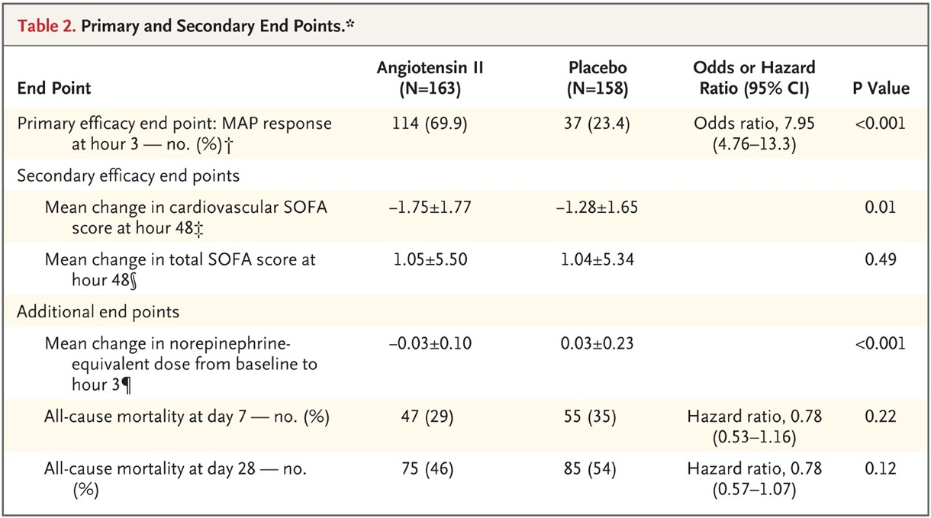
NEW PRESSOR
321 patients: 163 angiotensin II; 158 placebo
Randomly assigned to patients in vasodilatory shock already on >0.2μg/kg of norepinephrine
? Increase in blood clots
Khanna et al. Angiotensin II for the Treatment of Vasodilatory Shock. NEJM 2017; 377:419-430

Slide 50
Corticosteroids
1. We suggest against using IV hydrocortisone to treat septic shock patients if adequate fluid resuscitation and vasopressor therapy are able to restore hemodynamic stability. If this is not achievable, we suggest IV hydrocortisone at a dose of 200mg per day (weak recommendation, low quality of evidence).

Slide 51
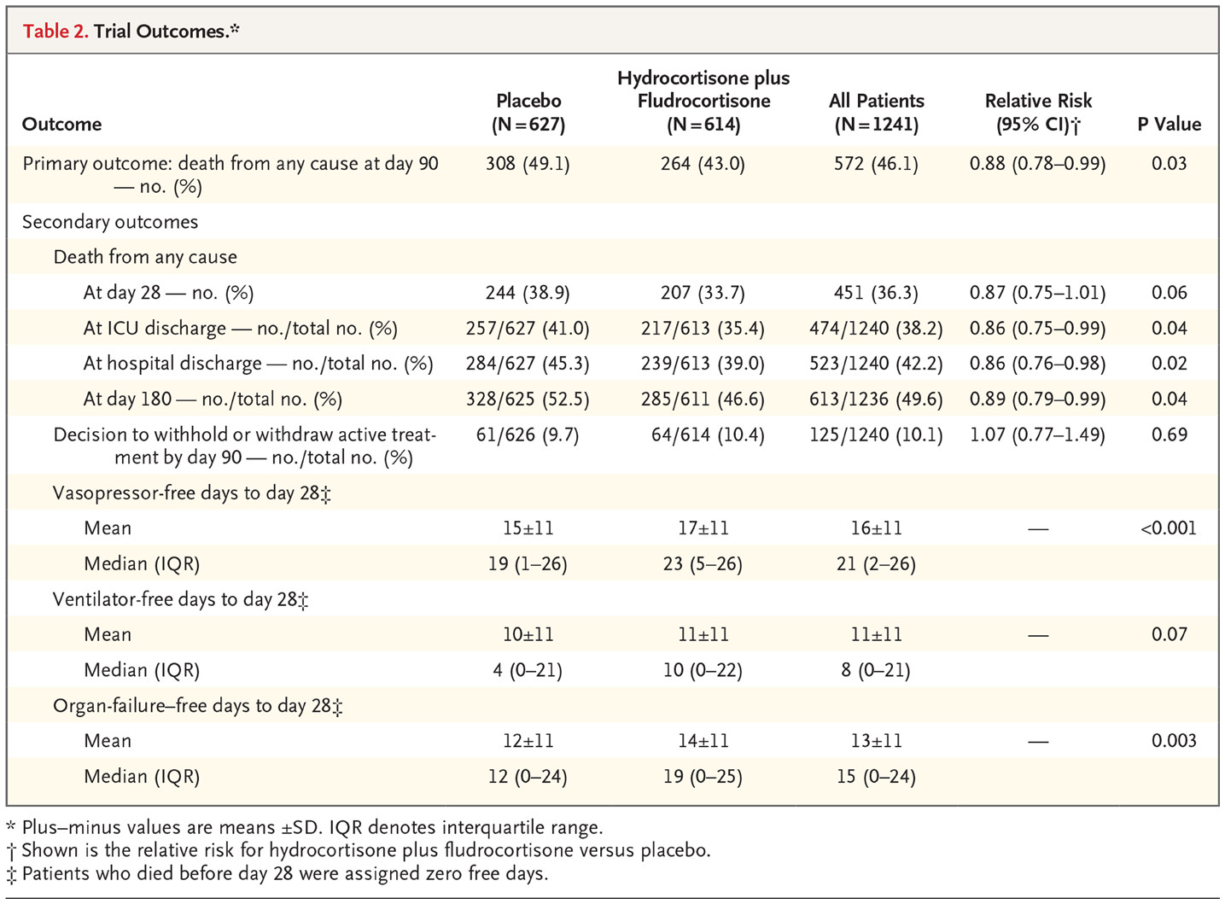
NEW STEROID COMBINATION
1241 patients
  hydrocortisone-plus-fludrocortisone vs
    50mgq6h & 50μg daily
  drotrecogin alfa (activated) vs
  hydrocortisone-plus-fludrocortisone-plus-drotercogin alfa (activated) vs
  Placebo
Increase in hyperglycemia (no increased risk for GI bleed nor super-infection)
Annane et al. Hydrocortisone plus Fludrocortisone for Adults with Septic Shock. NEJM 2018; 378: 809-818

Slide 52
Blood Products
1. We recommend that RBC transfusion occur only when hemoglobin concentration decreases to < 7.0 g/dL in adults in the absence of extenuating circumstances, such as myocardial ischemia, severe hypoxemia, or acute hemorrhage (strong recommendation, high quality of evidence).
2. We recommend against the use of erythropoietin for treatment of anemia associated with sepsis (strong recommendation, moderate quality of evidence).
3. We suggest against the use of fresh frozen plasma to correct clotting abnormalities in the absence of bleeding or planned invasive procedures (weak recommendation, very low quality of evidence).
4. We suggest prophylactic platelet transfusion when counts are < 10,000/mm3 (10×109 /L) in the absence of apparent bleeding and when counts are < 20,000/mm3 (20×109 /L) if the patient has a significant risk of bleeding. Higher platelet counts (≥ 50,000/mm3 [50×109 /L]) are advised for active bleeding, surgery, or invasive procedures (weak recommendation, very low quality of evidence).

Slide 53
Mechanical Ventilation
1. We recommend using a target tidal volume of 6mL/kg predicted body weight (PBW) compared with 12mL/kg in adult patients with sepsis-induced ARDS (strong recommendation, high quality of evidence).
2. We recommend using an upper limit goal for plateau pressures of 30 cm H2 O over higher plateau pressures in adult patients with sepsis-induced severe ARDS (strong recommendation, moderate quality of evidence).
3. We suggest using higher PEEP over lower PEEP in adult patients with sepsis-induced moderate to severe ARDS (weak recommendation, moderate quality of evidence).
9. We recommend a conservative fluid strategy for patients with established sepsis-induced ARDS who do not have evidence of tissue hypoperfusion (strong recommendation, moderate quality of evidence).
13. We recommend that mechanically ventilated sepsis patients be maintained with the head of the bed elevated between 30 and 45degrees to limit aspiration risk and to prevent the development of VAP (strong recommendation, low quality of evidence).

Slide 54
Sedation and Analgesia
1. We recommend that continuous or intermittent sedation be minimized in mechanically ventilated sepsis patients, targeting specific titration end points (BPS).

Slide 55
Glucose Control
1. We recommend a protocolized approach to blood glucose management in ICU patients with sepsis, commencing insulin dosing when two consecutive blood glucose levels are > 180mg/dL. This approach should target an upper blood glucose level ≤ 180mg/dL rather than an upper target blood glucose level ≤ 110mg/dL (strong recommendation, high quality of evidence).
2. We recommend that blood glucose values be monitored every 1 to 2 hours until glucose values and insulin infusion rates are stable, then every 4 hours thereafter in patients receiving insulin infusions (BPS).
3. We recommend that glucose levels obtained with point-of-care testing of capillary blood be interpreted with caution because such measurements may not accurately estimate arterial blood or plasma glucose values (BPS).
4. We suggest the use of arterial blood rather than capillary blood for point-of-care testing using glucose meters if patients have arterial catheters (weak recommendation, low quality of evidence).

Slide 56
Renal Replacement Therapy
1. We suggest that either continuous RRT (CRRT) or intermittent RRT be used in patients with sepsis and acute kidney injury (weak recommendation, moderate quality of evidence).
2. We suggest using CRRT to facilitate management of fluid balance in hemodynamically unstable septic patients (weak recommendation, very low quality of evidence).
3. We suggest against the use of RRT in patients with sepsis and acute kidney injury for increase in creatinine or oliguria without other definitive indications for dialysis (weak recommendation, low quality of evidence).

Slide 57
Bicarbonate Therapy
1. We suggest against the use of sodium bicarbonate therapy to improve hemodynamics or to reduce vasopressor requirements in patients with hypoperfusion-induced lactic acidemia with pH ≥ 7.15 (weak recommendation, moderate quality of evidence).

Slide 58
Venous Thromboembolism Prophylaxis
1. We recommend pharmacologic prophylaxis (unfractionated heparin [UFH] or low-molecular-weight heparin [LMWH]) against venous thromboembolism (VTE) in the absence of contraindications to the use of these agents (strong recommendation, moderate quality of evidence).
2. We recommend LMWH rather than UFH for VTE prophylaxis in the absence of contraindications to the use of LMWH (strong recommendation, moderate quality of evidence).
3. We suggest combination pharmacologic VTE prophylaxis and mechanical prophylaxis, whenever possible (weak recommendation, low quality of evidence).
4. We suggest mechanical VTE prophylaxis when pharmacologic VTE is contraindicated (weak recommendation, low quality of evidence).

Slide 59
Stress Ulcer Prophylaxis
1. We recommend that stress ulcer prophylaxis be given to patients with sepsis or septic shock who have risk factors for gastrointestinal (GI) bleeding (strong recommendation, low quality of evidence).
2. We suggest using either proton pump inhibitors (PPIs) or histamine-2 receptor antagonists (H2RAs) when stress ulcer prophylaxis is indicated (weak recommendation, low quality of evidence).
3. We recommend against stress ulcer prophylaxis in patients without risk factors for GI bleeding (BPS).

Slide 60
Nutrition
1. We recommend against the administration of early parenteral nutrition alone or parenteral nutrition in combination with enteral feedings (but rather initiate early enteral nutrition) in critically ill patients with sepsis or septic shock who can be fed enterally (strong recommendation, moderate quality of evidence).
2. We recommend against the administration of parenteral nutrition alone or in combination with enteral feeds (but rather to initiate IV glucose and advance enteral feeds as tolerated) over the first 7 days in critically ill patients with sepsis or septic shock for whom early enteral feeding is not feasible (strong recommendation, moderate quality of evidence).
3. We suggest the early initiation of enteral feeding rather than a complete fast or only IV glucose in critically ill patients with sepsis or septic shock who can be fed enterally (weak recommendation, low quality of evidence).
4. We suggest either early trophic/hypocaloric or early full enteral feeding in critically ill patients with sepsis or septic shock; if trophic/hypocaloric feeding is the initial strategy, then feeds should be advanced according to patient tolerance (weak recommendation, moderate quality of evidence).
5. We recommend against the use of omega-3 fatty acids as an immune supplement in critically ill patients with sepsis or septic shock (strong recommendation, low quality of evidence).
6. We suggest against routinely monitoring gastric residual volumes (GRVs) in critically ill patients with sepsis or septic shock (weak recommendation, low quality of evidence). However, we suggest measurement of gastric residuals in patients with feeding intolerance or who are considered to be at high risk of aspiration (weak recommendation, very low quality of evidence).
7. We suggest the use of prokinetic agents in critically ill patients with sepsis or septic shock and feeding intolerance (weak recommendation, low quality of evidence).
8. We suggest placement of post-pyloric feeding tubes in critically ill patients with sepsis or septic shock with feeding intolerance or who are considered to be at high risk of aspiration (weak recommendation, low quality of evidence).

Slide 61
Case
Patient’s Mucor controlled successfully (early and aggressive debridement is key)
Eventually transitioned to oral posaconazole and sent to rehab

Slide 62
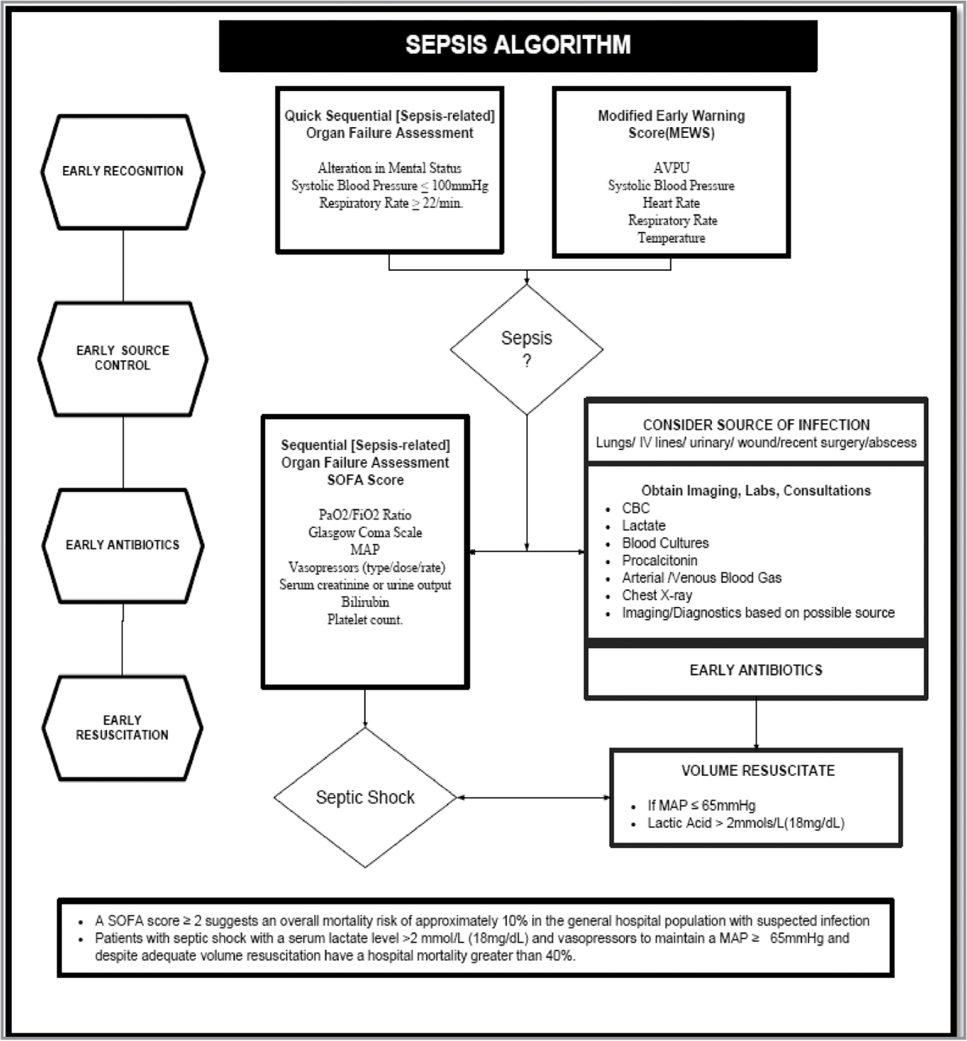
Modified Early Goal Directed Therapy

Slide 63
Sepsis Take-Home Points
Because our understanding of sepsis is increasing, the definitions will continue to change
Organ dysfunction should prompt health care providers to intervene quickly
Patients who meet SIRs criteria should not be ignored
EARLY THERAPY IS STILL THE KEY!
Early Antibiotics
  Every hour delay in abx is associated with an increase in mortality
Fluid Resuscitation
  Don’t add vasopressors to an empty system

