Slide 1
Updates in
Postcardiac Arrest Targeted Temperature Management
DR H

Slide 2
Objectives
Review of Targeted Temperature Management
  Initial Studies
  Review of Old Protocol
  Updated Protocol
General Guidelines in Neuroprognostication
  Initial Studies
  Updated Evaluations in TTM
  Hypothesized Evaluations in Modified TTM
Notes:
established predictors of neurologic outcome in comatose survivors of cardiac arrest would be confounded by the protective effects of mild hypothermia and/or by sedative and paralytic agents used during the hypothermia protocols.

Slide 3
TTM: Indications
Post-Cardiac Arrest Patients
  OHCA with ROSC
    Shockable Rhythm
    Studies date back to 2002
    Favorable CPC in 49-55% (as opposed to 29-39%)
  OHCA with ROSC
    Nonshockable Rhythm
    HYPERION (25 ICUs in France, 581 patients, 33°)
    10.2% vs 5.7% with CPC Score of 1 or 2
Lascarrou, etal. Targeted Temperature Management for Cardiac Arrest with Nonshockable Rhythm. N Engl J Med 2019; 381:2327-2337

Slide 4
TTM: Epidemiology
Incidence of out-of-hospital cardiac arrest ~0.10% (375,000 persons/year)
15-40% have ROSC
7-30% are discharged with normal neurological function

Slide 5
TTM: Mechanistic Theories
Cooling Likely:
  Suppresses Chemical Cascades
    Generation of free radicals (and other mediators such as glutamate) leads to multifocal brain damage
  Preserves the blood brain barrier
  Protects ATP stores
  Decreases ICP & Increases cerebral blood flow

Slide 6
TTM: Initial Studies
NEJM 346:549-556 2002
Mild Therapeutic Hypothermia To Improve The Neurologic Outcome After Cardiac Arrest
275 patients randomized to normo- vs hypo- thermia
Favorable Neurologic Outcome: 39 vs 55 % (NNT 6)
Death at 6 months 14% lower in treatment group (NNT 7)
No statistically significant adverse events

Slide 7
TTM: Initial Studies
NEJM 346:557-563 2002
Treatment of Comatose Survivors of Out-of-Hospital Cardiac Arrest with Induced Hypothermia
77 patients randomized to normo- vs hypo- thermia
Favorable Neurologic Outcome: 29 vs 49 %

Slide 8
Cerebral Performance Categories
1. good cerebral performance (full function)
2. moderate cerebral disability (disabled but independent)
3. severe cerebral disability (conscious but disabled & dependent)
4. coma/vegetative state (unconscious)
5. brain death or death

Slide 9
Inclusion Criteria
(still hold true)
Age 18 or older
Cardiac arrest (VT/VF) resuscitated with return of spontaneous circulation within 1 hour of treatment.
Glasgow Coma Score<8 after return of spontaneous circulation
Hemodynamically stable patients, systolic BP above 90 with or without fluid and or pressors
Women of child-bearing age must have negative pregnancy documented in chart.
Witnessed cardiac arrest with a downtime of less than 60 minutes.

Slide 10
Exclusion Criteria
(still hold true)
Known preexisting severe coagulopathy or active bleeding
Terminal illness
Systemic infection or severe sepsis
Preexisting temperature of less than 32 degrees C
Coma from other causes such as drug intoxication, head trauma, status epilepticus, CVA
Hemodynamically unstable patients
Over 6 hours post arrest
Acute lung injury in the presence of heart failure
Cardiogenic shock
Refractory ventricular arrhythmias
QT interval over 150 msec
Existing DNR status
CPR >60 minutes

Slide 11
Diagnostics
(mostly still hold true)
  Foley
  OG tube
  Temperature probe
  Triple lumen with CVP monitor
  Consider A-line
  Vitals (temp, HR with rhythm, BP, SpO2) q1h
  Skin Inspection q2h (esp under ice packs)
  EKG STAT & q8h (or with any rhythm change)
  Echo
  Labs
    BMP, Mag, PO4, Coags Lactate STAT & q4h x 48 hours
    ABG STAT & q6h x 48 hours
    Cardiac Enzymes STAT & q8h x 24 hours
    Blood Cultures at 12&24 hours

Slide 12
Induction
(slightly different)
  Ice cold Normal Saline 30mL/kg (18gauge PERIPHERAL IV) NOT RECOMMENDED – decreases ROSC
  Ice packs to groin, axilla, and neck (WRAP IN A TOWEL) – LIKELY ONLY USEFUL AT TIME ZERO
  Turn temperature down in room
  Acetaminophen 1Gram PR or PNG
  Cooling Device – External or Internal
Bernard et al. The RINSE Trial Circulation. 2016;134:797–805

Slide 13
High-Quality TTM
Initiate ASAP (?bolus paralytic)
Cool to 33°-36° (NOT 37° - CORE temp)
Duration at least 24h
Control temperature at least 48h
? Sedatives/Analgesic (paper states ALL pts should receive)
Use cooling device with TFS (temperature feedback system)
Taccone et al. High Quality Targeted Temperature Management (TTM) After Cardiac Arrest. Critical Care volume 24, Article number: 6 (2020)

Slide 14
Comfort
  Sedation
    Propofol gtt 17mcg/kg/min (max 80)
    If Low BP: Midazolam 1-2 mg/hr
  Analgesia
    Fentanyl 50-100mcg IV bolus then 50mcg/hr
  Paralysis
    Rocuronium 600mcg/kg IV bolus then 4-16mcg/kg/min
  Stress Ulcer Prophylaxis
  DVT Prophylaxis

Slide 15
Rewarming
(very different)
  Passive is the preferred method (will take about 8 hours)
  Remove all cooling devices
  Turn up the temperature in the room
  Goal 37°C at 0.3°C/hr
    (may consider warming device)
  Hyperkalemia is common as is vasodilation (consider MAP >70mmHg)
  Maintain sedation until temp is 36°C (stop paralytic first, then sedative/analgesic)

Slide 16
Modified TTM
NEJM 369: 23 2013
Targeted Temperature Management at 33°C versus 36°C after Cardiac Arrest
950 patients randomized to 33°C vs 36°C
Primary end-point of death
  50% of the patients in the 33°C group (235 of 473 patients) died, vs 48% of the patients in the 36°C group (225 of 466 patients) (hazard ratio with a temperature of 33°C, 1.06; 95% confidence interval [CI], 0.89 to 1.28; P=0.51)
Secondary outcome of CPC score or death
  180-day follow-up, 54% of the patients in the 33°C group had poor CPC/death vs 52% of patients in the 36°C group (risk ratio, 1.02; 95% CI, 0.88 to 1.16; P=0.78).

Slide 17
Neuroprognostication:
Pre-TTM
Levy et al. JAMA; 1985: 253 1420-1426
210 patients with nontraumatic cerebral hypoxia-ischemia
Neuro exam at 0,1,2,3 4-7 & 8-14 days post-coma
71% cardiac arrest, 11% respiratory arrest, 18% “other” such as anesthetic accidents
25 gained consciousness within 3 days and 19 of those had a good recovery
3 gained consciousness at 2 weeks and 2 had moderate recovery
Lack of pupillary reflex: none became independent (and only 5% of these pts regained consciousness)
Lack of corneal reflex: none regained consciousness
Absence of motor activity (or posturing) at 3 days predicted severe disability
Notes:
Predicting Outcome from Hypoxic-Ischemic Coma.

Slide 18
Neuroprognostication:
Pre-TTM
Booth et al JAMA 2004; 291(7): 870
Meta-analysis
Notes:
Is This Patient Dead, Vegetative, or Severely Neurologically Impaired?: Assessing Outcome for Comatose Survivors of Cardiac Arrest.

Slide 19
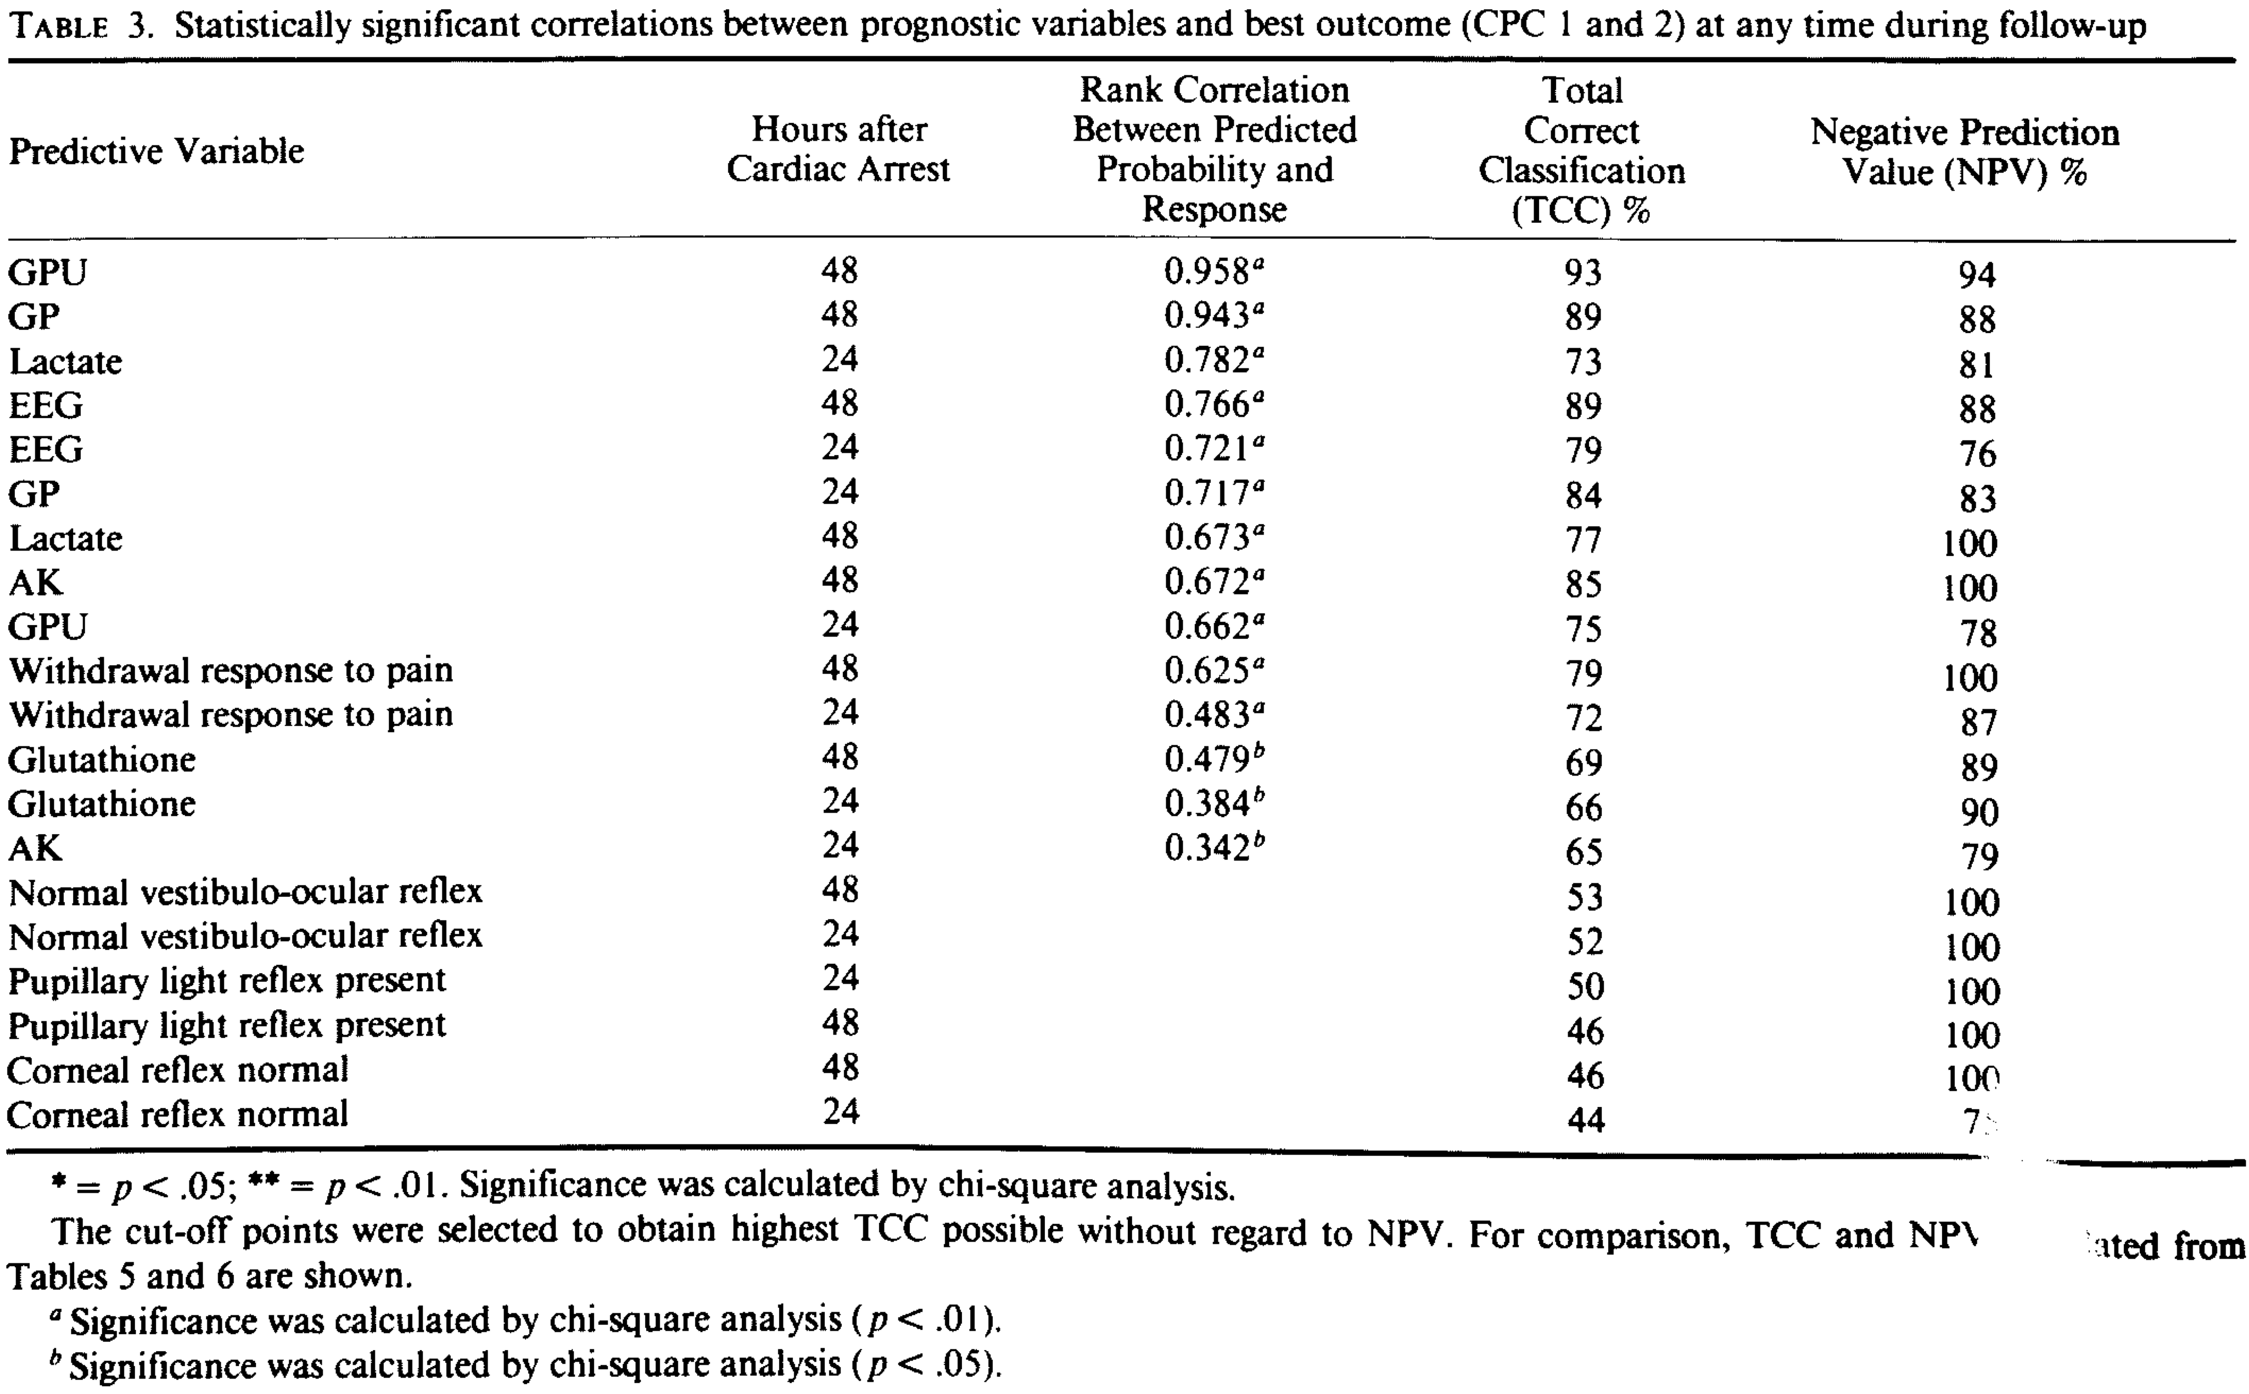
EEG
Edgren et al. Crit Care Med 1987 15(9)
32 patients studied
Notes:
Prediction outcome after cardiac arrest
Favorable outcome with survival seems to occur with both grade 1 and the "reactive type" of grade 2 abnormalities, with preservation of normal sleep features, and with frontal monorhythmic delta activity. Prognostically uncertain patterns are "nonreactive" grade 2 abnormalities, diffuse delta activity with grade 3 abnormality, and the "reactive type of alpha pattern coma." The following patterns are suggested to be prognostically malignant if persistent: grade 3 abnormality with small amplitude, diffuse, irregular delta activity; grade 4 ("burst suppression pattern"), in particular when epileptiform discharges are present and with "low-output EEG"; and grade 5 ("isoelectric EEG"). Fatal outcome is also common with the "nonreactive type of alpha pattern coma" and the recently reported "theta pattern coma."

Slide 20
EEG
Hofmeijer et al AAN 2015; 1-7
277 pt - prospective cohort study
  Continuous EEG was measured during the first 3 days /Outcome was dichotomized as good or poor
  unfavorable (isoelectric, low-voltage, burst-suppression with identical bursts)
  Intermediate
  favorable (continuous patterns)
  Poor outcome occurred in 149 patients (54%)
  Single measures unequivocally predicting poor outcome were an unfavorable EEG pattern at 24 hours, absent pupillary light responses at 48 hours, and absent somatosensory evoked potentials at 72 hours. Together, these had a specificity of 100% and a sensitivity of 50%.
  For the remaining 203 patients, who were still in the “gray zone” at 72 hours, a predictive model including unfavorable EEG patterns at 12 hours, absent or extensor motor response to pain at 72 hours, and higher age had an area under the curve of 0.90 (95% confidence interval 0.84–0.96).
  Favorable EEG patterns at 12 hours were strongly associated with good outcome.

Slide 21
NSE
Cronberg et al. Neurology. 77(7):623-630, August 16, 2011.
Prospective observational study of 111 patients
Notes:
Neuron-specific enolase correlates with other prognostic markers after cardiac arrest
Unfilled rhombs represent the patients who wake up and filled rhombs represent patients who remain in coma until death. Dotted line denotes NSE level 33 􏰁g/L. (A) Diffusion-weighted MRI (DWI) findings correlated with the NSE level 48 hours after cardiac arrest. The MRI findings were divided into 3 groups: 0 (no signs of acute ischemia or brain damage), 1 (focal ischemia with total lesion volume in cortex or basal ganglia 􏰅20 mL), or 2 (generalized ischemia or focal ischemia with total lesion volume 􏰃20 mL). Normal DWI was only found in patients with a normal or slightly elevated NSE while a moderate increase in NSE was associated with focal ischemic changes (table 2). All 10 MRI-examined patients with an NSE 􏰃33 􏰁g/L had pronounced DWI signal changes. (B) Correlation between neuropathology findings and NSE levels 48 hours after car- diac arrest. The patients were divided into 3 groups based on the neuropathology findings: mild, moderate, and severe. All 6 individuals with mild or moderate brain damage had NSE 􏰀33 􏰁g/L, while all 6 with severe damage had NSE 􏰃33 􏰁g/L.

Slide 22
NSE
Tiainen et al. Stroke 2003; 34:2881-2886
Randomized controlled trial of 70 pts
Notes:
Serum Neuron-Specific Enolase and S-100B Protein in Cardiac Arrest Patients Treated With Hypothermia
Time course of serum NSE lev- els between 24 and 48 hours after CA in hypothermia- and normothermia-treated patients.
A decrease (defined as any decrease) in NSE values between 24 and 48 hours was observed in 30 of 34 patients (88%) in the hypothermia group and 16 of 32 patients (50%) in the normothermia group (P􏰀0.001). The decrease in NSE values was associated with good outcome at 6 months after ROSC (P􏰂0.005). It was also associated with regaining consciousness (P􏰀0.001), no change to prearrest CPC (P􏰀0.001), and survival for at least 6 months after ROSC (P􏰂0.012).
The levels of NSE (P􏰂0.007 by analysis of variance for repeated measurements) but not S-100B were lower in hypothermia- than normothermia-treated patients. A decrease in NSE values between 24 and 48 hours was observed in 30 of 34 patients (88%) in the hypothermia group and in 16 of 32 patients (50%) in the normothermia group (P􏰀0.001). The decrease in NSE values was associated with good outcome at 6 months after cardiac arrest (P􏰂0.005), recovery of consciousness (P􏰀0.001), and survival for at least 6 months after cardiac arrest (P􏰂0.012).

Slide 23
SSEP
Robinson, et al. Crit Care Med 2003; 31:960-967
bi- lateral absence of cortical responses to median nerve stimulation are associated with poor neurologic prognosis
Systematic review of 41 articles
  Hypoxic-ischemic encephalopathy
  ICH
  TBI
  Other
Notes:
• SSEPs have emerged as a reliable test for prognostication after cardiac arrest (CA). • The short latency cortical response (N20) has been extensively evaluated in the prediction of never awakening. • Meta-analysis from 18 studies and 1136 patients found 336 patients who had bilaterally absent N20 after cardiac arrest never recovered. • Sensitivity for identifying patients who would never awaken was 42% with a PPV of 100%.

Slide 24
SSEP
Robinson, et al. Crit Care Med 2003; 31:960-967
Notes:
Figure 1. Separation of prognostic groups for patients in coma. Percent of patients awakening in each group: adults with hypoxic-ischemic encephalopathy (HIE), adults with intracranial hemorrhage (ICH), adults and adolescents with traumatic brain injury (TBI), and children and adolescents with any etiology. Small bars represent 95% confidence intervals. The presence or absence of cortical somato- sensory evoked potential responses provides a clear separation for prognosis of awakening from coma. Normal vs. abnormal cortical somatosensory evoked potential responses provides additional separa- tion.

Slide 25
Neuroprognostication:
Pre-TTM
3 days post-arrest
  Exam can predict neurologic outcome
    Lack of motor response, lack of eye opening, & absence of pupil response on day 3 is 100% predictive of poor outcome (FP rate of 0% 95%CI 0-3)
NSE (neuron-specific enolase)
SSEP (somatosensory evoked potential)

Slide 26
Timing of Neuroprognostication
Both TTM
Critical Care Medicine March 2012 40(3): 719-730
Retrospective Chart Review from 220-2009
55 cases reviewed
In essence:
  “poor” prognosis was assigned likely at inappropriate times
    Prior to TH & during TH
  Should prognosticate at least three days after normothermia has been achieved and perhaps up to four
    This essentially helps physicians and families to make decisions about level of care & DNAR status

Slide 27
Timing of Neuroprognostication
Post-TTM
Tiainen et al. Crit Care Med 2005 33(8) 1736- 1740
Prospective, randomized, controlled trial of 60 patients
Notes:
Somatosensory and brainstem auditory evoked potentials in cardiac arrest patients treated with hypothermia
Mild to moderate hypothermia does not abolish cortical re- sponses to sensory evoked potentials (9). The cortically generated component N20 has been shown to disappear only at mean nasopharyngeal temperature of 20°C under normal hemodynamic conditions
The bilateral absence of early N20 cortical responses also was a reliable predictor of permanent coma after car- diac arrest in these patients. The high sensitivity is most likely attributed to the small number of patients.
Therapeutic hypothermia significantly reduces the nerve conduction velocities
(n 􏰂 30)
33.0 (32.7–33.4) 1.85 (1.77–1.99) 1.85 (1.69–1.97) 4.59 (4.33–4.73) 4.54 (4.29–4.91) 6.88 (6.61–7.10) 6.90 (6.71–7.19) 2.70 (2.53–2.87) 2.73 (2.54–3.04) 2.28 (2.14–2.48) 2.35 (2.07–2.50) 5.01 (4.76–5.25) 5.13 (4.86–5.35)
(n 􏰂 30)
37.5 (37.2–37.8) 1.70 (1.60–1.94) 1.64 (1.55–1.80) 4.08 (3.89–4.23) 4.06 (3.84–4.13) 6.08 (5.78–6.44) 5.88 (5.64–6.51) 2.32 (2.09–2.43) 2.33 (2.19–2.48) 1.99 (1.85–2.14) 1.94 (1.75–2.19) 4.33 (4.08–4.57) 4.22 (3.89–4.45)
p Value
.02
.005 􏰀.001 􏰀.001 􏰀.001 􏰀.001 􏰀.001 􏰀.001 􏰀.001 􏰀.001 􏰀.001 􏰀.001
Crit Care Med 2005 Vol. 33, No. 8
1739
No. of Patients
Median (Interquartile Range)
Hypothermia Group Normothermia Group
and increases the cervicocortical conduc- tion time. This reflects slowing of neural conduction along the axons and an in- crease in synaptic delay (16). In periph- eral nerves, sensory nerve conduction ve- locity has been reported to decrease at a rate of about 2.0 m/sec per each degree Celsius (17). In our study the difference in nerve conduction velocity between the two treatment groups was about 7 m/sec, and the difference in core temperature was 4.5°C. The amplitudes of N20 re- sponses did not differ between the two treatment groups.

Slide 28
Timing of Neuroprognostication
Post-TTM
Al Thenayan et al. Neurology 2008; 71: 1535-1537
Retrospective chart review of 37 patients
Absence of motor responses better than extensor posturing on day 3 is not a sufficiently reliable predictor of poor neuro- logic outcome (FPR of 14%)
Lack of pupillary reflex & corneal reflex do predict well, as does the development of myoclonal status epilepticus (FPR 0%)
Notes:
Predictors of poor neurologic outcome after induced mild hypothermia following cardiac arrest
American Academy of Neurology (AAN).1 The report recommended the following prognostic indicators of poor neurologic outcome for these patients: the presence of myoclonus status epilepticus, absent pupillary and corneal reflexes and motor responses no better than extension on day 3, bilaterally absent N20 responses of somatosensory evoked potentials on days 1 to 3, and elevated serum neuron-specific enolase 􏰃33 g/L at days 1 to 3 after CA.

Slide 29
Timing of Neuroprognostication
Post-TTM
Absent pupillary & corneal reflexes on day 3 consistent with poor outcome
Motor response is unreliable and should be delayed to day 6
Exam should be supplemented with SSEP, NSE, or EEG

Slide 30
Timing of Neuroprognostication
Modified TTM
In our new modified-TH cases, neuroprognostication should be delayed to day 3, but likely can be done prior to day 5 if we are not over-administering sedatives

