Slide 1
EMBOLI
Dr H

Slide 2
Objectives
General VTE guidelines
Special Situations
Atrial Thrombus Treatment Options
Algorithm
A Few Notes on Special Situations
Bridging
Reversal

Slide 3
In Your Leisure Time
Review: Kearon et al. Antithrombotic Therapy for VTE Disease : CHEST Guideline and Expert Panel Report. Chest 2016; 149: 315-352
Review: Witt et al. American Society of Hematology 2018 guidelines for management of venous thromboembolism: optimal management of anticoagulation therapy. Blood Adv (2018) 2 (22) 3257-3291

Slide 4
Epidemiology
3rd most common cause of cardiovascular death (after MI and Stroke)
2-4/1000 patients
14-20/1000 ICU patients
Even despite prophylaxis

Slide 5
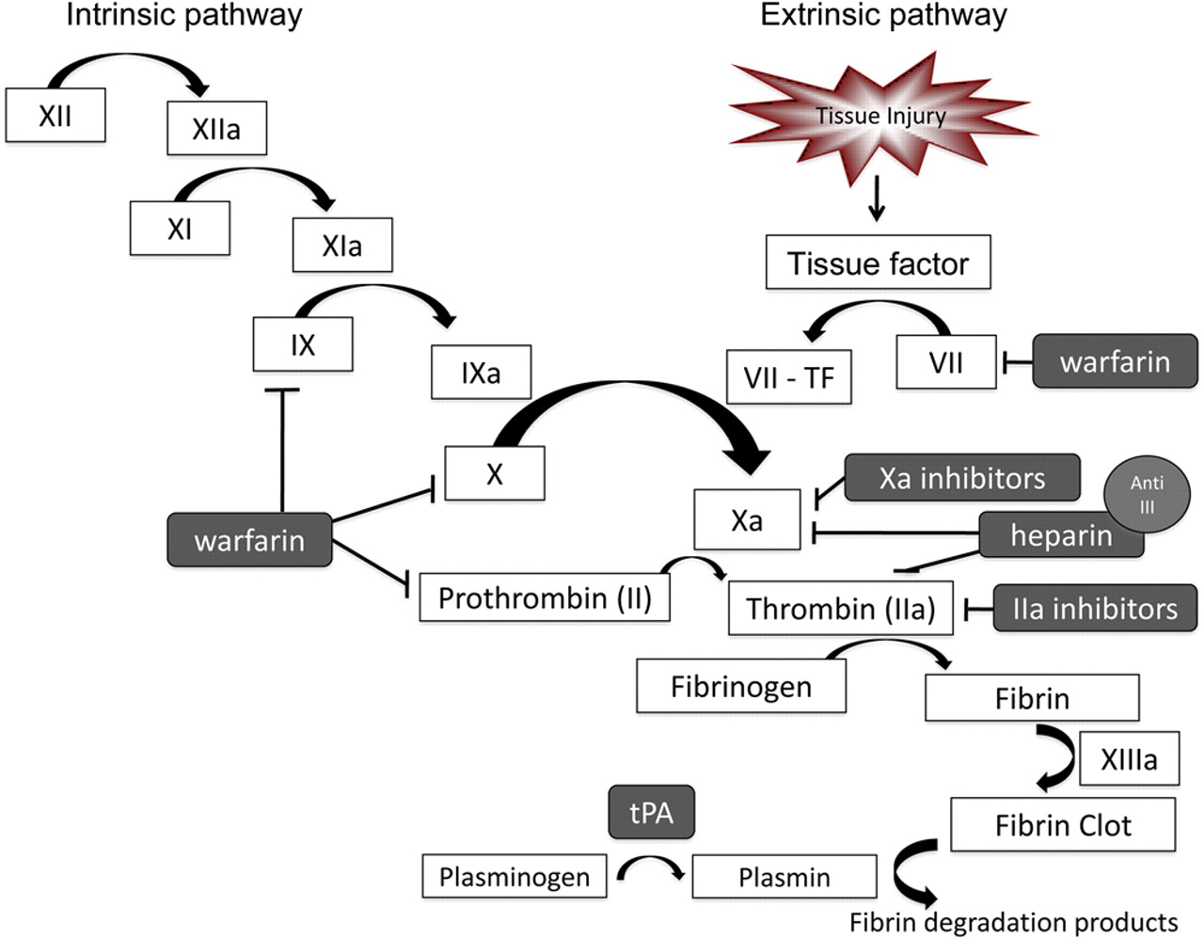
Coagulation Cascade
Neurology.org

Slide 6
Case
60 y/o woman presented to OSH with 2 months of progressive dyspnea. Had been treated on and off for asthma exacerbations and CAP.
PMH
Asthma
HTN/HL
DM
Bipolar d/o
SHx
Married with 2 adult children. Non-smoker
FHx
Daughter had a PE with atrial thrombus that required surgical thrombectomy (when undergoing IVF treatment)

Slide 7
Case
98.6; 98; 121/63; 18; 98% 2L
Overweight
Appeared tired
Bibasilar crackles
NSR without m/r/g
No LE edema
Neurologically intact
BNP 21; Troponin flat

Slide 8
Case
CT at OSH:
Large PE seen in the left main pulm artery, extending into the interlobar artery and LLL. Also as large filling defect which is also likely a large thrombus seen in the right atrium and upper inferior vena cava which is distended. The inferior vena cava near the level of the renals was is flattened and diminutive which is suspicious for shock.
Started on heparin and transferred for a higher level of care
LE Dopplers negative

Slide 9
Case CTPE

Slide 10
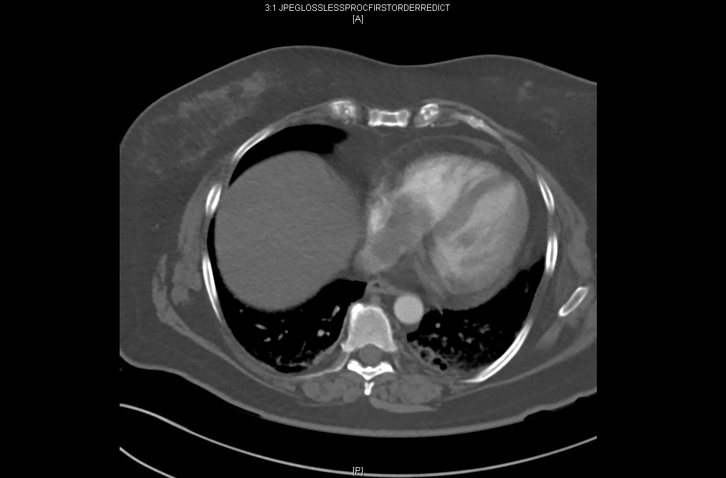
Case CTPE

Slide 11
GENERAL VTE GUIDELINES
Anticoagulate! (1B)
Dabigatran/Rivaroxaban/Apixaban/Edoxaban > VKA (2B)
LMWH > Heparin (2C)
Clot and Cancer
LMWH = NOAC > VKA
3 month therapy for transient risk factor (1B)
Extended therapy for “permanent” risk factor (1B)
Kearon et al. Antithrombotic Therapy for VTE Disease : CHEST Guideline and Expert Panel Report. Chest 2016; 149: 315-352

Slide 12
GENERAL VTE GUIDELINES
Compression stockings to prevent post-thrombotic syndrome not recommended (2B)
Subsegmental PE does not require therapy unless high-risk VTE recurrence / proximal DVT (2C)
In patients with an unprovoked proximal DVT or PE who are stopping anticoagulant therapy and do not have a contraindication to aspirin, we suggest aspirin over no aspirin to prevent recurrent VTE (Grade 2B)
Recurrent DVT on non-LMWH, start LMWH
Recurrent DVT on LMWH, increase LMWH (1/4 to 1/3)
Kearon et al. Antithrombotic Therapy for VTE Disease : CHEST Guideline and Expert Panel Report. Chest 2016; 149: 315-352

Slide 13
Clot and Cancer
Prophylaxis (for hospitalization and surgery T-1 to T+7/10)
Apixaban
Rivaroxaban
LMWH
Treatment (documented VTE)
Rivaroxiban
Edoxaban
LMWH
Key et al. Venous Thromboembolism Prophylaxis and Treatment in Patients With Cancer: ASCO Clinical Practice Guideline Update. J Clin Oncol 37. 2019

Slide 14
Clot and Can’t Anticoagulate
ONLY INDICATION FOR AN IVC FILTER!!!

Slide 15
Case Echo
Normal biventricular size and systolic function.
There is mild tricuspid regurgitation.
There is a large mobile mass in the right atrium, consistent with thrombus (measuring 3.1x2.0 cm).
In some views there is thickening of the interatrial septum raising the possibility of a septal attachment point. If so tumor (myxoma) is also within the differential diagnosis. No tricuspid valve inflow obstruction is demonstrated.

Slide 16
Case
Patient transferred to MICU after pulmonary consult given high risk nature of clot burden
Discussion between intensivist, interventional radiologist, and CT surgery ensued
MRI performed which identified atrial abnormality as a clot rather than a myxoma
On HD#2 lysis attempted with tPA

Slide 17
SUBMASSIVE PE
Characterized by PE with signs of R heart dysfunction or failure
RV dysfunction on echo (RVE + loss of IVC collapse on inspiration without LV or MV dz) Pulmonary HTN on echo (TR jet > 2.8 m/s)
Precapillary pulmonary HTN on R heart cath (mean PA > 20 mmHg, PCWP < 18 mmHg)
New ECG signs of RV strain (S1Q3T3 or RBBB or T wave inversion in V1-4)
Troponin elevation
BNP elevation
R heart failure is the usual cause of death from PE; therefore RV dysfunction may be an important warning sign of a bad outcome

Slide 18
SUBMASSIVE PE
Exclusion criteria for tPA in submassive PE:
Age > 80
Hemodynamic instability (SBP < 90 mmHg)
Onset of symptoms > 96 hours
Thrombolytic treatment, major surgery, or biopsy < 7 days ago; major trauma < 10 days ago
CVA, TIA, craniocerebral trauma, or neurosurgery < 6 months ago
GI bleeding < 3 months ago
Uncontrolled HTN
Known bleeding disorder or diabetic retinopathy
Current therapy with oral anticoagulant; Current pregnancy or lactation
Life expectancy < 6 months because of underlying disease

Slide 19
MASSIVE PE
• For purposes of thrombolysis, massive PE is characterized by hypotension (cardiogenic shock)
• Size of PE on imaging study does not correlate well with clinical outcome
• FDA approved indication for thrombolysis though data is scant

Slide 20
Thrombolytics for PE with hypotension (2C)
Systemic therapy over catheter-directed thrombolysis (2C)
100mg tPA over 2 hours
NEWER DATA 50MG tPA OVER 2 HOURS
Generally restart Heparin 3 hours later if PTT/Fibrinogen okay
GENERAL VTE GUIDELINES
Wang et al. Efficacy and Safety of Low Dose Recombinant Tissue-Type Plasminogen Activator for the Treatment of Acute Pulmonary Thromboembolism. Chest 2010; 137 (20): 254-262

Slide 21
Thrombolysis
Lysis improves:
PAP, AV oxygenation, pulmonary perfusion, and echocardiographic assessment
10+ RCTs
rtPA 100mg IV over 2h
Fibrinospecific & short half-life
does not contraindicate surgical embolectomy when hemodynamic status continues to worsen
Notes:
accelerates thrombus lysis and pulmonary reperfusion, reduces pulmonary hypertension, and because of right ventricle–left ventricle interdependence,²⁵ improved right ventricular function helps to increase both right and left ventricle output and to reverse cardiogenic shock. Moreover, thrombolysis may dissolve the clot in 3 locations at the same time²⁰ : the intracardiac thrombus, the pulmonary embolus, and the venous thrombosis.
Longer infusions cause more bleeding, boluses do not improve outcomes, intra-PA administration causes more bleeding without improving outcomes

Slide 22
Differences between the RV and LV
Muscle structure is purely longitudinal in contraction
In addition, the wall is thin
Sustained ejection
Coronary blood flow is continuous from the RCA
Right Heart Failure in the ICU
Poor H., Ventetuolo C. Pulmonary Hypertension in the Intensive Care Unit. Prog Cardiovasc Dis 2012;55:187-198.

Slide 23
Treat underlying cause
Fluid management – negative fluid balance with diuretics or hemofiltration
Vasopressors – low dose dopamine or norepinephrine are favored over neosynephrine, epinephrine, and vasopressin
Inotropes – dobutamine and milrinone may augment diuretic effect but can induce hypotension
Pulmonary Vasodilators – inhaled NO will increase CO (20%) and decrease PVR (may need to monitor for methemoglobinemia and to “titrate” off)
Goal O2Sat >90%
Goal Hgb >10
VA-ECMO as a bridge (to thromboendarterectomy or transplant)
Management of RHF

Slide 24
Case Cardiac MRI

Slide 25
Case
Patient does very well s/p lysis. Discharge planning is initiated in the morning of HD #3
However, that afternoon, the patient had a near-syncopal episode and O2 sats dropped.

Slide 26
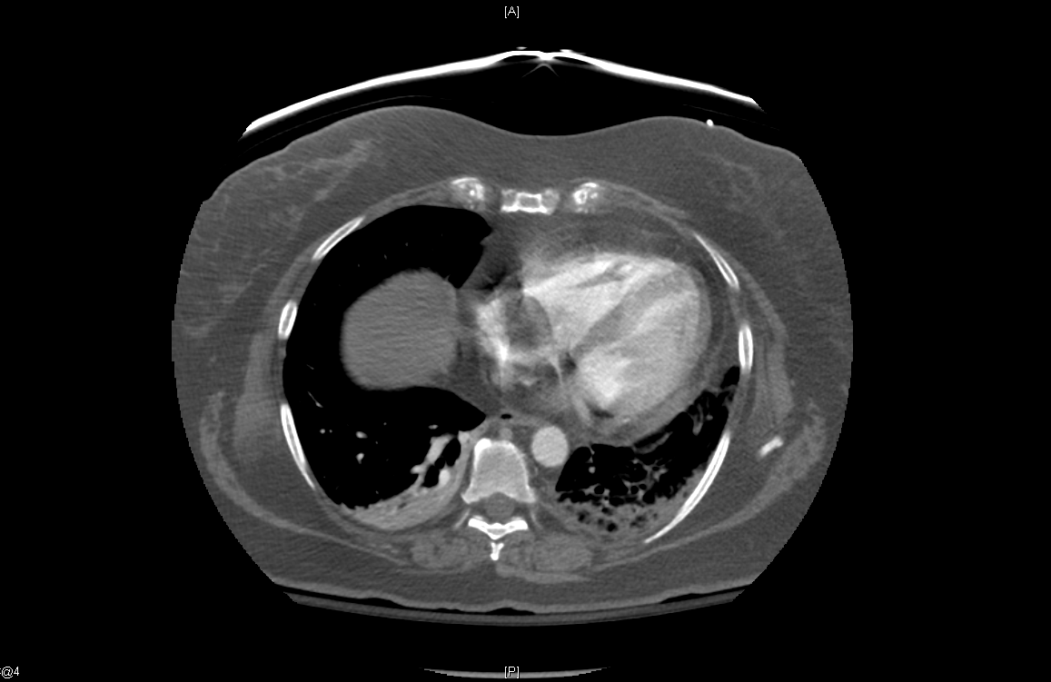
Case Repeat CTPE

Slide 27
Case
CT surgery already involved and decision made to take pt to OR for surgical thrombectomy on HD#4

Slide 28
General VTE Guidelines
In selected patients with acute PE not associated with hypotension and with a low bleeding risk whose initial clinical presentation, or clinical course after starting anticoagulant therapy, suggests a high risk of developing hypotension, we suggest administration of thrombolytic therapy (2C)
Kearon et al. Antithrombotic Therapy for VTE Disease : CHEST Guideline and Expert Panel Report. Chest 2016; 149: 315-352
Notes:
Such as a fall in SBP >40mm Hg; tachycardia, hypoxemia, JVD, poor perfusion (do not recommend using BNP, troponin, or echo alone for decision to go to lysis)

Slide 29
General VTE Guidelines
In patients with acute PE associated with hypotension and who have (i) contraindications to thrombolysis, (ii) failed thrombolysis, or (iii) shock that is likely to cause death before systemic thrombolysis can take effect (eg within hours), if appropriate expertise and resources are available, we suggest catheter-assisted thrombus removal over no such intervention (2C)
Kearon et al. Antithrombotic Therapy for VTE Disease : CHEST Guideline and Expert Panel Report. Chest 2016; 149: 315-352

Slide 30
General VTE Guidelines
In patients with acute PE associated with hypotension, we suggest surgical pulmonary embolectomy over no such intervention if they have (i) contraindications to thrombolysis, (ii) failed thrombolysis or catheter-assisted embolectomy, or (iii) shock that is likely to cause death before systemic thrombolysis can take effect (eg within hours), provided surgical expertise and resources are available (2C)
Kearon et al. Antithrombotic Therapy for VTE Disease : CHEST Guideline and Expert Panel Report. Chest 2016; 149: 315-352

Slide 31
Epidemiology of Atrial Thrombi
Right heart thrombus occurs in 4% of all PEs
Mortality of 40%
Can also occur from CVCs (for HD), prosthetic TV, and pacemaker leads (2-29% incidence)
ICOPER 2003

Slide 32
Classification of Atrial Thrombi
A: elongated, serpiginous, highly mobile (usually associated with DVTs and PEs)
B: ovoid, nonmobile (thought to arise from underlying cardiac anomolies)
C: resemble cardiac myxomas, highly mobile
Eur Heart J 1989

Slide 33
Retrospective Analysis of RHT Treatment
177 cases (1966-2000)
Treatment
None vs Anticoagulation vs Surgical vs Lysis
Mortality
100% vs 28.6% vs 23.8% vs 11.3%
When reporting bias was taken into account, the mortality rate was not statistically different
Chest 2002

Slide 34
Interventional Radiology
Mechanical fragmentation (using a pulmonary artery catheter)
Clot pulverization (using a rotating basket catheter)
Percutaneous rheolytic thromboectomy
Pigtail rotational catheter embolectomy
Clot fragments are suctioned or displaced (intact clot is not removed)
Result in modest angiographic improvement
No RCTs for this therapy (retrospective series of <30 pts)

Slide 35
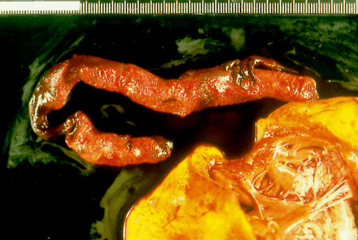
Surgery
Embolectomy while on cardiopulmonary bypass
Suited for pts who require excision of a right atrial thrombus, paradoxical arterial embolism, or closure of a patent foramen ovale
Rescue therapy for failed thrombolysis
No RCTs
Notes:
Surgical embolectomy has an inherent delay of hours, general anesthesia, & cardiopulmonary bypass

Slide 36
Case Conclusion
Patient did very well s/p surgical thrombectomy. She started PT on POD#1/HD#5
Chest tubes removed on POD#6/HD#10
Discharged to rehab on warfarin POD#7/HD#11

Slide 37
Case Conclusion

Slide 38
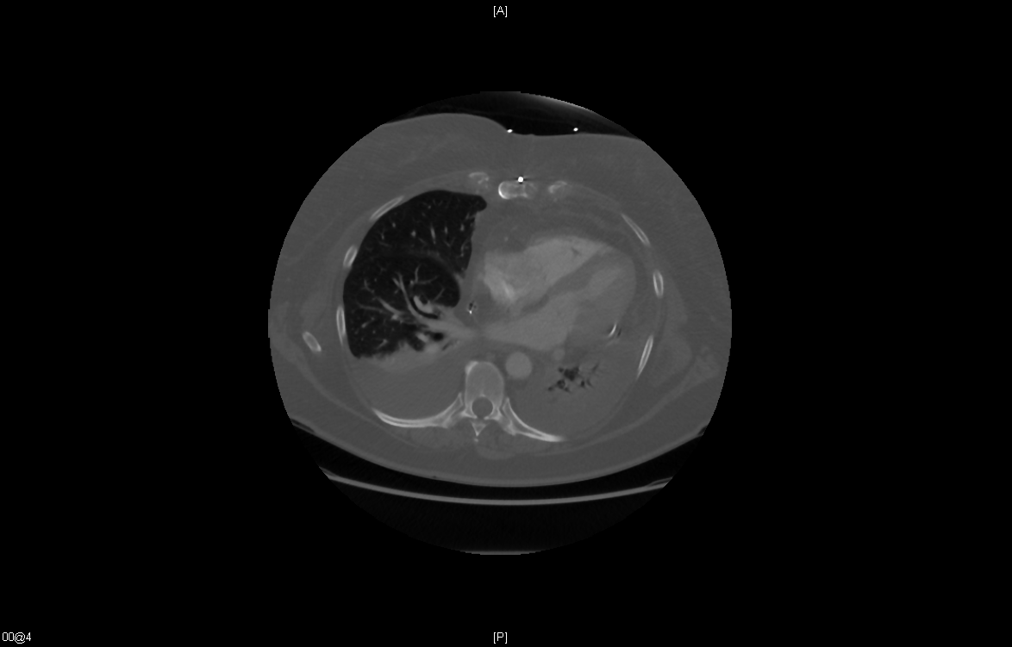
Case Conclusion

Slide 39
PE
Stable
Unstable
Low-risk
High-risk
Ø CI to Lyse
+ CI to Lyse
Ø CI to Lyse
+ CI to Lyse, Failed lysis, or PFO
DOAC/LMWH
Thrombectomy
Lyse
Thrombectomy
Lyse
?IR
CI - contraindication

Slide 40
Bridging / VTE Recurrence Risk Stratification
In patients at low to moderate risk of recurrent VTE who require interruption of VKA for invasive procedures, the panel recommends against periprocedural bridging with LMWH or UFH in favour of VKA interruption alone (strong recommendation, moderate certainty)
High Risk | Moderate Risk | Low Risk
VTE within past 3 months Deficiency of protein C, protein S, or antithrombin Antiphospholipid antibody syndrome Multiple thrombophilic abnormalities | VTE within past 3-12 months Heterozygous factor V Leiden Prothrombin 20210 mutation Recurrent VTE Active cancer | VTE > 12 months previously No other risk factors
Witt et al. American Society of Hematology 2018 guidelines for management of venous thromboembolism: optimal management of anticoagulation therapy. Blood Adv (2018) 2 (22) 3257-3291

Slide 41
Recommendation
In patients with life-threatening bleeding during VKA treatment for VTE who have an elevated INR, the panel suggests using 4-factor PCC rather than FFP, in addition to cessation of VKA and intravenous vitamin K (conditional recommendation, very low certainty)
PCC compared with FFP, in addition to intravenous vitamin K cessation of VKA:
Outcomes (Quality of Evidence) | Relative effect (95% CI) | Anticipated absolute effects (95% CI)
 |  | Risk with FFP | Risk difference with PCC
Mortality | RR 0.92 (0.37 to 2.28) | 18 of 145 (12.4%) | 10 fewer deaths per 1,000 (78 fewer to 159 more)
PE | RR 7.71 (0.44 to 136.11) | 0 of 23 (0.0%) | 15 more PE per 1,000 (0 fewer to 0 fewer)
Symp. Prox DVT | RR 2.57 (0.11 to 60.24) | 0 of 23 (0.0%) | 4 more DVT per 1,000 (2 fewer to 13 more)
Major bleeding | RR 1.34 (0.78 to 2.29) | 12 of 132 (9.1%) | 31 more bleed per 1,000 (20 fewer to 117 more)
Given low certainty of effects, other driving factors for PCC recommendation:
PCC: less volume overload, faster reduction of INR compared with FFP
PCC easier to administer
Witt et al. American Society of Hematology 2018 guidelines for management of venous thromboembolism: optimal management of anticoagulation therapy. Blood Adv (2018) 2 (22) 3257-3291

Slide 42
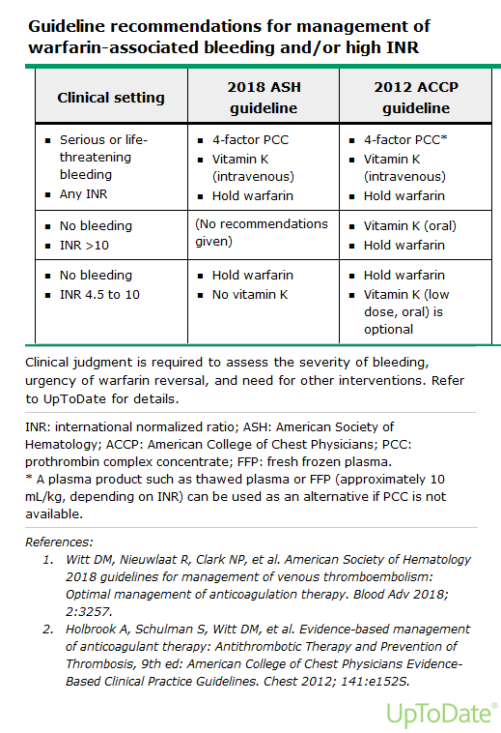

Slide 43
Recommendations:
For patients with life-threatening bleeding during oral direct Xa inhibitor (apixiban,edoxaban, rivaroxaban) treatment for VTE:
The panel suggests using either 4-factor PCC as an addition to cessation of the DOAC, or cessation of the DOAC alone (conditional recommendation, very low certainty)
The panel suggests using recombinant coagulation factor Xa (andexanet) in addition to cessation of the DOAC, rather than no coagulation factor Xa (recombinant) (conditional recommendation, very low certainty)
In patients with life-threatening bleeding during dabigatran treatment for VTE, the panel suggests using idarucizumab in addition to cessation of dabigatran rather than no idarucizumab (conditional recommendation, very low certainty)
Compared with non-idarucizumab control group, patients receiving idarucizumab may have had less worsening or recurrence of bleeding (RR 0.12 [95% CI, 0.03 to 0.43])
In one cohort study, 6.3% of patients who received idarucizumab for uncontrolled bleeding developed arterial or venous thrombosis within 90 days

Slide 44
Recommendation
In patients receiving anticoagulation therapy for VTE who survive an episode of major bleeding, the panel suggests resumption of oral anticoagulation therapy within 90 days rather than discontinuation (conditional recommendation, very low certainty)
Resumption versus discontinuation of anticoagulant therapy for VTE after major bleeding:
Outcomes (Quality of Evidence) | Relative effect (95% CI) | Anticipated absolute effects (95% CI)
 |  | Risk without resumption | Risk difference with resumption
Mortality | RR 0.59 (0.45 to 0.77) | 845 of 2,455 (34.4%) | 141 fewer death per 1,000 (79 fewer to 189 fewer)
PE | RR 0.26 (0.08 to 0.82) | 12 of 425 (2.8%) | 21 fewer PE per 1,000 (from 5 fewer to 26 fewer)
Symp. Prox DVT | RR 0.66 (0.25 to 1.75) | 11 of 464 (2.4%) | 8 fewer DVT per 1,000 (18 fewer to 18 more)
Major bleeding | RR 1.54 (1.18 to 2.02) | 230 of 3,304 (7.0%) | 38 more bleeds per 1,000 (13 more to 71 more)
Increase in risk of recurrent bleeding offset by improvement in all-cause mortality
Applies to patients requiring long-term or indefinite anticoagulation

