Slide 1
Intralipids, High-Dose Insulin Therapy, and Glucagon
Oh My!
Dr H

Slide 2
Objectives
Epidemiology of Overdoses
Review of pertinent physiology and pharmacology
Intralipid Therapy
High-Dose Insulin Therapy

Slide 3
Caveat to Toxicology Case Reports
  Though case reports are inherent in publication bias, many therapies cannot undergo rigorous double-blind, placebo-controlled, prospective trials. They do however, support the animal models.

Slide 4
Epidemiology of Overdoses
Drug-induced deaths account for 73,990 deaths in 2017, a steady increase over the last 20 years, doubling from 2005
  10% are due to heart medications
Opioids account for the majority of overdoses, >40%
Nonfatal overdoses accounted for almost 1 million ED visits in 2017.
CDC.GOV National Vital Statistics System

Slide 5
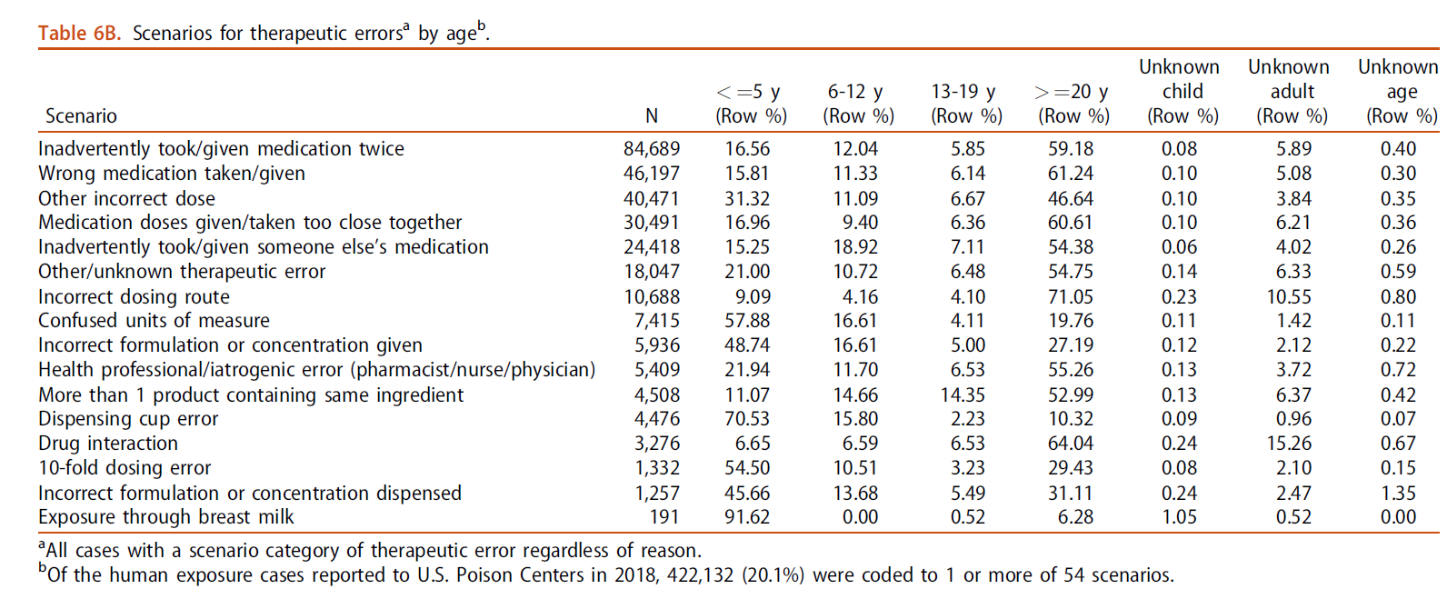
Therapeutic Errors in Overdose
David D. Gummin et al (2019)
2018 Annual Reportof the American Association of Poison Control Centers’ National Poison Data System (NPDS):
36thAnnual Report, Clinical Toxicology, 57:12, 1220-1413

Slide 6
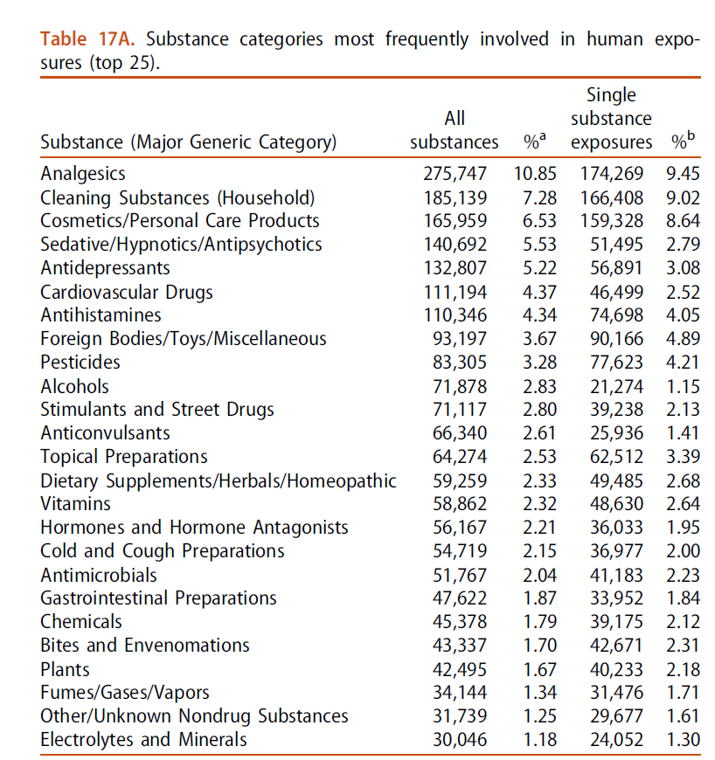
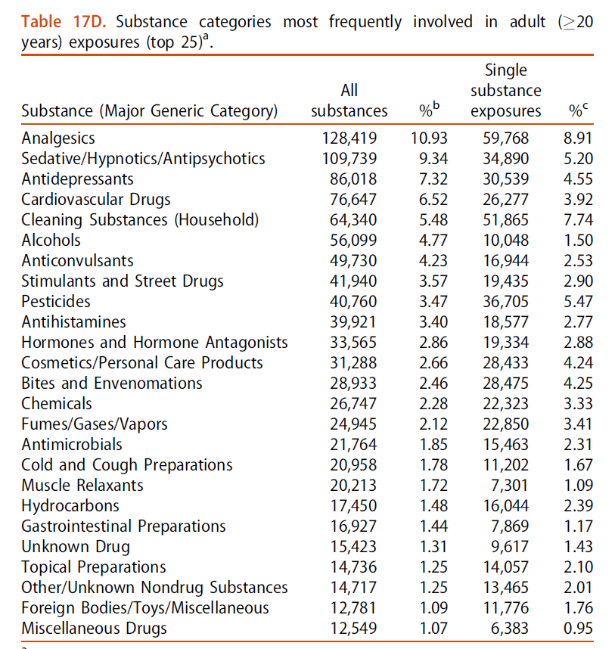
Most Frequent Substances in Overdose
David D. Gummin et al (2019)
2018 Annual Reportof the American Association of Poison Control Centers’ National Poison Data System (NPDS):
36thAnnual Report, Clinical Toxicology, 57:12, 1220-1413

Slide 7
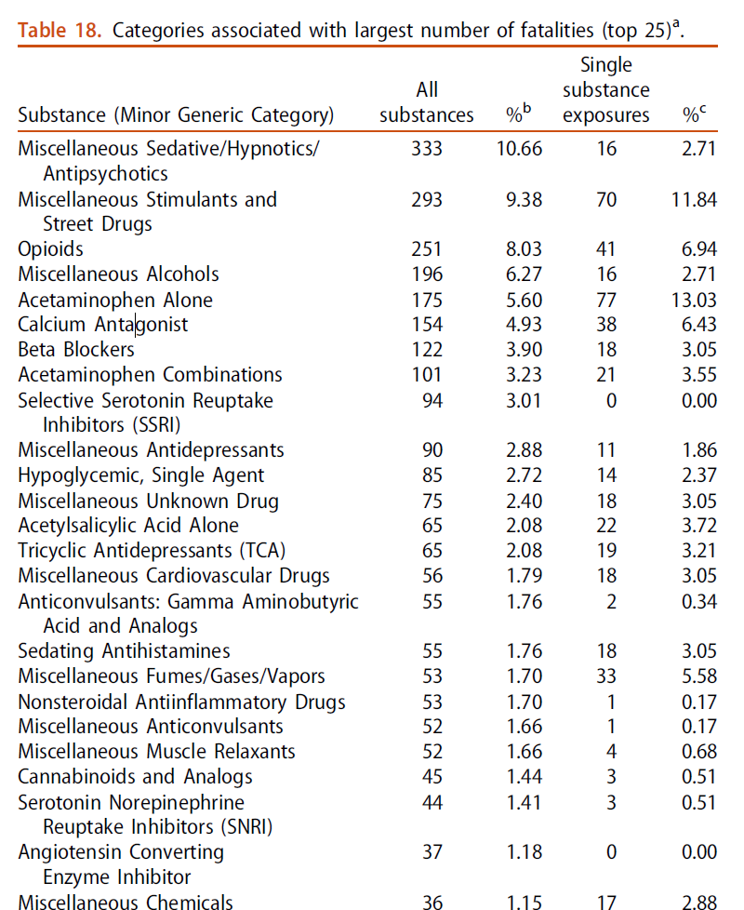
Most Fatal Overdoses
David D. Gummin et al (2019)
2018 Annual Reportof the American Association of Poison Control Centers’ National Poison Data System (NPDS):
36thAnnual Report, Clinical Toxicology, 57:12, 1220-1413

Slide 8
Intralipid Therapy
Local Anesthetic and Antidepressant Overdoses

Slide 9
Intralipid Therapy
First described in local anesthetic overdose
Approximately 7.5 to 20 per 10,000 peripheral nerve blocks and 4 per 10,000 epidurals result in notable systemic toxicity

Slide 10
Local Anesthetics
Amphipathic chemicals
  Compatible with lipid and water environments
  Can cross plasma & intracellular membranes
  Act upon more than just the voltage-gated sodium channel
  Can disrupt oxidative phosphorylation
Presentation of Toxicity
  Seizures
  Ventricular dysrhythmias

Slide 11
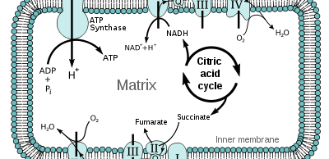
Remembering Mitochondria
Required by every cell for function (energy production)
ATP is the final product of the electron transport chain

Slide 12
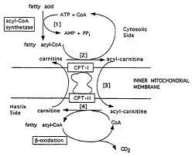
Carnitine
Local anesthetics inhibit carnitine acylcarnitine translocase
This enzyme is required for fatty acid metabolism and transport in cardiac ATP synthesis
Lipid therapy may increase fatty acid content enough to overcome the CACT inhibition
Notes:
The second possible mechanism is reversal of mitochondrial fatty acid transport inhibition. It is believed that local anesthetics inhibit carnitine acylcarnitine translocase (CACT), an enzyme used in mitochondrial fatty acid metabolism and transport. Because fatty acids are involved in 80% to 90% of cardiac adenosine 5'-triphosphate (ATP) synthesis, inhibition of CACT may contribute to cardiac toxicity. Lipid infusion may increase the intracellular fatty acid content enough to overcome the inhibition of the CACT enzyme by the anesthetic.

Slide 13
Proposed Mechanisms
Metabolic Theory
  Local anesthetics inhibit fatty acid transport at the inner mitochondrial membrane
  Lipid emulsion may prevent oxidative inhibition
Direct Inotropic Effect
Lipid Sink
  Extract lipid soluble drugs
    (May affect other drugs being used in treatment of overdose)
  Proportionally related to lipophilicity of each drug

Slide 14
Pretreatment with Lipids
Anesthesiology. 1998; 88: 1071-5
Rats were anesthetized & intubated & cannulated
Saline vs 10% lipid vs 20% lipid vs 30% lipid infused prior to injection of bupivacaine
~48% increase in LD50 of bupivacaine when pretreated with lipids

Slide 15
No Treatment vs Saline vs Intralipid
http://youtu.be/D6aS8wWfR7o
  Bupivicaine Toxicity without therapy
http://youtu.be/jFH4V3dMOnc
  Bupivicaine Toxicity with supportive care
http://youtu.be/B3au3aKU4oE
  Bupivicaine Reversal with intralipid

Slide 16
Dog Models
LRT in Bupivacaine-Induced Cardiac Toxicity in Dogs
Weinberg et al. Regional Anesthesia & Pain Medicine. 2003; 28(3): 198-202
Dogs anesthetized & intubated & cannulated, left ventricle exposed
Bupivacaine infused, when circulatory arrest occurred, internal cardiac massage was instituted. CPR vs saline infusion vs lipid infusion compared
Only dogs treated with lipid demonstrated return of BP and HR (all within 5 minutes), to normal levels within 30 minutes

Slide 17
Olanzapine (Zyprexa)
Primarily Dopamine & Serotonin Reuptake Inh
  Weak affinity for GABA A, Histamine & α1adrenergic
  Strong affinity for murscarinic receptors
CNS depression and Tachyarrhythmias
Case Report: Am J Emerg Med 2011
4 y/o accidental ingestion of olanzapine responded to infusion of LRT

Slide 18
Lidocaine
Class 1B antiarrhythmic
  Na channel blockade (reversible)
Seizures and Arrhythmias
Case Report: Crit Care Med 2011 Apr 29(4)
57 y/o with h/o of hypertrophic cardiomyopathy (since age 26, possible glycogen storage disease)
  Developed lidocaine toxicity while on a gtt for VT
  Reversed with LRT

Slide 19
Lamotrigine (Lamictal)
Sodium channel blocking agent (likely)
Seizures & Arrhythmias
Case Report: J Emerg Med 2011 May 26
50 y/o woman OD’d on lamotrigine
  Symptoms included loss of consciousness & widening of QRS with LBBB
  Pt treated with traditional ACLS without effect
  Recovery occurred with LRT

Slide 20
Bupropion (Wellbutrin)
Dopamine & Norepinephrine Reuptake Inh
Seizures & Arrhythmias
Case Report: Ann Emerg Med. 2008 Apr;51(4)412-5
17 y/o ingested ~8g of bupropion (and 4g of lamotrigine)
  Presented with seizures and cardiovascular collapse (ACLS initiated)
  After 100mL of LRT, recovery occurred
    including walking out of the hospital

Slide 21
Dosulepin (Prothiaden)
TCA
  Serotonin & Norepinephrine Reuptake Inhibition
  Na & K channel blockade
  Some α1adrenergic and anticholinergic activity
Seizures & Arrhythmias
Case Report: Clin Toxicology 2011 Apr; 49(4): 337-9
36 y/o ingested 5.25g of dosulepin
  Pt developed seizures and QRS widening and QT prolongation
  Initially treated with sodium-bicarb
  Pt recovered with LRT

Slide 22
Verapamil
L-type Calcium-channel Blocker
Bradycardia & Dysrhythmias
Case Report: Resuscitation 2009 May; 80(5):591-3
Cardiogenic shock in which the patient fully recovered after LRT (when traditional methods failed)
  Toxicity confirmed with levels (including metabolites)

Slide 23
Haloperidol
Dopamine Antagonist
NMS, Seizures, and Dysrhythmias
Case Report: Ann Intern Med 2009 May 19;150(10):737-8
45 y/o woman with HTN, anxiety, depression, opioid abuse, & cigarette smoking presented with palpitations and chest pain treated successfully with Intralipids

Slide 24
Quetiapine & Sertraline (Seroquel & Zoloft)
Quetiapine – Serotonin reuptake inh
  Also some Dopamine, Histamine, and α1&2adrenergic antagonism
  Anticholinergic toxidrome, Seizures, CNS dep & QT prolongation (no known Torsades)
Sertraline – SSRI
  Seizures, CNS dep, & QT prolongation (no known Torsades)
Case Report: Anesthesia 2009 Feb;64(2):191-4
61 y/o man who attempted suicide by ingesting quetiapine and sertraline. Pt was in a deep comatose state. Given LRT soon after ACLS initiated. Pt’s mental status improved almost immediately and intubation staved off

Slide 25
Technical Aspects - Intralipids
In the event of local anesthetic-induced cardiac arrest that is unresponsive to standard therapy, in addition to standard cardio-pulmonary resuscitation, Intralipid 20% should be given i.v. in the following dose regime:
Intralipid 20% 1.5mL/kg over 1 minute
  Take a 500ml bag of Intralipid20%and a 50ml syringe.
  Draw up 50ml and give stat i.v.X2
  Then attach the Intralipid bag to an iv administration set (macrodrip) and run it i.v. over the next 15 minutes
  Repeat the initial bolus up to twice more – if spontaneous circulation has not returned.
Follow immediately with an infusion at a rate of 0.25mL/kg/min
Continue chest compressions
Repeat bolus every 3-5 minutes up to 3 mL/kg total dose until circulation is restored
Continue infusion until hemodynamic stability is restored. Increase the rate to 0.5 mL/kg/min if BP declines
A maximum total dose of 8mL/kg is recommended (560mL for a 70kg man)

Slide 26
High-Dose Insulin Therapy, etc
Cardiovascular Overdose

Slide 27
Adrenoreceptors
Alpha1 effects are mediated by Gq protein coupling > IP3 & DAG > calcium release from smooth muscle
Alpha1
  Contracts vascular smooth muscle, pupils, and pilomotor smooth muscle
  Stimulates glycogenolysis
Notes:
Gq coupling leads to activation of the phosphoinositide cascade and the release of inositol-1,4,5-triphosphate and diacylglycerol (DAG) from membrane lipids. Calcium is then released from smooth muscle and enzymes are activated.

Slide 28
Adrenoreceptors
Alpha2 activation results in inhibition of adenyl cyclase through Gi protein coupling
Alpha2
  Contracts some vascular smooth muscle
  Inhibits adrenergic and cholinergic transmitter release
  Stimulates platelet aggregation
  Inhibits lipolysis and insulin release

Slide 29
Adrenoreceptors
Beta receptors stimulate adenyl cyclase via Gs protein coupling, which releases cAMP in the cell
Beta1
  Stimulates rate and force of the heart
  Stimulates renin release (at juxtaglomerular cells)
Beta2
  Relaxes respiratory, uterine, and vascular smooth muscle
  Stimulates glycogenolysis and insulin release
  Causes tremor at the somatic (voluntary muscle) motor nerve terminals
Notes:
B1-adrenergic receptor stimulation facilitates calcium entry into cardiac myocytes by increasing the number of open calcium channels. b-adrenergic–facilitated calcium entry involves activation of adenyl cyclase, a membrane-bound enzyme that catalyzes cyclic adenosine mono- phosphate (cAMP) formation. Formation of cAMP leads to phosphorylation of the L-type channel with subsequent opening and calcium influx. Although they act through differing mechanisms, both BBs and CCAs inhibit calcium entry. b-adrenergic–blocking drugs inhibit facilitated L-type calcium channel opening, and CCAs maintain the channel in the closed state. Excessive inhibition of calcium entry results in hallmark toxicity of bradycardia, conduction abnormalities, hypotension, and, if severe, hypodynamic shock .
Calcium signaling is critical to other processes that are affected by cardiac drug toxicity including carbohydrate metabolism. During drug-induced shock due to either BBs or CCAs, the heart switches its preferred source of energy substrate from free fatty acids to carbohydrates. In response, the liver increases glucose availability by way of glycogenolysis. Even though circulating glucose is sufficient enough to support the heart during stress, CCAs block calcium-mediated insulin release by pancreatic b-islet cells that is necessary for myocardial cells to use the additional glucose. The resulting metabolic manifestations resemble diabetic ketoacidosis with insulin deficiency, hyperglycemia, and acidemia

Slide 30
Adrenoreceptors
Dopamine 1
  Relaxes renal and splanchnic blood vessels
Dopamine 2
  Inhibits adenylyl cyclase at nerve terminals

Slide 31
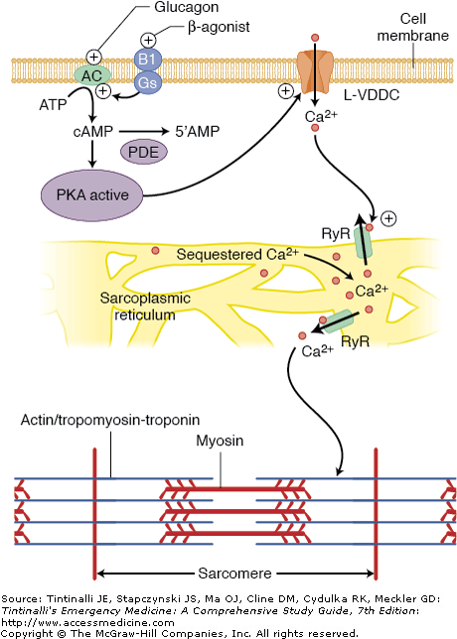
Notes:
Cardiac myocyte -receptor and calcium signaling. Calcium plays a key role in intracellular signaling and myocyte contraction. Binding of a agonist to the 1-adrenergic receptor (B1) on the cell surface activates the Gs protein. The Gs protein then activates adenylate cyclace (AC), which converts adenosine triphosphate (ATP) to cyclic adenosine monophosphate (cAMP). The increased cAMP activates protein kinase A (PKA). Activated PKA causes the L-type voltage-dependent calcium channel (L-VDCC) to open. Extracellular calcium (Ca2+) then enters the cell and binds to the ryanodine receptor (RyR) in the sarcoplasmic reticulum, causing an efflux of sequestered Ca2+ out of the sarcoplasmic reticulum into the cell. The released Ca2+ binds to troponin, which allows the myosin and actin interaction that causes contraction of the cardiac myocyte. Glucagon is a stress-reactive protein that independently activates adenylate cyclase. cAMP is metabolized by phosphodiesterase (PDE) into inactive adenosine 5'-monophosphate (5'AMP).

Slide 32
Beta Blockers
Adrenoreceptor Antagonists
  Nonselective
    nadolol, propranolol, timolol, carvedilol, labetalol (also has alpha receptor blockade activity)
  Beta1-selective
    acebutolol, atenolol, esmolol, metoprolol
  Beta2-selective (agonistic)

Slide 33
Beta Blocker Toxic Doses
Labetalol
  >2400mg/day oral; >300mg IV
Metoprolol
  >400mg/day oral; >15mg IV
Carvedilol
  >50mg/day oral
Propranolol
  >640mg/day oral
Esmolol
  >300mcg/kg/min (with up to 1500mcg/kg total loading)
Atenolol
  >100mg/day oral

Slide 34
Beta Blocker Overdose
Block beta receptors (competitive inhibition)
Decreasing cAMP production and calcium influx
  Decreasing heart rate and contractility
    Hypotension and cardiogenic shock ensue

Slide 35
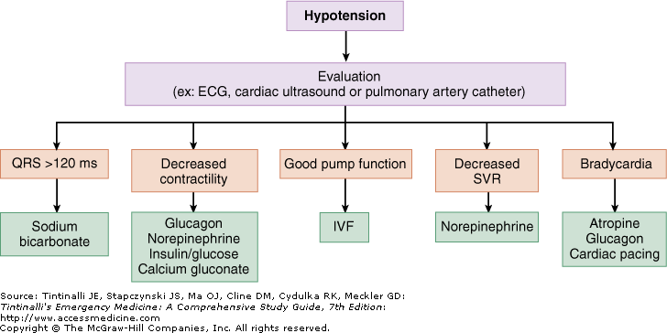
Beta Blocker Overdose

Slide 36
Calcium Channel Blockers
Block “L-type” calcium channels
  Decrease calcium influx during action potential (at the AV node)
    Thereby reducing cardiac contractility
      Diltiazem & Verapamil
Relax blood vessels
  This action may actually result in increased HR
    Nifedipine
Carbohydrate metabolism is induced
  In the non-stressed state, the myocardium uses free fatty acid oxidation
  Meanwhile, in the pancreas CCB inhibits insulin secretion (inducing a hyperglycemic state)

Slide 37
Calcium Channel Blocker Toxic Doses
Diltiazem
  IR >360mg/day oral; ER>540mg/day; >0.6mg/kg loading dose IV; >15mg/hr for 24 hrs IV
Verapamil
  IR&ER >480mg/day oral; >20mg/day IV
Nifedipine
  IR >180mg/day; ER>90mg/day; 40mg/day IV (for tocolysis)

Slide 38
Calcium Channel Blocker Overdose
Decrease in cytosolic calcium
  Decreasing heart rate and contractility
  Vasodilation and conduction delay may occur
    Hypotension and cardiogenic shock ensue

Slide 39
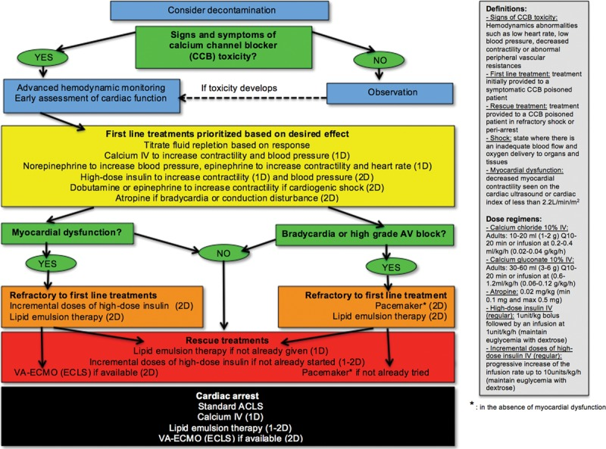
CCB Overdoses
Maude St-Orange et al
Experts Consensus Recommendations for the Management of Calcium Channel Blocker Poisoning in Adults
Crit Care Med. 2017 Mar; 45(3): e306–e315.

Slide 40
Glucagon
Produced by pancreatic a-cells
  Opposes the hypoglycemic action of insulin
  Stimulates hepatic glycogenolysis resulting in increased circulating glucose (occurs at 30 minutes)
  Inotropic activity (occurs at 5 minutes)
    stimulating adenyl cyclase (through a different receptor than catecholamines)

Slide 41
Glucagon
Initial studies (‘68 Glick et al)
Notes:
Comparison of the effects of glucagon and isoproterenol before and after beta-receptor blockade produced by propranolol. Panels A and B illustrate the finding that although the effects of isoproterenol (triangles) on right ventricular contractile force and on left ventricular dP/dt were markedly decreased after treatment with propranolol, the effects of glucagon (circles) on these variables were not altered significantly. However, as shown in panel C, the positive chronotropic effects of these two drugs were strikingly lessened by administration of propranolol. Solid symbols connected by solid lines illustrate the data before beta-receptor blockade; open symbols connected by broken lines depict the data after blockade. Vertical bars = SBM.

Slide 42
Technical Aspects - Glucagon
IVF
50 to 150 mcg/kg bolus (3-10mg for a 70kg person)
  Repeat q3-5 minutes
Continuous infusion
  Initiate if more than two boluses given
  Dose by effective bolus dose each hour (for example, if two 5mg boluses given, rate should be 10mg/hr)
Consider anti-emetic
  Vomiting and possible aspiration

Slide 43
Methylene Blue Therapy
Including Technical Aspects
Inhibits the nitric oxide–cyclic guanosine monophosphate pathway
Scavenges nitric oxide (NO)
Inhibits NO synthesis
MB is 1–2 mg kg^{–1} as a single injection
  Particularly in amlodipine overdoses
Adverse effects include vomiting, dyspnoea and haemolytic anaemia may occur at higher doses
It is an MAOI - do not give if pt on serotonergic agents
Andis Graudins et al
Calcium channel antagonist and beta‐blocker overdose: antidotes and adjunct therapies
Br J Clin Pharmacol. 2016 Mar; 81(3): 453–461.

Slide 44
Insulin
Polypeptide produced in the pancreatic b-islet cells
  Promotes glucose use and storage
  Inhibits glucose release, gluconeogenesis, and lipolysis
  Inotropic activity
  Assists in myocardial uptake of carbohydrates (preferred fuel when the heart is stressed)
  Inhibits free fatty acid metabolism
Notes:
During drug-induced shock, the preferred myocardial energy substrate shifts from free fatty acids to carbohydrates.
Insulin aids in carbohydrate utilization
This is in contrast to glucagon, epinephrine, and calcium, which promote free fatty acid utilization.

Slide 45
High-Dose Insulin Therapy
(HDIT)
Initial Studies (’93, Kline et al)
Dogs poisoned with verapamil
Notes:
HDI was associated with improved LVED, ventricular relaxation, and coronary blood flow
Another canine study identified HDI improved myocardial contractility and improved the ratio of oxygen delivery/work. In these studies myocardial glucose concentrations were increased

Slide 46
HDIT
Initial Studies (’97 Kerns et al)
Dogs poisoned with propranolol
Notes:
HDI was associated with increased CO and contractility and decreased SVR
Though epi increased contractility & BP, it did so for only a short period of time and then resulted in a steady decline of both
These results were also seen in a porcine model in 2007

Slide 47
HDIT Case Reports
68 cases
  Overall survival has been 85%
  One inadvertent case received 1000U bolus with no adverse events (likely since CCB overdoses induce a hyperglycemic state)

Slide 48
Technical Aspects - HDIT
IVF
Baseline glucose (goal ~200mg/dL)
1U/kg bolus
0.5-1.0 U/kg/h continuous infusion
  Increase by 2U/kg/h every 10 min to a max of 10U/kg/h
Dextrose infusion
  10% in ½ NS or 5-10%D5W, goal glucose >100
Monitor
  Glucose q10min & Potassium q60min while titrating insulin
  Glucose q30-60 min & Potassium q6h when infusion rate stable

