Slide 1
Out of or airway management
Karin Halvorson, MD
Emergency Medicine, Internal Medicine, Pulmonology, Critical Care
Tulane University

Slide 2
objective
Management of the airway during emergencies

Slide 3
objectives
Review of Airway Basics
Review of NIMV
Review of Supraglottic Airway Devices
Review of Endotracheal Intubation
  RSI
Review of Cricothyrotomy
So what, so what, so what’s the Scenario!?!

Slide 4
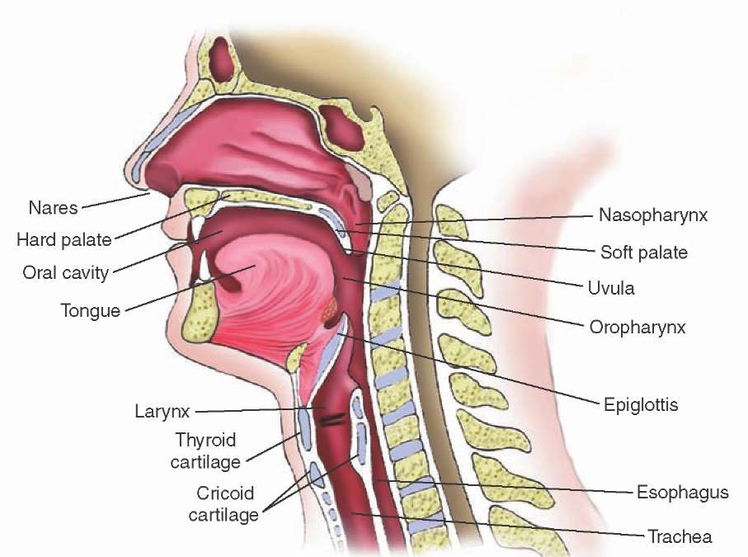
Airway basics anatomy

Slide 5
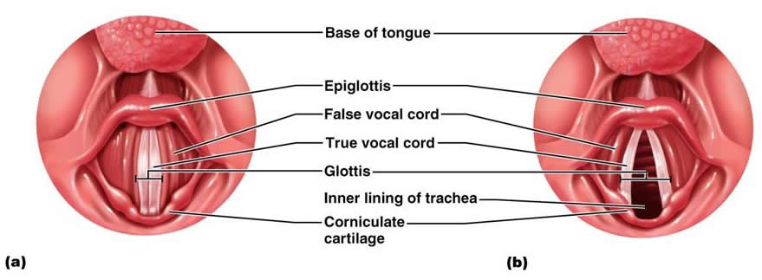
More anatomy

Slide 6
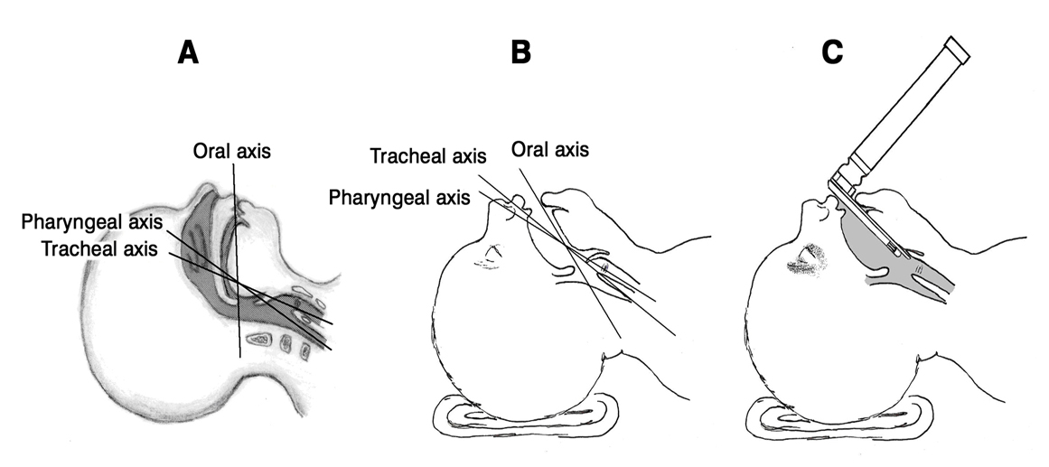
Sniff position

Slide 7
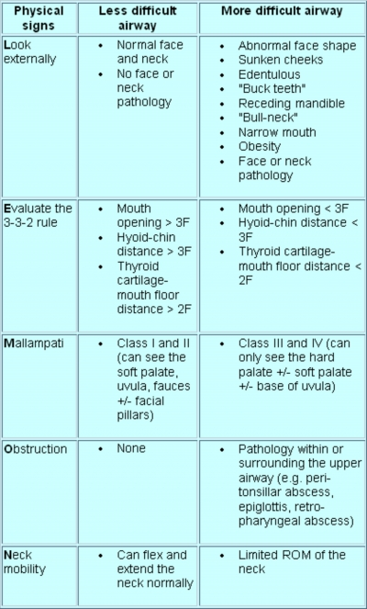
lemon

Slide 8
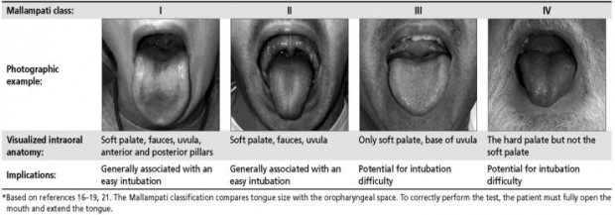
Mallampati score

Slide 9
Airway basics oxygen delivery options
Nasal Cannula
  Flow rate 1-6LPM, 25-45% O2
Simple Face Mask
  Flow rate 6-8L/min, 40-60% O2
Non-rebreather
  Flow rate 10-15 LPM, up to 95% O2
  Venturi Mask
    Flow rate 4-8L/min with a specific O2 concentration
  High Flow Nasal Cannula
    Flow rate up to 60L/min
  BVM
    Flow rate 15 LPM or more, 90%+ O2

Slide 10
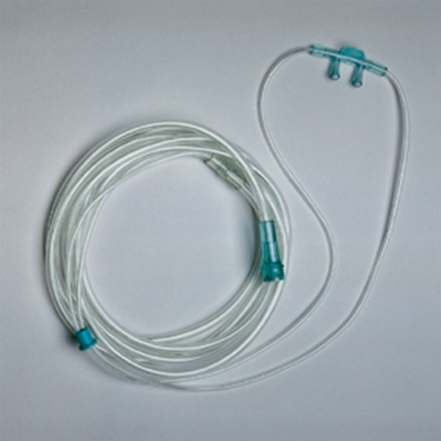
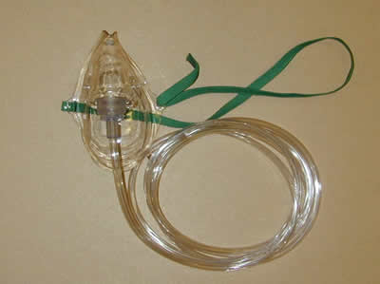
NC and Simple face mask

Slide 11
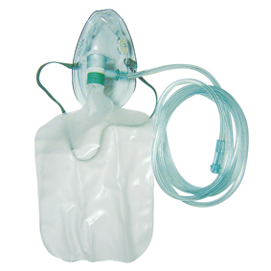
Non rebreather

Slide 12
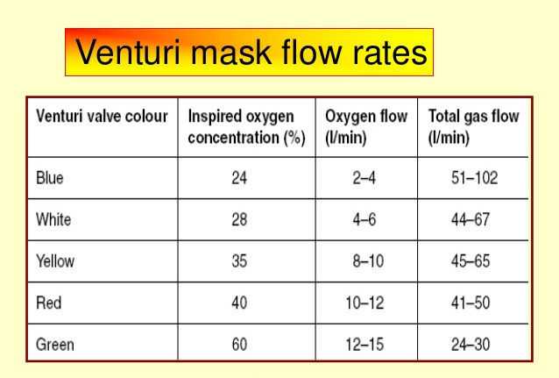
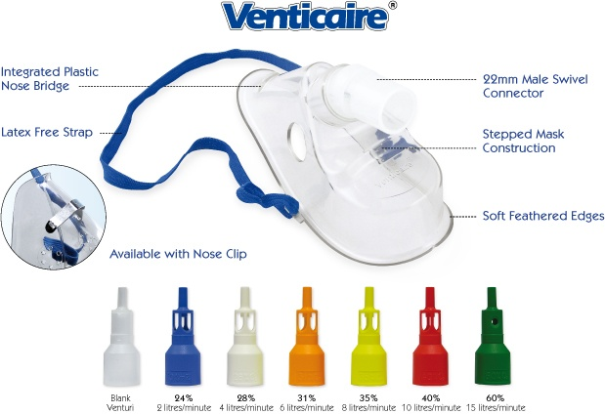
Venturi mask

Slide 13
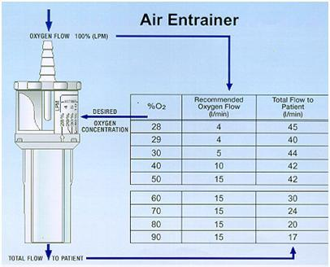
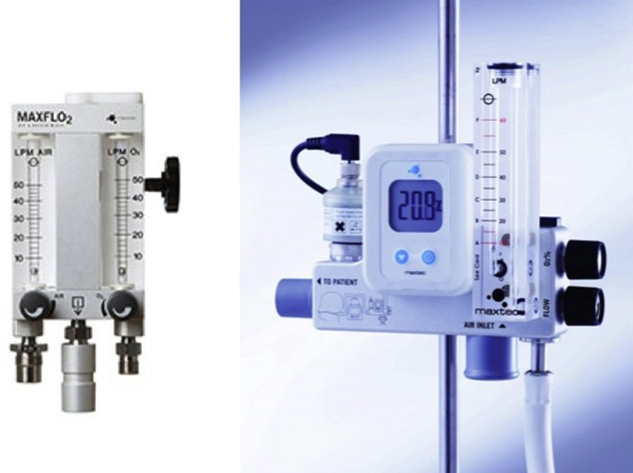
High flow NC

Slide 14
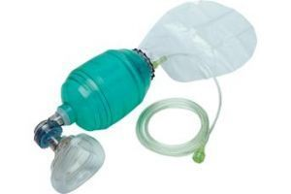
Bag valve mask

Slide 15
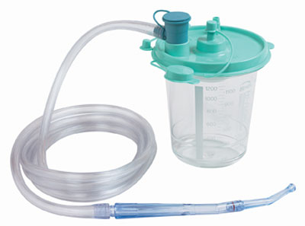
suction

Slide 16
Bvm IS A SKILL
Personal protection equipment
Suction
Position head (head tilt/chin lift or jaw thrust)
Consider oral or nasal airway device
Slide mask over nose and mouth using nose as bridge
EC technique for good mask seal (2 people preferred)
Ventilation (rate and volume)

Slide 17
nimv
NIV is particularly indicated in:
• COPD with a respiratory acidosis pH 7.25–7.35 (H+ 45–56 nmol/l)
• Hypercapnic respiratory failure secondary to chest wall deformity (scoliosis, thoracoplasty) or neuromuscular diseases
• Cardiogenic pulmonary oedema
NIV is not indicated in:
• Impaired consciousness
• Severe hypoxaemia
• Patients with copious respiratory secretions

Slide 18
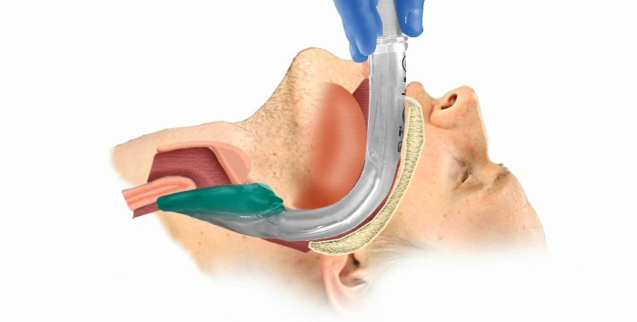
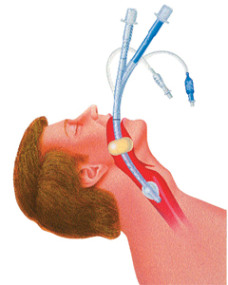
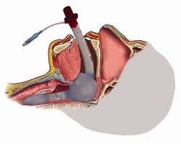
Supraglottic devices

Slide 19
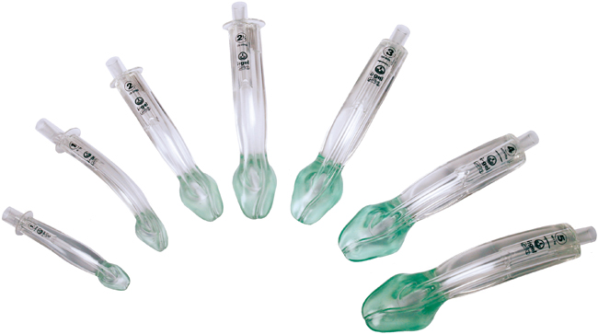
Supraglottic devices

Slide 20
Lma
Personal protection equipment
Pre-oxygenate (BVM)
Assess anatomy and remove dentures
Suction
Prepare equipment (ensure no leak in old LMAs, and lubricate)
Position head (sniffing position)
Consider nasal airway device
Place LMA (inflate if old LMA)
Attach bag and provide ventilation (rate and volume)
Auscultate
Secure tube (consider bite block)

Slide 21
Direct laryngoscopy
Personal protection equipment
Pre-oxygenate (BVM)
  Consider nasal airway device
Assess anatomy and remove dentures
Suction
Prepare equipment
  Select tube, ensure no leak, lubricate
  Select blade, clip in and ensure light bulb works
Position head (sniffing position)
Insert blade
  Provide external laryngeal manipulation as needed
  Visualize vocal cords and insert tube to proper depth
Inflate cuff and remove stylet
Verify placement with CO2 detector or capnography
Attach bag and provide ventilation (rate and volume)
Auscultate
Secure tube (consider bite block)
CXR

Slide 22
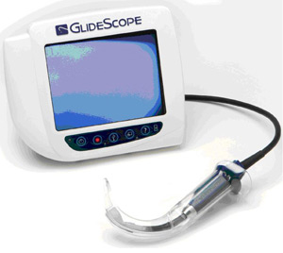
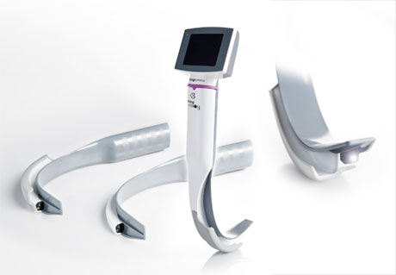
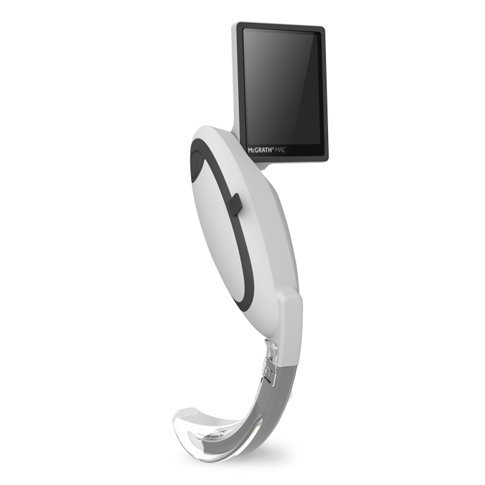
Video laryngoscopy

Slide 23
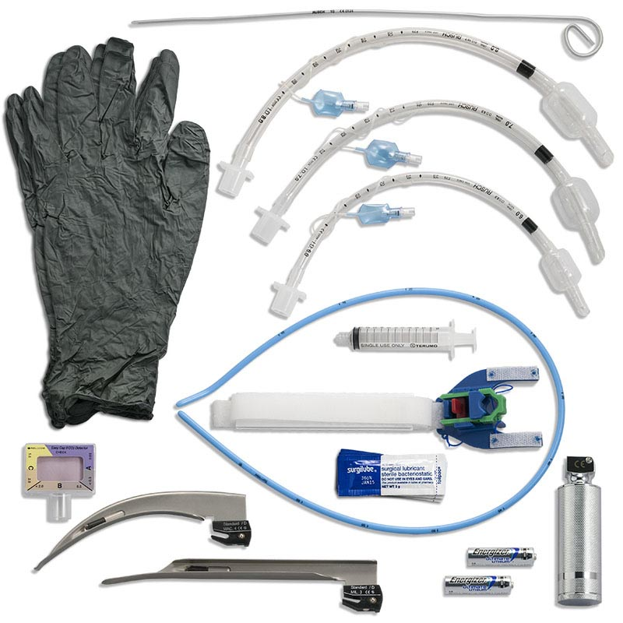
ENDOTRACHEAL INTUBATION
https://www.youtube.com/watch?v=8AOB2PtHfVM -

Slide 24
RSI pretreatment
Lidocaine 1.5 mg/kg IV – reduces intracranial and bronchospastic response to laryngoscopy in patients with elevated intracranial pressure (ICP) or reactive airway disease
Fentanyl 3 μg/kg IV (over 1 minute) – reduces sympathetic response [elevated heart rate (HR) and blood pressure (BP)] to intubation in patients with elevated ICP, intracranial hemorrhage, cardiac ischemia, or aortic dissection

Slide 25
RSI INDUCTION
Etomidate 0.3 mg/kg IV
  ~20-25mg for a 75kg pt
    DOES NOT STACK
Midazolam 0.3 mg/kg IV
  ~20-25mg for a 75kg pt
Ketamine hydrochloride 1.5 mg/kg IV
  ~110mg for a 75kg pt
Propofol 1‐2mg/kg IV
  ~75-150mg for a 75kg pt

Slide 26
RSI PARALYSIS
Succinylcholine 1.5 mg/kg IV
  ~100mg per patient
    Contraindicated in:
      malignant hyperthermia
      skeletal muscle myopathies such as myasthenia gravis
      hyperkalemia
        kidney disease or injury
        burn injury
        trauma
Rocuronium 0.6-1.2 mg/kg IV
  ~50-70mg per 75kg pt

Slide 27
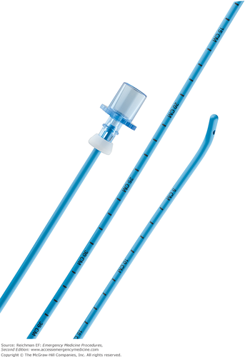
bougie

Slide 28
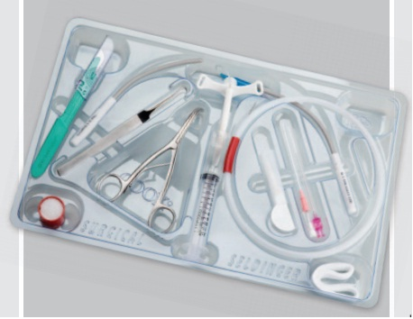
cricothyrotomy
https://youtu.be/_VFJGkJy1G8

